Slide 1
Great Depression
Cause and effect

Slide 2
Causes
What do you think was the main reason for the Depression?
Many will say the Stock Market Crash…
What about bank failures?
Historians can’t agree on what caused it, so we look at the many possibilities

Slide 3
Stock Market Crash
Why was it such a big deal?
Speculation of the 1920’s had people buying cheap with the hope of selling high
Buying on Margin
Did people have the cash to buy all these stocks?
Nope
They paid a stock broker 10% down payment (called a margin)
The rest they financed with a loan from the stock broker
If the price fell, you still paid the original price (Problem, when you don’t have the cash)
The Crash
October 1929 stock prices start falling
October 29, 1929 – BLACK TUESDAY
Stock prices fall to an all time low

Slide 4
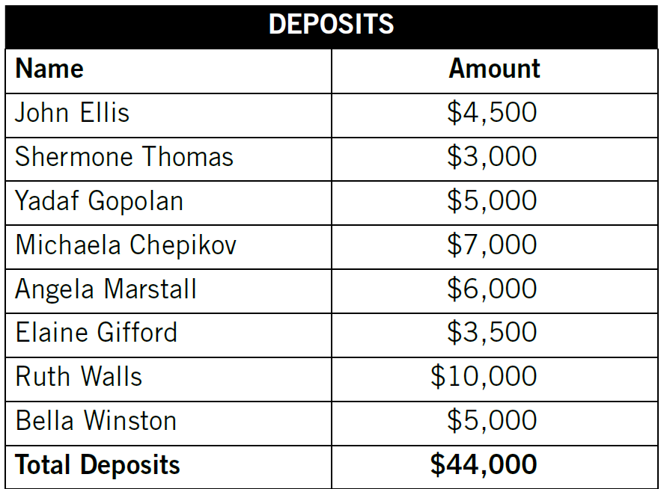
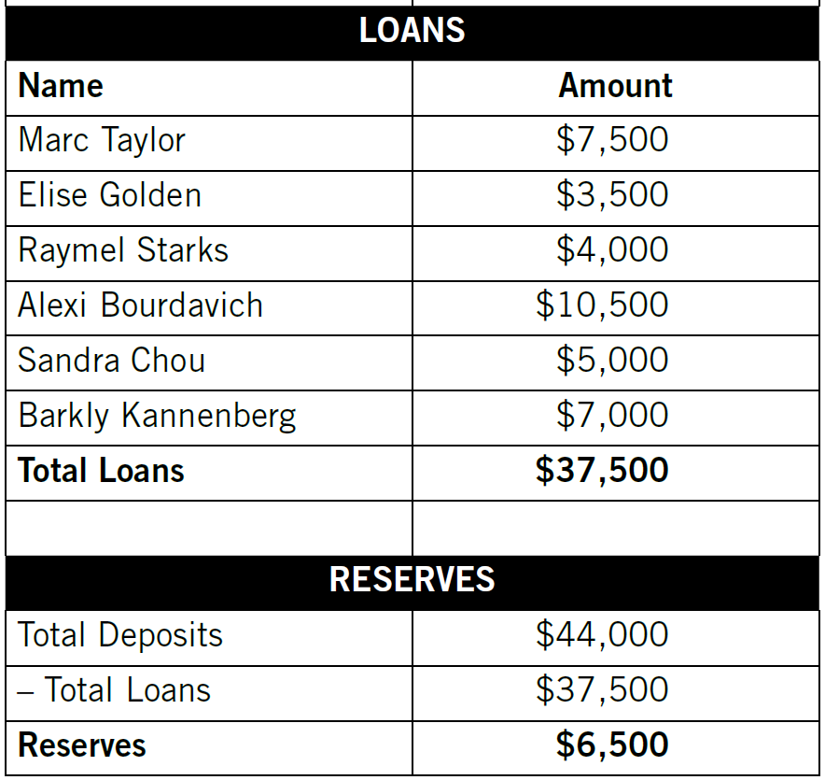
Banks – How did they fail?
Deposits, Loans and Reserves for the Community Bank

Slide 5
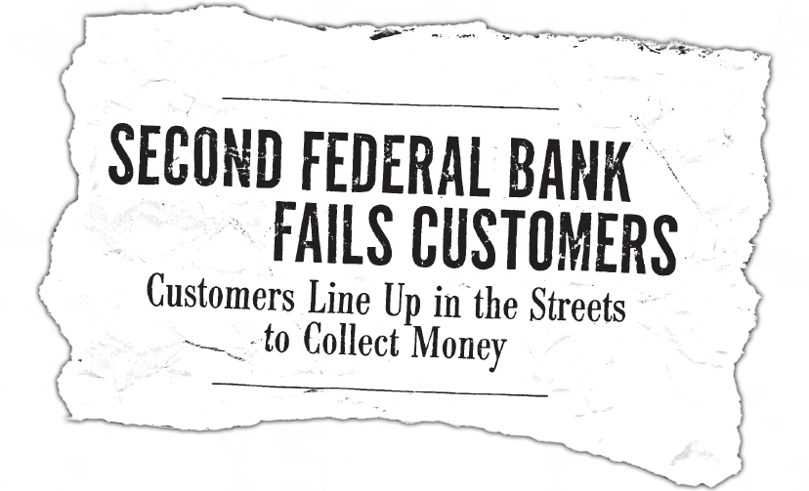
Banks – How did they fail?
What would cause this headline to occur?

Slide 6
Banks – How did they fail?
Banks invest the money deposited to them
The investments allows them to pay “interest” to you
Many banks made bad investments
Many people were seriously in debt
There was not effective government regulation

Slide 7
Banks – How did they fail?
Time for an active demonstration…
You will take an active role of an individual in the 1930’s
You live in a community that has 3 banks
You will receive a Simulation Card and the appropriate amount of money
Once the bankers get set up, you will do what your card says to do

Slide 8
Banks – How did they fail?
How many of you made deposits in your account?
Should have been 6
How many of you made loan payments to your bank?
Should have been 4
How many of you were unable to make loan payments?
Should have been 2
How many of you want to withdraw money from your bank?
Should be 12
Did anyone have problems?
With which bank did you have your account?
How would this have made you feel if the money was real?
Remember this?

Slide 9
Banks – How did they fail?
Second Federal Banker, how much money did you have in reserve at the beginning?
$800
Stand up if you did or wanted to withdraw money from the bank…
Your funds would have totaled $1850
There are two other banks in your community, how safe would you feel putting your money there?
What would you do no if you already have money there?

Slide 10
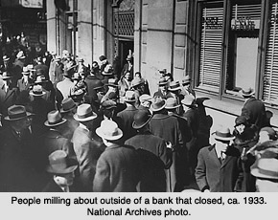
Banks – How did they fail?
Bank Run
Bank failures occur when banks can’t give depositors their money.
http://www.history.com/topics/1929-stock-market-crash/videos/1929-stock-market-crash?m=528e394da93ae&s=undefined&f=1&free=false
Bank Panic
Bank Failures

Slide 11
People and businesses
borrow less
from banks.
The Depression Progression
People buy fewer goods and services.
Businesses sell fewer goods and services because people have less to spend.
Prices decline.
Business
Revenues
decline.
Businesses
are able to
buy fewer supplies and equipment.
Businesses are unable to employ as many workers, they must pay workers less or a combination of both.
Workers who are paid less or lose their jobs may buy fewer goods and services and may be unable to repay bank loans.
More banks fail, so the economy's supply of money and credit shrinks. This causes a decline in business revenues, which leads to more unemployment and/or decreases in wages.

Slide 12
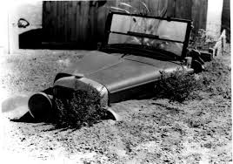
Dust Bowl (The Great Plains)
Decades of poor farming conservation
Major droughts
Heavy winds carried off topsoil
Farmers couldn’t grow crops and abandoned their farms
John Steinbeck wrote articles about “Okies” moving from Oklahoma to work in California
He based the “Grapes of Wrath” on this research
http://www.history.com/topics/1929-stock-market-crash/videos/black-blizzard?m=528e394da93ae&s=undefined&f=1&free=false

Slide 13
Overproduction
Making too much stuff
People are not buying it all
Prices fall
Reduces company profits – leads to lower income/layoffs

Slide 14
High Tariffs
We charge high taxes for other countries goods
They retaliate and tax our manufacturers high taxes
Makes it difficult for our companies to sell goods there too

