Slide 1
Great Depression
Solutions

Slide 2
It’s been a couple of weeks…
At your tables, come up with at least 3 causes of the Great Depression
Let’s look at the human toll…

Slide 3
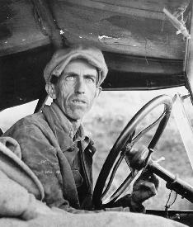
Hi, I’m Harry

Slide 4
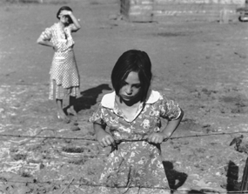
Wife…Betty and Daughter Kit

Slide 5
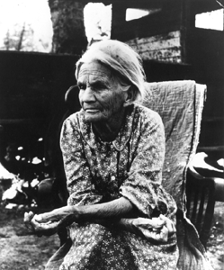
Grandma Margaret

Slide 6
Grandpa - Dead

Slide 7
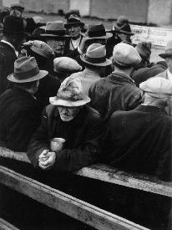
I’m a Little Depressed…
13 Million unemployed
(25 % of population)

Slide 8
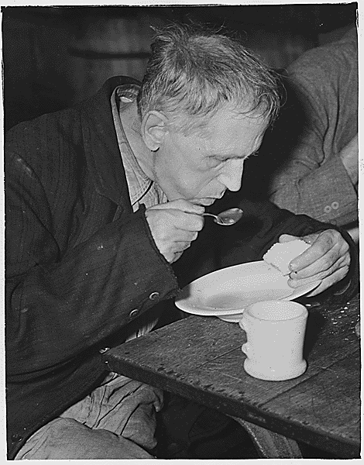
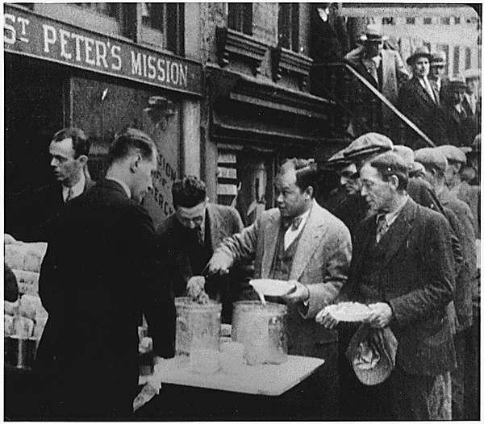
Soup and Bread Lines

Slide 9
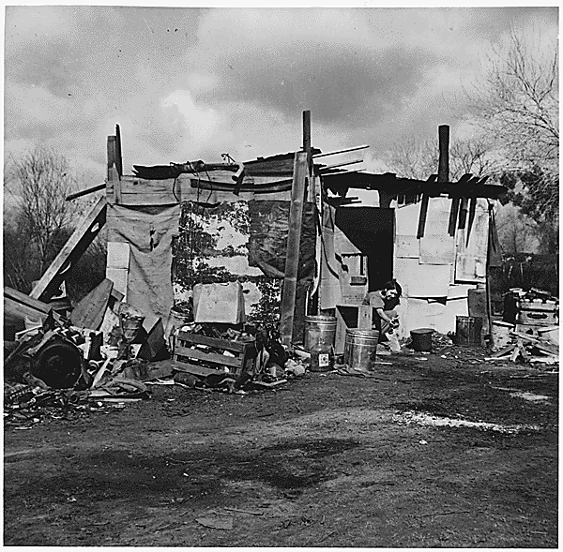
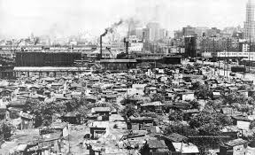
Hoovervilles
Shanty (shack) towns of unemployed

Slide 10
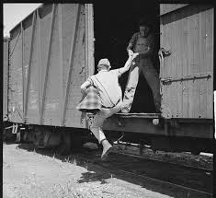
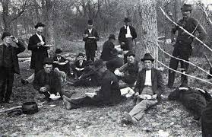
Crime Increased
Looting, Riding the Rails, vagrancy, loitering, etc

Slide 11
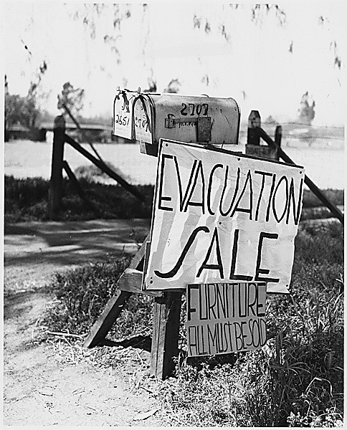
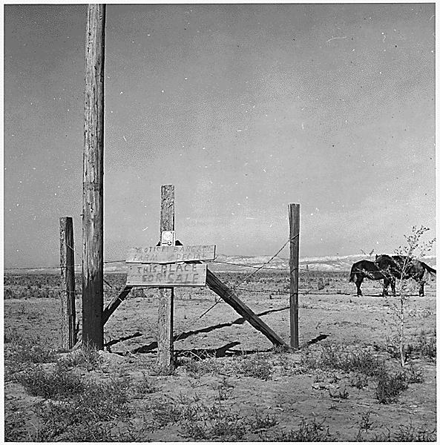
Farm Prices Fall (Burn Crops, Waste Milk, Farms Fail)

Slide 12
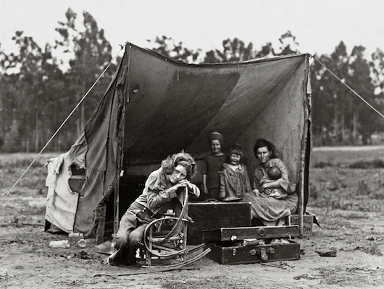
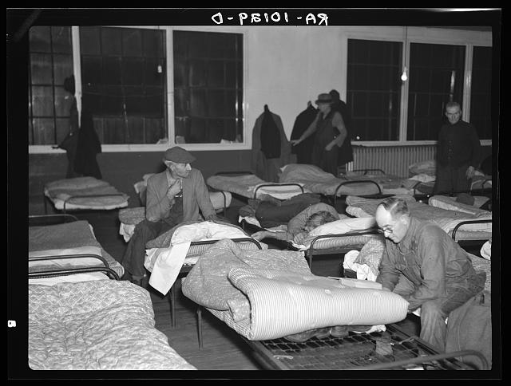
Less Marriages and More Divorces

Slide 13
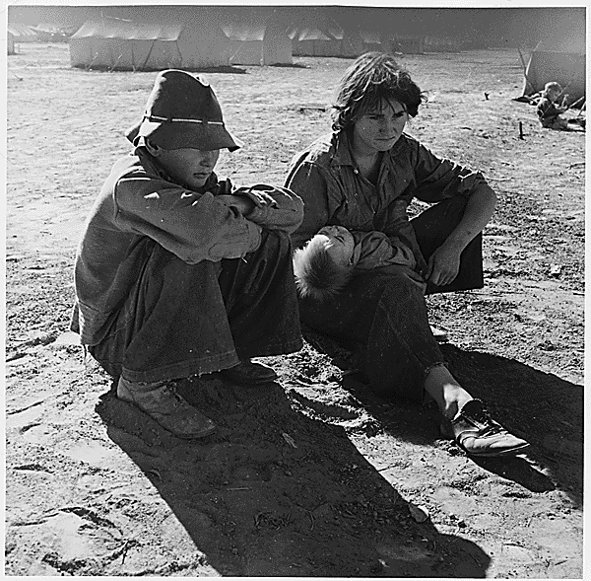
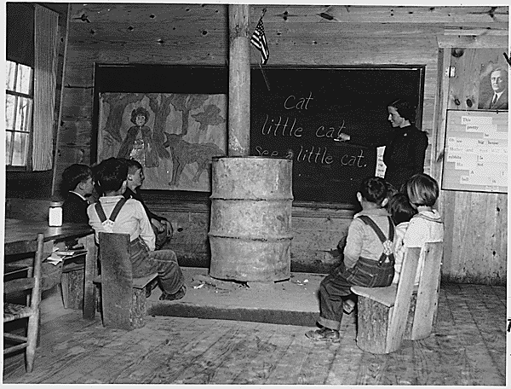
Less Education

Slide 14
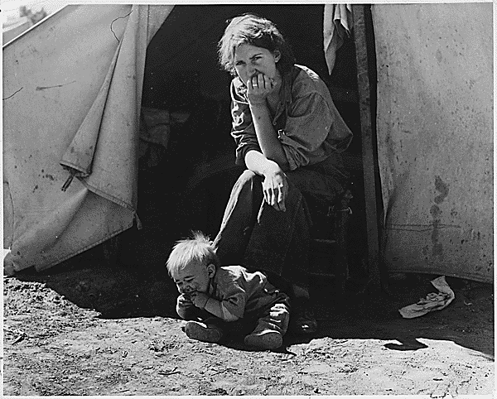
Female and Minority Tensions
(Fired for Male Employment)

Slide 15
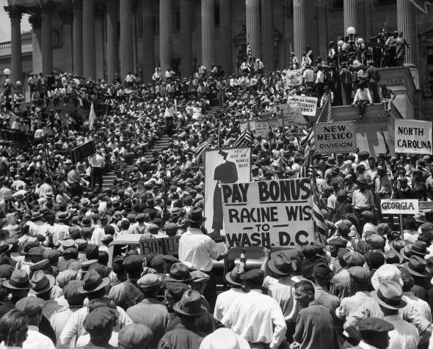
Bonus Army
WW I Veterans want Pension $ promised by gov’t in 1945
(Want $ NOW!)
What did Hoover do?

Slide 16
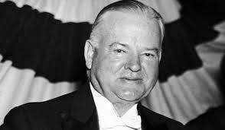
Hoover… At the start
With unemployment rising – Hoover did nothing
Didn’t think gov’t should make direct payments to unemployed
Thought it would reduce desire to work
Expected private organizations to step in and help
Economists said people would buy when prices got low enough
They were wrong

Slide 17
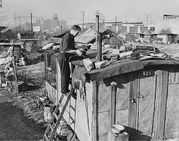
Hoover…Too little, too late
Cut taxes
Increased federal spending
Created “Reconstruction Finance Corporation”
Give emergency loans to banks and businesses
Thought it would “trickle down” to families
People lost homes – Hoovervilles started – people frustrated
Not re-elected

Slide 18
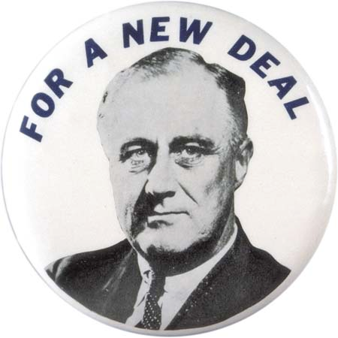
Franklin Delano Roosevelt (FDR)
Elected with promise of a “NEW DEAL”
New Deal
Ends view that gov’t & economy should be separate
Permanently increased size and power of gov’t

Slide 19
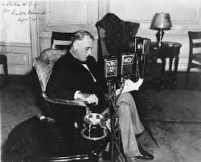
Franklin Delano Roosevelt (FDR)
New Leadership
“Brain Trust” – brought people from universities to be as creative as possible
“Fireside Chats” – FDR addresses people by radio
Personally
Had polio & could only walk short distances
Wife Eleanor Roosevelt was his eyes & ears by travelling the country

Slide 20
FDR Quote
The next slide contains a quote from Roosevelt in 1932
As we read it, note:
What are the problems?
What are the responsibilities of the gov’t?
Got it? Here we go…

Slide 21
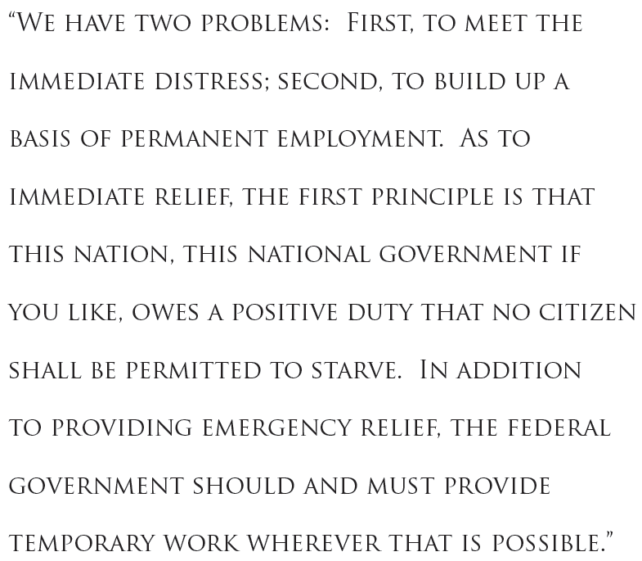
What are the problems?
What are the responsibilities of the gov’t?

Slide 22
New Deal Basics
Known as “Alphabet Soup” – created lots of programs
Almost all bills he submitted in first 100 Days were enacted by Congress
Why did he start with banking?
FDR Explained them as the three R’s
Relief – Programs to help immediately
Recovery – Programs to rebuild
Reform – Programs to prevent the disaster from reoccurring

Slide 23
Federal Emergency Relief Administration (FERA)
RELIEF
Federal Deposit Insurance Corporation (FDIC)
National Youth Administration (NYA)
Federal Art Project (FAP)
Civilian Conservation Corps (CCC)
RECOVERY
Revenue Act of 1935 (Wealth Tax Act)
Tennessee Valley Authority (TVA)
Federal Theatre Project
Public Works Administration (PWA)
Civil Works Administration (CWA)
Social Security Act of 1935
Federal Writers Project (FWP)
Federal Housing Administration (FHA)
National Labor Relations Act (Wagner Act)
REFORM
National Recovery Act (NRA)
Securities and Exchange Commission (SEC)
Rural Electrification Administration (REA)
Emergency Banking Act
COMBINATION
Agriculture Adjustment Administration (AAA)
Fair Labor Standards Act
Works Project Administration (WPA)

