Slide 1
Nonrenewable Resources

Slide 2
We Use a Variety of Nonrenewable Mineral Resources
Mineral resource
Fossil fuels (coal)
Metallic minerals (aluminum, iron, copper)
Nonmetallic minerals (sand, gravel, limestone)
Ore
High-grade ore
Low-grade ore
Importance and examples of nonrenewable metal and nonmetal mineral resources

Slide 3
Mineral Use Has Advantages and Disadvantages
Advantages of the processes of mining and converting minerals into useful products
Generates significant income and tax revenue
Provides employment
Disadvantages
Use a lot of energy
Disturbs the land and causes erosion

Slide 4
There Are Several Ways to Remove Mineral Deposits (1)
Surface mining
Shallow deposits removed
Subsurface mining
Deep deposits removed
Type of surface mining used depends on
Resource being sought
Local topography

Slide 5
There Are Several Ways to Remove Mineral Deposits (2)
Types of surface mining
Open-pit mining
Strip mining
Contour mining
Mountaintop removal

Slide 6
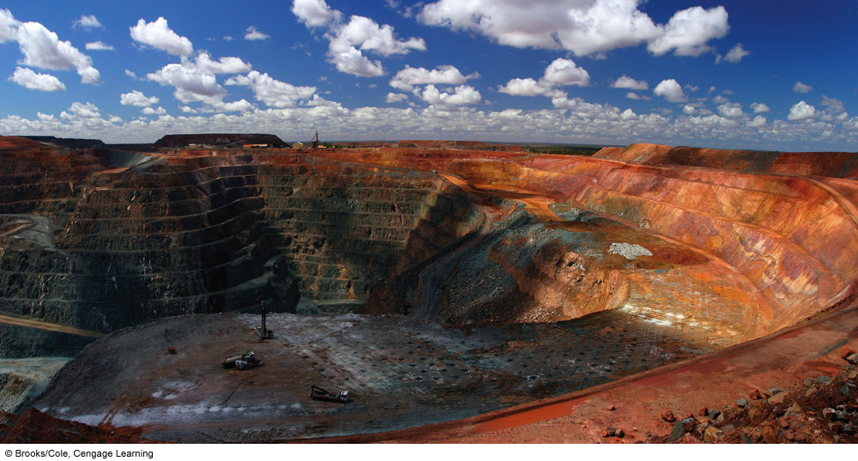
Natural Capital Degradation: Open-Pit Mine in Western Australia

Slide 7
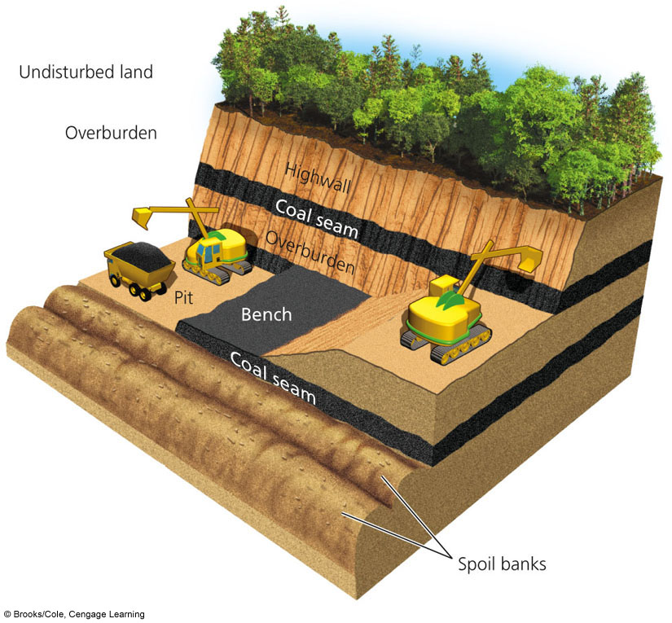
Natural Capital Degradation: Contour Strip Mining Used in Hilly or Mountainous Region

Slide 8
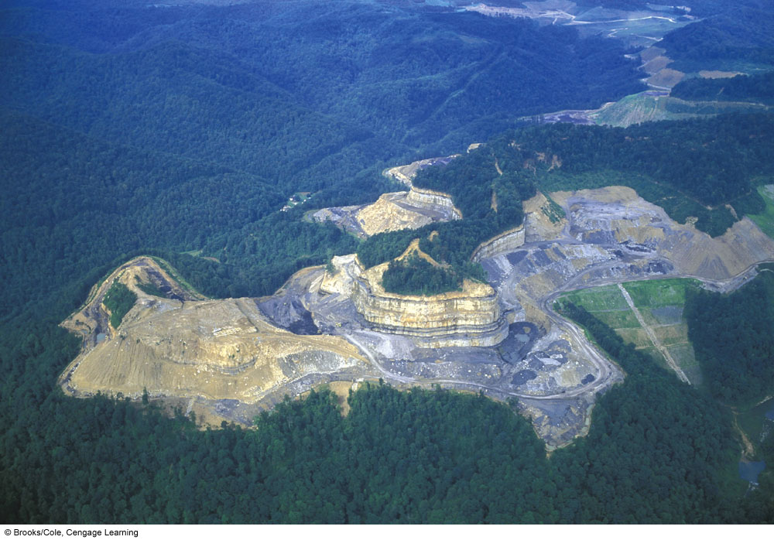
Natural Capital Degradation: Mountaintop Coal Mining in West Virginia, U.S.

Slide 9
Mining Has Harmful Environmental Effects (1)
Scarring and disruption of the land surface
E.g., spoils banks
Loss of rivers and streams
Subsidence
Collapse of land above some underground mines

Slide 10
Mining Has Harmful Environmental Effects (2)
Major pollution of water and air
Effect on aquatic life
Large amounts of solid waste
Notes:
10

Slide 11
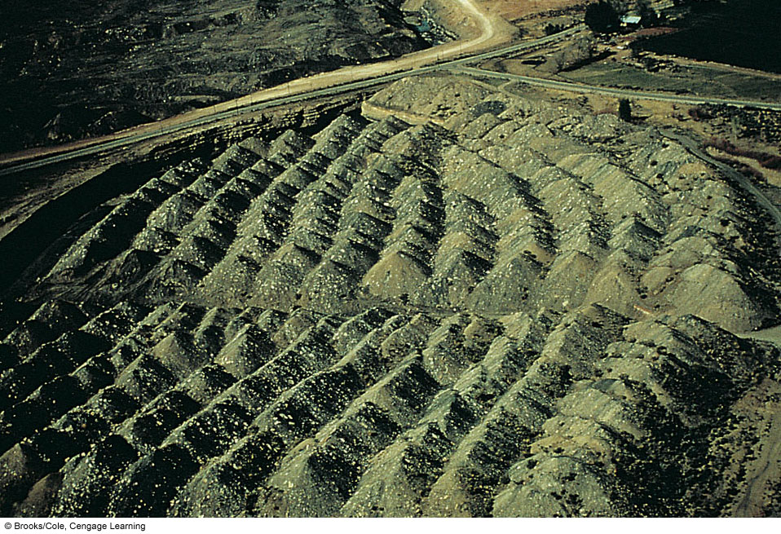
Banks of Waste or Spoils Created by Coal Area Strip Mining in Colorado, U.S.

Slide 12
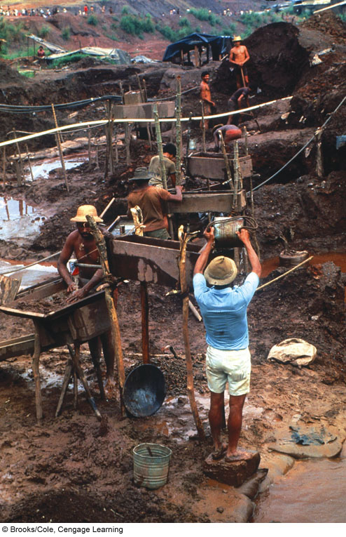
Illegal Gold Mine

Slide 13
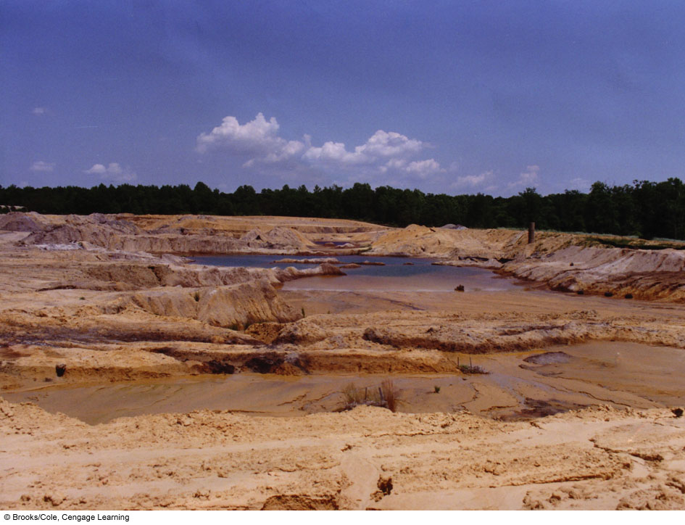
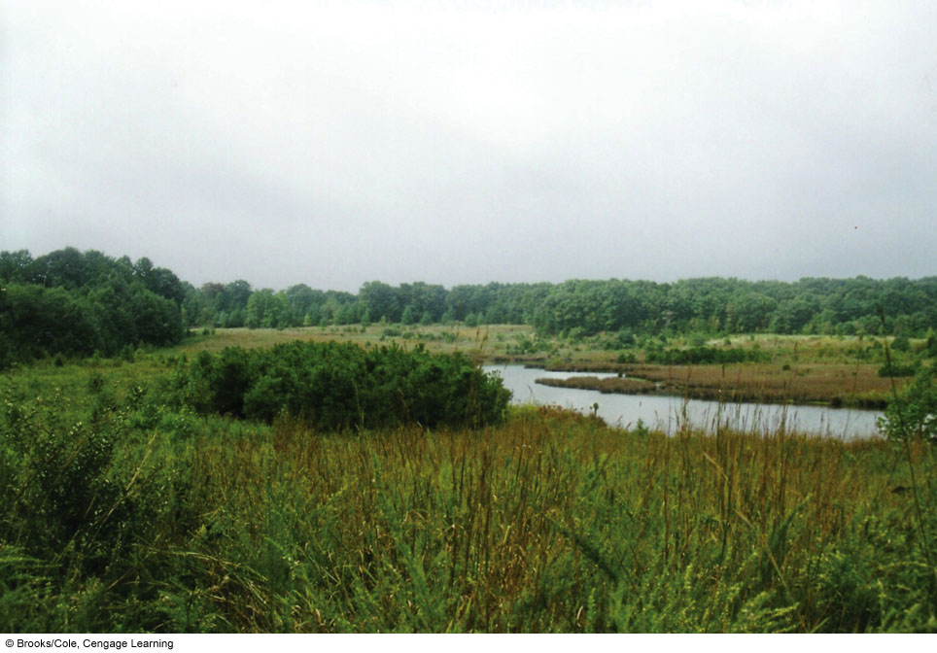
Ecological Restoration of a Mining Site in New Jersey, U.S.

Slide 14
Removing Metals from Ores Has Harmful Environmental Effects (1)
Ore extracted by mining
Ore mineral (containing the desired metal and gangue)
Gangue (waste material)
Smelting (process of heating ores to release metals)
Water pollution

Slide 15
Removing Metals from Ores Has Harmful Environmental Effects (2)
Liquid and solid hazardous wastes produced
Use of cyanide salt of extract gold from its ore
Summitville gold mine: Colorado, U.S.

Slide 16
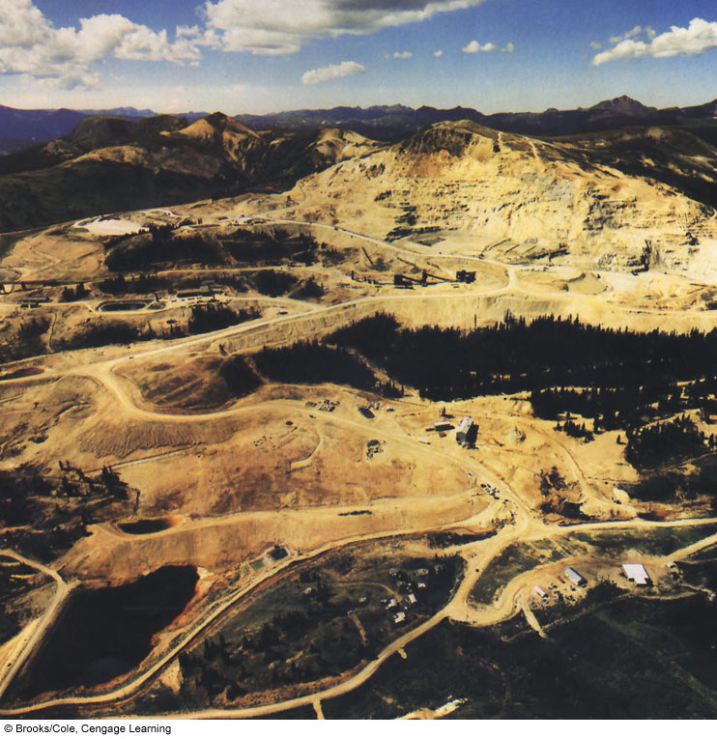
Natural Capital Degradation: Summitville Gold Mining Site in Colorado, U.S.

Slide 17
Mineral Resources Are Distributed Unevenly (1)
Most of the nonrenewable mineral resources supplied by
United States
Canada
Russia
South Africa
Australia

Slide 18
Mineral Resources Are Distributed Unevenly (2)
Strategic metal resources (essential for the country’s economy and military strength)
Manganese (Mn)
Cobalt (Co)
Chromium (Cr)
Platinum (Pt)

Slide 19
Supplies of Nonrenewable Mineral Resources Can Be Economically Depleted
Future supply depends on
Actual or potential supply of the mineral
Rate at which it is used
When it becomes economically depleted
Recycle or reuse existing supplies
Waste less
Use less
Find a substitute
Do without

Slide 20
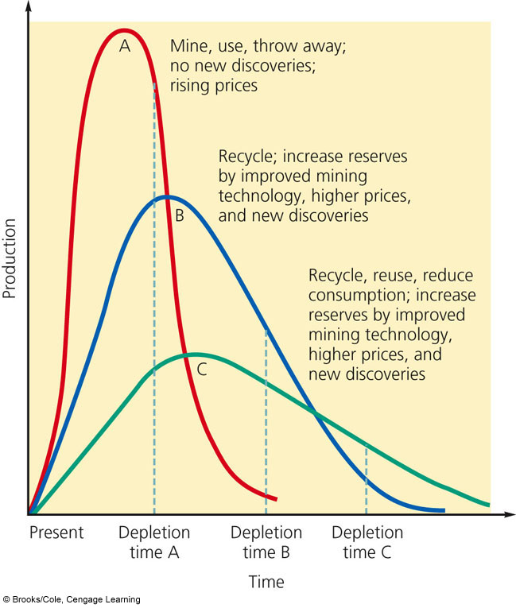
Natural Capital Depletion: Depletion Curves for a Nonrenewable Resource

Slide 21
Market Prices Affect Supplies of Nonrenewable Minerals
Subsidies and tax breaks to mining companies keep mineral prices artificially low
Does this promote economic growth and national security?
Scarce investment capital hinders the development of new supplies of mineral resources

Slide 22
Is Mining Lower-Grade Ores the Answer?
Factors that limit the mining of lower-grade ores
Increased cost of mining and processing larger volumes of ore
Availability of freshwater
Environmental impact
Improve mining technology
Use microorganisms, in situ
Slow process
What about genetic engineering of the microbes?

Slide 23
Can We Extend Supplies by Getting More Minerals from the Ocean? (1)
Mineral resources dissolved in the ocean-low concentrations
Deposits of minerals in sediments along the shallow continental shelf and near shorelines

Slide 24
Can We Extend Supplies by Getting More Minerals from the Ocean? (2)
Hydrothermal ore deposits
Metals from the ocean floor: manganese nodules
Effect of mining on aquatic life
Environmental impact

Slide 25
We Can Find Substitutes for Some Scarce Mineral Resources (1)
Materials revolution
Nanotechnology
Silicon
High-strength plastics
Drawbacks?

Slide 26
We Can Find Substitutes for Some Scarce Mineral Resources (2)
Substitution is not a cure-all
Pt: industrial catalyst
Cr: essential ingredient of stainless steel

Slide 27
We Can Recycle and Reuse Valuable Metals
Recycling
Lower environmental impact than mining and processing metals from ores
Reuse

