Slide 1
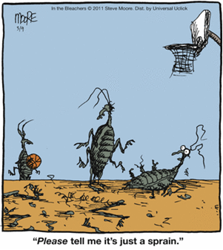
Recognizing Different Sports Injuries and The Healing Process

Slide 2
Key Terminology

Slide 3
Key Terminology
Swelling- Enlargement of organs, skin, or other body parts; Caused by the build up of fluid in the tissues
Ecchymosis – black/blue discoloration due to hemorrhaging
Edema – the collection of fluid in connective tissue
Inflammation- A basic way in which the body reacts to infection, irritation or other injury

Slide 4
Key Terminology
Modality - A therapeutic method or agent
Analgesic – agent that relieves pain w/out causing a complete loss of sensation
Vasoconstriction – decrease in the diameter of the blood vessel
Vasodilation – Increase in the diameter of the blood vessel
Erythema – redness of the skin

Slide 5
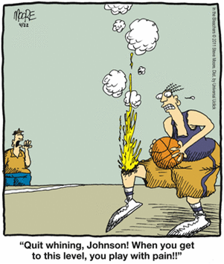
Pain and Acute Injury
Everyone copes with pain differently.
Pain is as much psychological as physiological.
Pain results from sensory input received through the nervous system and indicates location of tissue damage.
Pain is not a useful indicator of injury severity.

Slide 6
Modalities
Cryotherapy
Appropriate immediately following an injury (20min)
Direct application of cold causes vasoconstriction in the affected tissues
Constriction of the surrounding blood vessels
Why??
Analgesic – decreases pain
reduces muscle spasm (involuntary contraction of muscle)
Decreases blood flow, decreases temperature = a decrease in secondary swelling
Ice bags or packs, aerosol coolants, ice cups, ice water immersion/whirlpool

Slide 7
Modalities
Thermotherapy
Appropriate 48-72 hours post injury
Considered an analgesic
Why should you not use heat for an acute injury?
Increases blood flow, Increases temperature = an Increase in swelling = longer recovery time
Your goal is to decrease swelling when dealing with an acute injury
Hydrocollator packs, paraffin wax, warm whirlpool and ultrasound

Slide 8
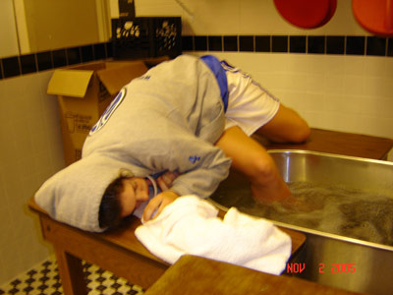
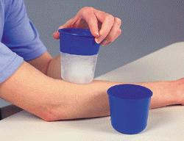
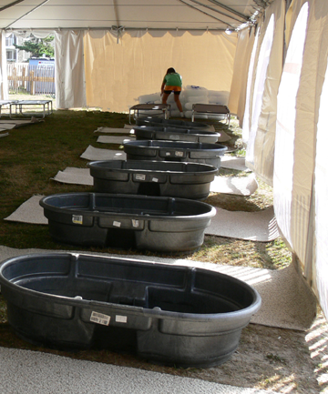
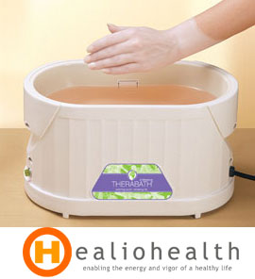
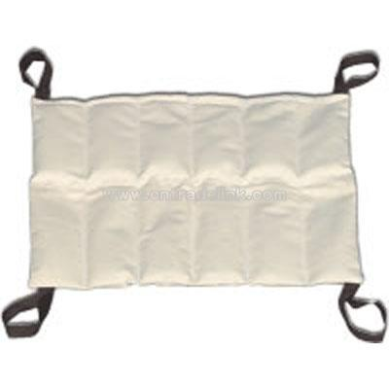
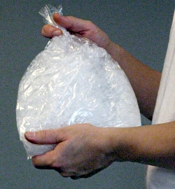
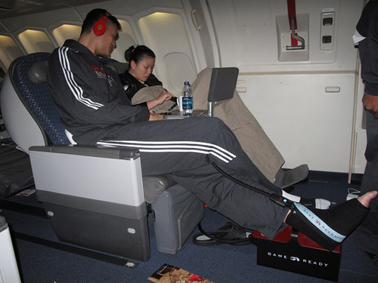
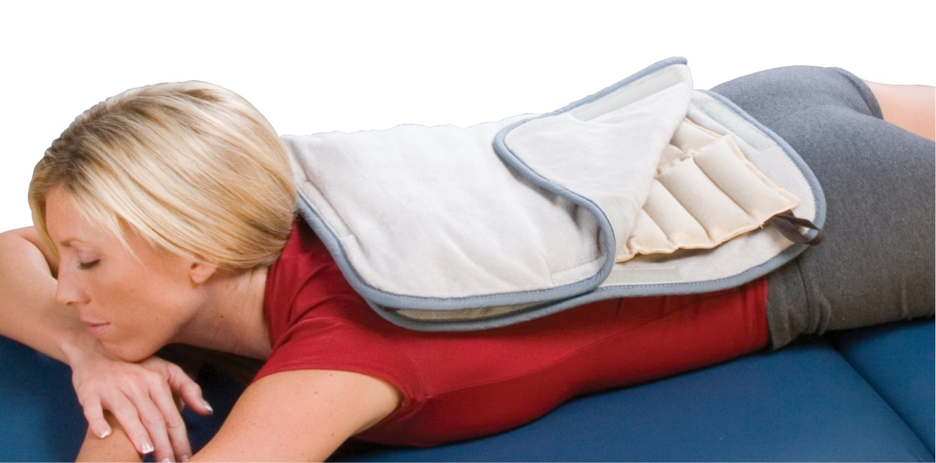

Slide 9
NSAIDs
Non-Steroidal Anti-Inflammatory Drug
NSAIDs are very popular drugs.
They work to decrease inflammation
Common NSAIDs include Aspirin, Ibuprofen, Motrin, Aleve, and Advil
Rx (prescription) or OTC (over the counter)

Slide 10
Acute or chronic in nature
Acute
Result of sudden trauma; Isolated event
Examples???
Chronic
Caused by repetitive, overuse activities
Examples???

Slide 11
Acute Traumatic Injuries
Fractures
Result of extreme stress and strain on bone – breaks bone
Bone Anatomy
Diaphysis -shaft
hollow and cylindrical
Epiphysis - composed of cancellous bone and has hyaline cartilage covering
Periosteum - dense, white fibrous covering
contains blood vessels and osteoblasts

Slide 12
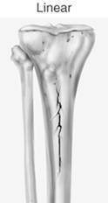
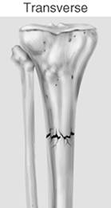
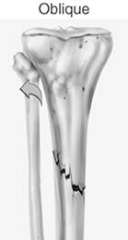
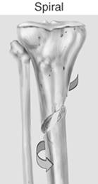
Acute Fractures
Partial or complete
Either closed or open (through skin)
Presents with deformity, point tenderness, swelling and pain with movement

Slide 13
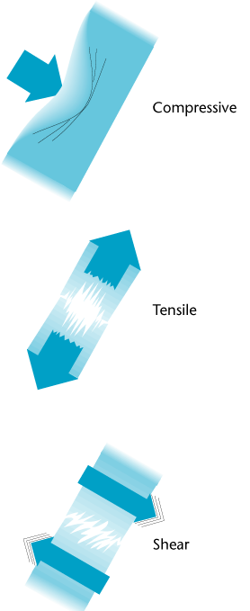
Load Characteristics
Bones can be stressed or loaded through:
Tension
Compression
Bending
twisting
shearing
Greater force = more severe fracture
Some bones will require more force than others

Slide 14
Mechanical Forces of Injury
Tendons resist tensile forces.
Bones resist compressive forces.
Ligaments resist tensile forces.
Each type of tissue has a limit for how much force it can withstand.

Slide 15
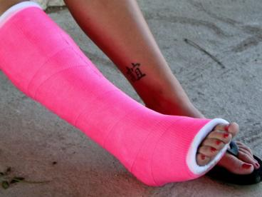
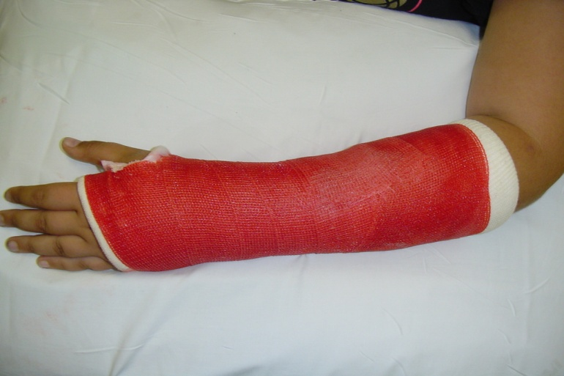
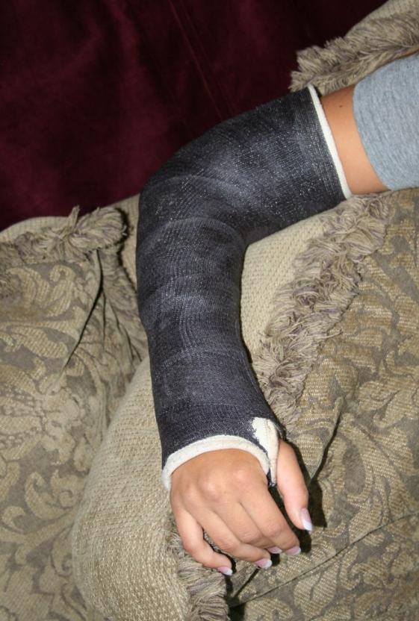
Healing of a Fracture
Generally requires immobilization (boot or cast)
usually 6-8 wks
Following cast removal, normal stresses and strains will aid in healing = Rehabilitation

Slide 16
Stress Fractures (fx)
Possible causes
Overload due to muscle contraction,
Altered stress distribution due to muscle fatigue
Changes in surface
Too much activity too soon or in general
Begins with a dull ache becoming worse over time
Initially pain during activity and then progresses to pain following activity
Early detection is difficult, bone scan is useful
X-ray is effective after several weeks
If suspected, Stop activity and refer to Orthopedic

Slide 17
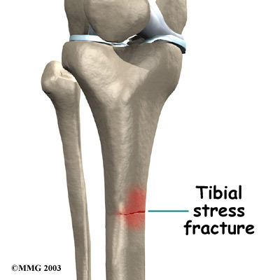
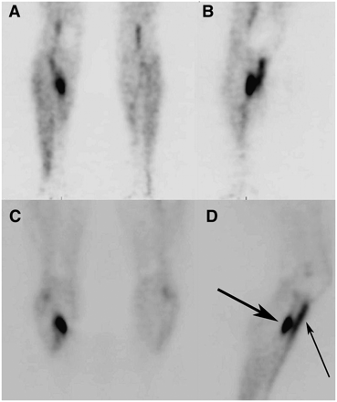
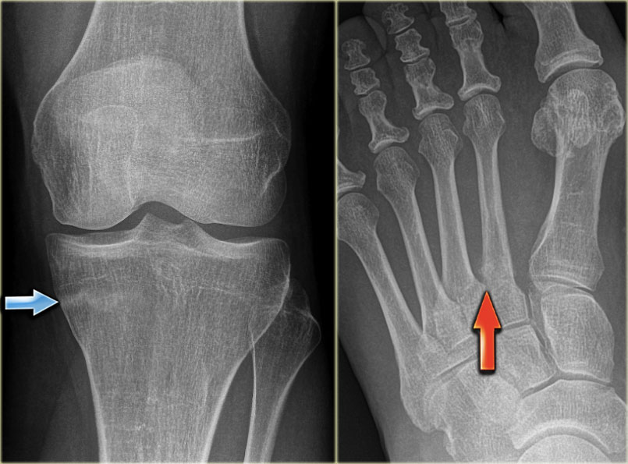

Slide 18
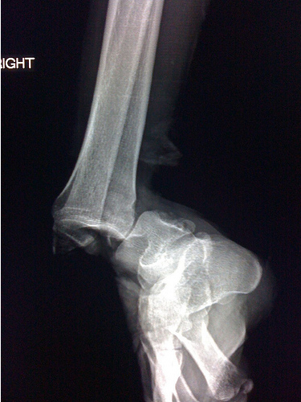
Dislocation’s and Subluxation’s
Dislocations
At least one bone in a joint is forced completely out of the respected joint
Most common at the fingers, ankle, and shoulders
Subluxations
Partial dislocation of the joint. Usually reducing itself because the bone did not come completely out of the joint.
Often occurs at the shoulder and patella
Signs and symptoms
Deformity
Swelling
Subluxation – pain and the sensation that it ‘came out’ of place

Slide 19
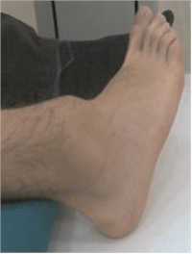
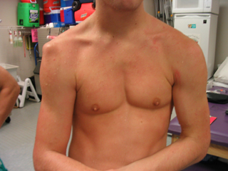
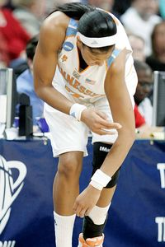
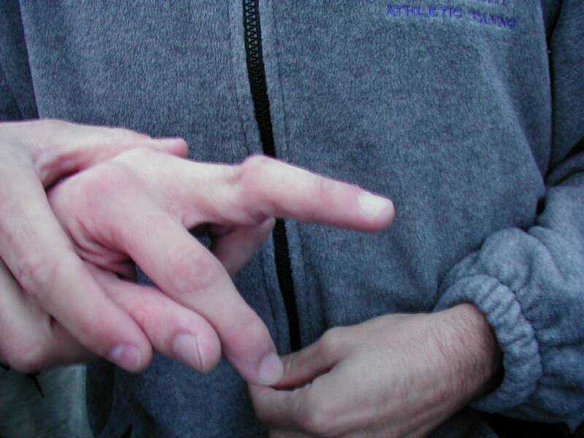
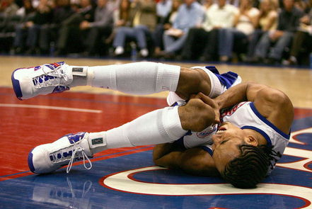
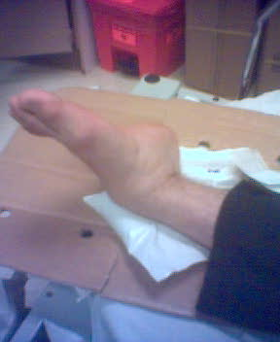

Slide 20
Signs and symptoms continued…
Other factors associated with dislocations –
1) loss of limb function
2) swelling and point tenderness
Additional concerns
Avulsion fractures, ligament/muscular damage
“Once a dislocation, always a dislocation”
Treatment (tx)
Reduction- generally done by a Physician
Dislocations (particularly first time) should always be considered and treated as a fracture until ruled out
X-ray is a MUST
Return to play often determined by extent of soft tissue damage

Slide 21
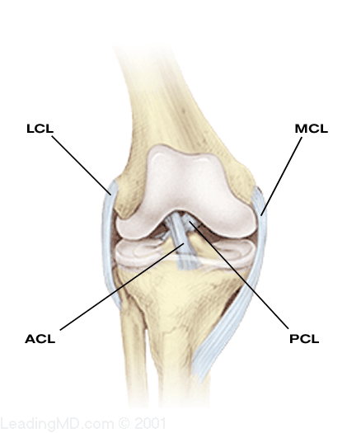
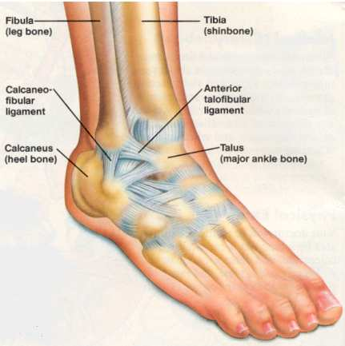
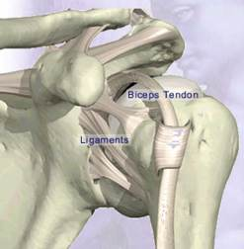
Ligament Sprains
Damage to a ligament (provides support to a joint)
Connects a bone to another bone
Extreme twist or rotation of the joint results in the stretching or tearing of the ligament

Slide 22
Grading System
Grade/degree 1 – Stretching of the Ligament
some pain, minimal loss of function, no abnormal motion, and mild point tenderness, slight swelling and joint stiffness
Grade/degree II – Stretching and some tearing of ligament
pain, moderate loss of function, swelling, and instability, some tearing of ligament fibers
Grade/degree III – Tearing/rupture of the ligament
Severe pain, significant loss of function, severe instability and swelling, and may also represent subluxation

Slide 23
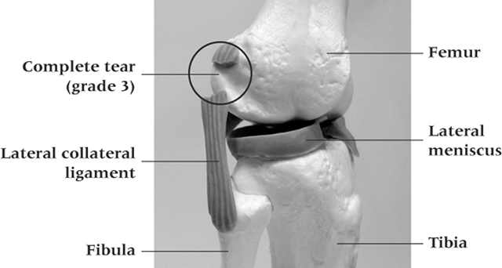
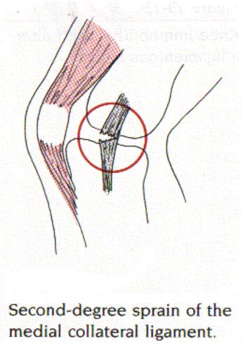

Slide 24
Ligament Sprains
Restoration of joint stability is difficult with grade I and II injuries
Must rely on other structures around the joint
Rely heavily on muscles surrounding joint
Ligament has been stretched/partially torn causing development of inelastic scar
Ligament will not regain original tension
Rehab = strengthening = improved joint stability

Slide 25
Contusions (Bruise)
Result of sudden blow to body, blunt force trauma
Deep or superficial
Hematoma = blood and lymph flow of tissue
bleeding results in discoloration of skin
Must be cautious of repeated blows to same area
Myositis Ossificans
Calcium deposits form within the soft tissue
Protect the area with padding
Quadriceps and biceps are common sites

Slide 26
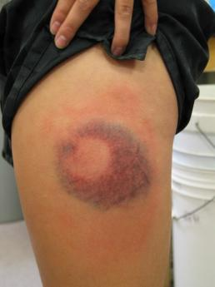
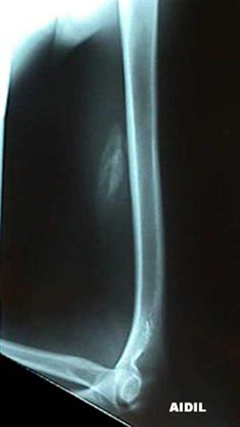
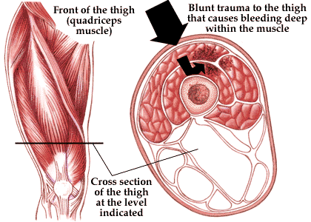
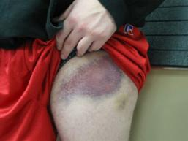

Slide 27
Muscle Strains
MOI
Stretch, tear or rupture of muscle or connective tissue
Signs and Symptoms
Hear/feel a pop - Tightness
Deformity - feels like they have been
Pain ‘shot’
Decreased ROM/flexibility
Rehabilitation
Lengthy process regardless of severity
6-8 weeks
Return to activity too soon= re-injury

Slide 28
Grades/severity
Grade/Deg I - some fibers have been stretched or actually torn resulting in tenderness and pain on active ROM; movement painful but full ROM present
Grade/Deg II – more fibers have been torn and contraction is painful; usually a depression or divot is palpable; some swelling and discoloration are present
Grade/Deg III- Complete rupture of muscle or musculotendinous junction; usual loss of function; initial great deal of pain that diminishes due to nerve damage

Slide 29
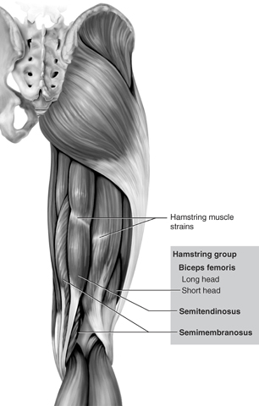
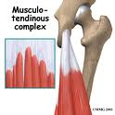
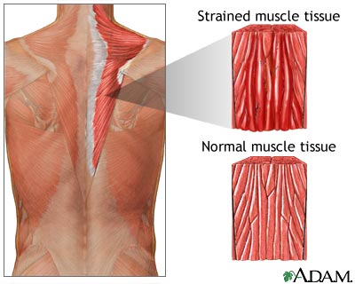

Slide 30
Muscle Cramps
Painful involuntary contraction
Attributed to dehydration/electrolyte imbalance and fatigue
Muscle Soreness
Overexertion in strenuous exercise resulting in pain
Two types of soreness
Acute-onset muscle soreness - accompanies fatigue, and is transient muscle pain experienced immediately after exercise
Delayed-onset muscle soreness (DOMS) - pain that occurs 24-48 hours following activity that gradually subsides (pain free 3-4 days later)
Caused by slight microtrauma to muscle

Slide 31
Nerve Injuries
MOI
Two main causes
compression and tension
Acute or Chronic
Causes pain and result in sensory responses
pinch, burn, tingle, muscle weakness, radiating pain
Minor → Severe → Life Altering
Healing process is very slow and long term
Tx –
Referral, rest, Anti-inflammatories
No sport related activity until asymptomatic

Slide 32
Chronic Overuse Injuries
Constant Inflammation
Essential part of healing process
Must occur following tissue damage to initiate healing
Signs and Symptoms
Pain,
Redness
Swelling
Loss of function
Increase in Temperature
If source of irritation is not removed then inflammatory process becomes chronic

Slide 33
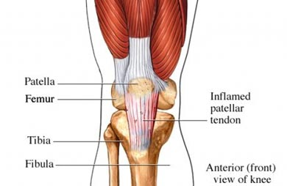
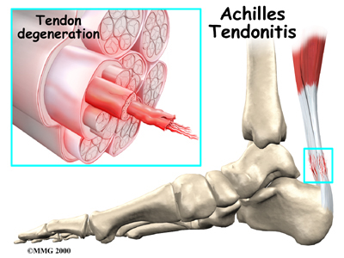
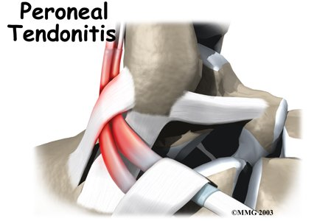
Tendinitis
Most common overuse injury
S/S
swelling and pain
Decreased function and ROM
May also experience crepitus
Key treatment = rest
Maintain fitness through non-weight bearing (NWB) or non impact activities
Swimming, bike and elipitical

Slide 34
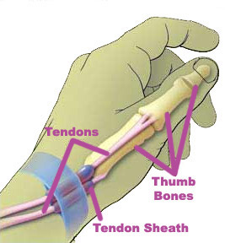
Tenosynovitis
Inflammation of synovial sheath
Area of the tendon that’s subject to ↑ of friction
Acute = sudden onset, crepitus, and diffuse swelling
Chronic = thickening of tendon with pain and crepitus
Common in the long flexor tendons of fingers
Tx
same as Tendinitis
NSAID’s

Slide 35
Bursitis
Bursa
Fluid filled sac found in areas of friction
Knees, shoulders, ankles, elbows, etc
Acute bursitis
Sudden traumatic injury
Chronic bursitis
Overuse and constant external trauma
S/S
Swelling = increase in pressure due to limited space around anatomical structures
Pain, and some loss of function

Slide 36
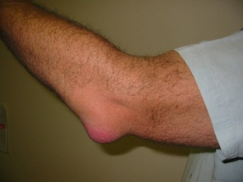
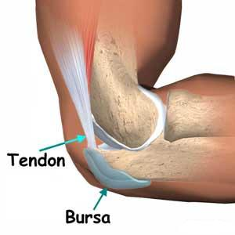
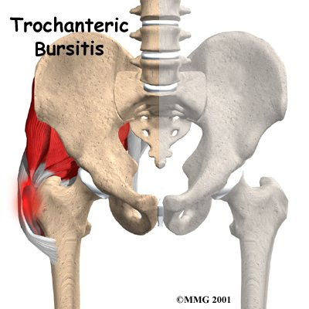
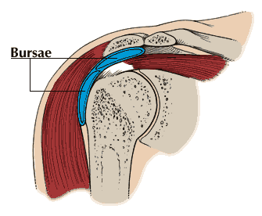
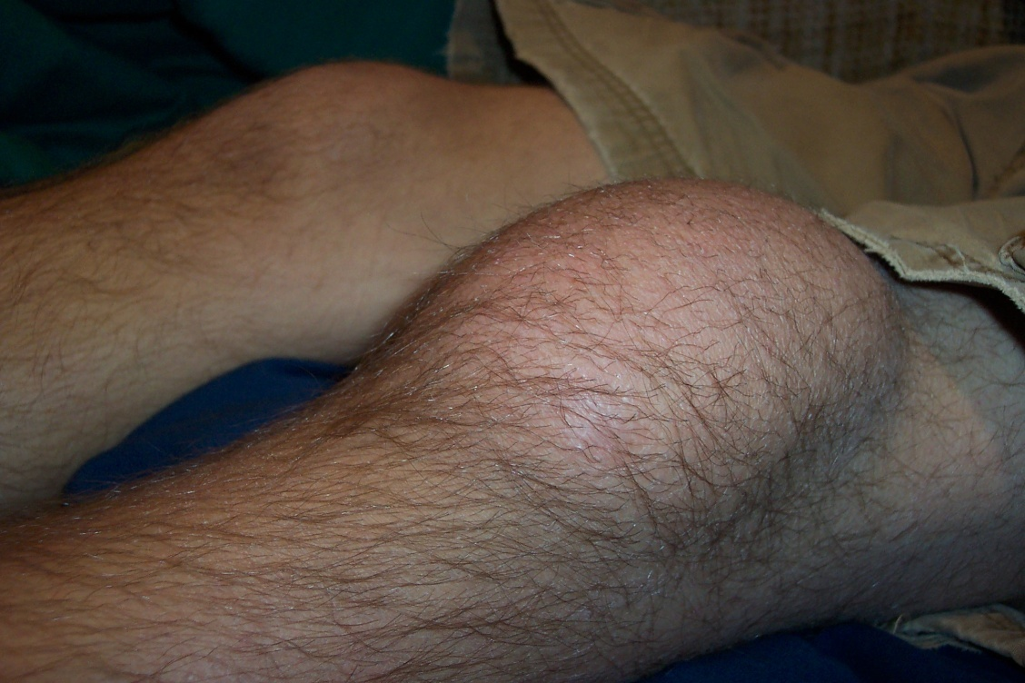

Slide 37
The Healing Process

Slide 38
Importance of the Healing Process Following Injury
Must understand the sequence and time frame of the various phases of healing
Interference with healing process will delay return to full activity
Need optimal healing environment
Little can be done to speed the process, while much can be done to impede it

Slide 39
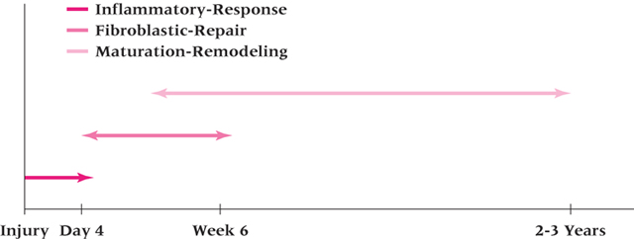
3 Phases
Inflammatory
Fibroblastic (Repair)
Maturation - Remodeling

Slide 40
Inflammatory Phase: 5 Cardinal signs of Inflammation
Swelling
Loss of function
Pain
Reddening of skin (erythema).
Warmth – an increase in temperature of the affected area.

Slide 41
Factors that interfere with Healing
Severity of injury
Swelling
Muscle spasm
Atrophy
Infection
Age
Health/nutrition

Slide 42
Inflammatory Phase
Begins immediately following injury
Without the inflammatory phase the other phases will not occur
Vasoconstriction initially, followed by vasodilation
Damage to blood vessels results in blood flow into interstitial spaces causing a hematoma.
Blood clot if formed to stop bleeding
Plasma proteins, platelets, and leukocytes move out of capillaries and into damaged tissue.
Leukocytes engage in phagocytosis
Phagocytosis occurs to clean the injured area
‘eats’ the debris and injured tissue

Slide 43
Inflammatory Phase
Chemical mediators are released to facilitate healing
Symptomatically presents with the 5 cardinal signs of inflammation
The acute inflammatory process results in a walling off of the damaged area from the rest of the body.
The process acts to clean up the debris and provide components for healing.
Inflammation phase lasts 2-4 days

Slide 44
Fibroblastic Repair Phase
Proliferative and regenerative activity occurs resulting in scar formation
Special leukocytes migrate to the area which break down debris and prepare the area for regeneration and repair.
Unorganized development of scar tissue/collagen is laid down
The collagen fibers are laid down randomly
As the tissue continues to proliferate the area of injury becomes stronger
Therefore the tensile strength of wound ↑rapidly in proportion to collagen synthesis
This signals the beginning of the next phase

Slide 45
Fibroblastic Repair Phase
Occurs within initial hours of injury and continues up to 4-6 weeks
S&S of inflammatory phase subside
Athlete will still experience some tenderness and pain with motion
With development of scar - complaints of pain and tenderness will decrease
Scar tissue can be 95% as strong as the original tissue. Stress on the tissue is helpful for rehabilitation; exercises are critical to this process.

Slide 46
Maturation-Remodeling Phase
Long-term process
Re-alignment of scar tissue according to tensile forces acting on tissue
Re-align to position of maximum efficiency (parallel to lines of tension)
Tissue gradually resumes normal appearance and function
After 3 weeks
Firm, strong, contracted, nonvascular scar exists
Maturation may take several years to be totally complete

