Slide 1
Chapter 19: The Elbow, Forearm, Wrist and Hand
© 2007 McGraw-Hill Higher Education. All rights reserved.

Slide 3
Anatomy of the Elbow
© 2007 McGraw-Hill Higher Education. All rights reserved.

Slide 4
© 2007 McGraw-Hill Higher Education. All rights reserved.

Slide 6
Assessment of the Elbow
History
Past history
Mechanism of injury
When and where does it hurt?
Motions that increase or decrease pain
Type of, quality of, duration of, pain?
Sounds or feelings?
How long were you disabled?
Swelling?
Previous treatments?

Slide 8
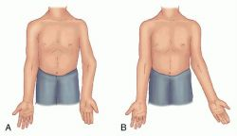
Observations
Deformities and swelling?
Carrying angle
Cubitus valgus versus cubitus varus
Flexion and extension
Cubitus recurvatum
Elbow hyperextension?
Palpation
Be sure to check sites of pain and deformity
Assess epicondyles, olecranon, distal aspect of humerus and proximal aspect of ulna
Soft tissue – muscles, tendons, joint capsules and ligaments surrounding joint

Slide 9
Prevention of Elbow, Forearm and Wrist Injuries
Vulnerable to a variety of acute and chronic injuries
Protective gear is always recommended to reduce severity of injury
Chronic injury reduction
Limit repetitions (baseball, tennis)
Utilize proper mechanics
Use equipment that is appropriate for skill level
Maintain appropriate levels of strength, flexibility, and endurance for activity

Slide 10
Recognition and Management of Injuries to the Elbow
Olecranon Bursitis
Cause of Injury
Superficial location makes it extremely susceptible to injury (acute or chronic) --direct blow
Signs of Injury
Pain, swelling, and point tenderness
Swelling will appear almost spontaneously and w/out usual pain and heat

Slide 11
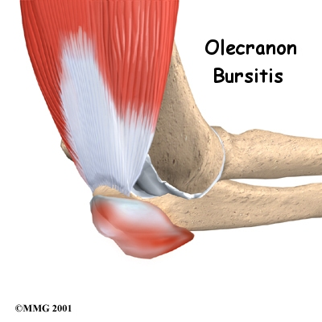
Care
In acute conditions, ice
Chronic cases require protective therapy
If swelling fails to resolve, aspiration may be necessary
Can be padded in order to return to competition

Slide 13
Contusion
Cause of Injury
Vulnerable area due to lack of padding
Result of direct blow or repetitive blows
Signs of Injury
Swelling (rapidly after irritation of bursa or synovial membrane)
Care
Treat w/ RICE immediately for at least 24 hours
If severe, refer for X-ray to determine presence of fracture

Slide 14
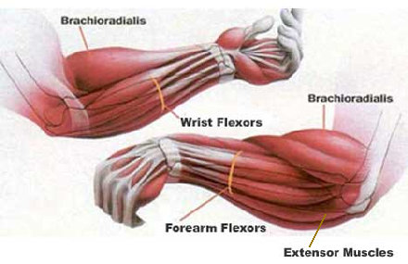
Elbow Sprains
Cause of Injury
Elbow hyperextension or a valgus force (often seen in the cocking phase of throwing
Signs of Injury
Pain along medial aspect of elbow
Inability to grasp objects
Point tenderness over the UCL
Care
Conservative treatment begins w/ RICE elbow fixed at 90 degrees in a sling for at least 24 hours
Coach should be concerned with gradually regaining elbow full ROM
Athlete should modify activity
Gradual progression involving an increase in number of throws while range and strength return

Slide 16
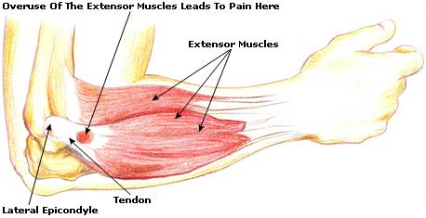
Lateral Epicondylitis (Tennis Elbow)
Cause of Injury
Repetitive microtrauma to insertion of extensor muscles of lateral epicondyle
Signs of Injury
Aching pain in region of lateral epicondyle after activity
Pain worsens and weakness in wrist and hand develop
Elbow has decreased ROM; pain w/ resistive wrist extension

Slide 17
Lateral Epicondylitis (continued)
Care
RICE, NSAID’s and analgesics
ROM exercises and PRE, deep friction massage, hand grasping while in supination, avoidance of pronation motions
Mobilization and stretching in pain free ranges
Use of a counter force or neoprene sleeve
Proper mechanics and equipment instruction is critically important

Slide 19
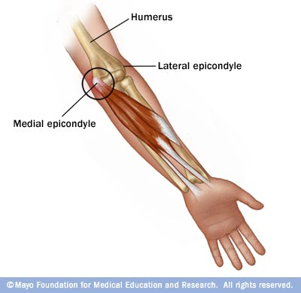
Medial Epicondylitis
Cause of Injury
Repeated forceful flexion of wrist and extreme valgus torque of elbow
Signs of Injury
Pain produced w/ forceful flexion or extension
Point tenderness and mild swelling
Passive movement of wrist seldom elicits pain, but active movement does

Slide 20
Care
Sling, rest, cryotherapy or heat through ultrasound
Analgesic and NSAID's
Curvilinear brace below elbow to reduce elbow stressing
Severe cases may require splinting and complete rest for 7-10 days

Slide 21
Elbow Osteochondritis Dissecans
Cause of Injury
Impairment of blood supply to anterior surface resulting in degeneration of articular cartilage, and bone creating loose bodies within the joint
Signs of Injury
Sudden pain, locking; range usually returns in a few days
Swelling, pain and crepitation may also occur
Care
If repeated locking occurs, loose bodies may be removed surgically
Without removal, arthritis may develop

Slide 22
Elbow Osteochondritis Dissecans

Slide 23
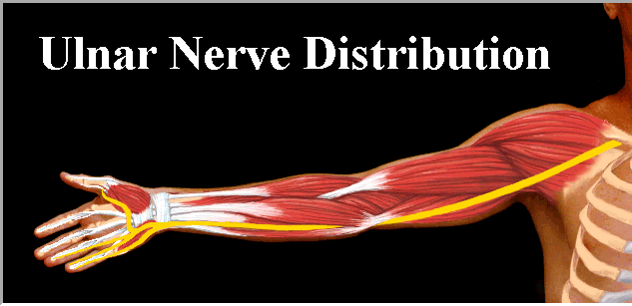
Ulnar Nerve Injuries
Cause of Injury
Pronounced cubital valgus may cause deep friction problem
Ulnar nerve dislocation
Traction injury from valgus force, irregularities w/ tunnel, subluxation of ulnar nerve due to lax impingement, or progressive compression of ligament on the nerve
Signs of Injury
Generally respond with paresthesia in 4th and 5th fingers

Slide 24
Care
Conservative management – avoid aggravating condition
Surgery may be necessary if stress on nerve can not be avoided

Slide 25
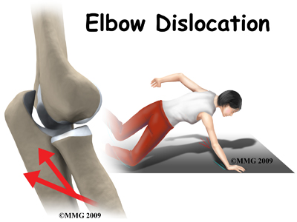
Dislocation of the Elbow
Cause of Injury
High incidence in sports caused by fall on outstretched hand w/ elbow extended or severe twist while flexed
Signs of Injury
Swelling, severe pain, disability
May be displaced backwards, forward, or laterally
Complications w/ median and radial nerves and blood vessels
Rupture and tearing of stabilizing ligaments will usually accompany the injury
Care
Immobilize and refer to physician for reduction
Following reduction, elbow should remain
splinted in flexion for 3 weeks
http://www.youtube.com/watch?v=k_mw704tezU
http://www.youtube.com/watch?v=ex2ryik9j9g&feature=related

Slide 26
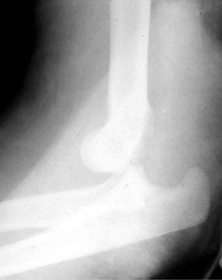
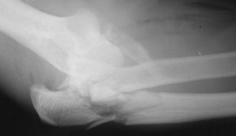
Elbow Dislocation

Slide 27
Fractures of the Elbow
Cause of Injury
Fall on flexed elbow or from a direct blow
Fracture can occur in any one or more of the bones
Fall on outstretched hand often fractures humerus above condyles or between condyles
Signs of Injury
May or may not result in visual deformity
Hemorrhaging, swelling, muscle spasm
Care
Ice and sling for support – refer to physician

Slide 28
-Care Ice and sling for support – refer to physician; surgery if necessary

Slide 29
http://www.youtube.com/watch?v=L9zjlRUSooE&feature=related
http://www.youtube.com/watch?v=RJt-O7knnOg&feature=related

Slide 30
Anatomy of the Forearm

Slide 33
Assessment of the Forearm
History
What was the cause?
What were the symptoms at the time of injury, did they occur later, were they localized or diffuse?
Was there swelling an discoloration?
What treatment was given and how does it feel now?
When did the injury occur?

Slide 34
Observation
Visually inspect for deformities, swelling and skin defects
Range of motion
Pain w/ motion
Palpation
Palpated at distant sites and at point of injury
Can reveal tenderness, edema, fracture, deformity, changes in skin temperature, a false joint, bone fragments or lack of bone continuity

Slide 35
Recognition and Management of Injuries to the Forearm
Contusion
Cause of Injury
Ulnar side receives majority of blows due to arm blocks
Can be acute or chronic
Result of direct contact or blow
Signs of Injury
Pain, swelling and hematoma
If repeated blows occur, heavy fibrosis and possibly bony callus could form w/in hematoma

Slide 36
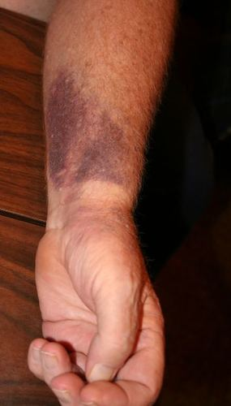
Contusion (continued)
Care
Proper care in acute stage involves RICE for at least one hour and followed up w/ additional cryotherapy
Protection is critical - full-length sponge rubber pad can be used to provide protective covering

Slide 37
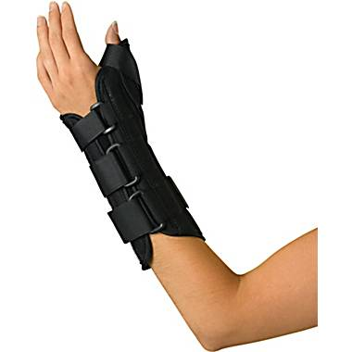
Forearm Splints and Other Strains
Cause of Injury
Forearm strain - most come from severe static contraction
Cause of splints - repeated static contractions
Creates minute tears in connective tissues of forearm
Signs of Injury
Dull ache between extensors which cross posterior aspect of forearm
Weakness and pain w/ contraction
Point tenderness in interosseus membrane
Care
Treat symptomatically
If occurs early in season, strengthen forearm; when it occurs late in season treat w/ cryotherapy, wraps, or heat

Slide 38
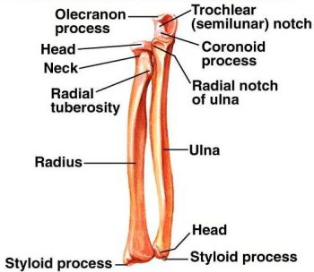
Forearm Fractures
Cause of Injury
Common in youth - due to falls and direct blows
Fracturing ulna or radius singularly is rarer than simultaneous fractures to both
Signs of Injury
Audible pop or crack followed by moderate to severe pain, swelling, and disability
Edema, ecchymosis w/ possible crepitus
Older athlete may experience extensive damage to soft tissue structures

Slide 40
Care
RICE, splint, immobilize and refer to physician
Athlete is usually incapacitated for 8 weeks

Slide 41
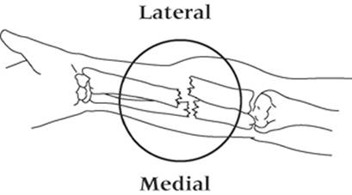
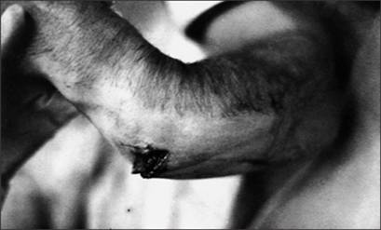
Colles’ Fracture
Cause of Injury
Occurs in lower end of radius or ulna
MOI is fall on outstretched hand, forcing radius and ulna into hyperextension

Slide 42
Signs of Injury
Forward displacement of radius causing visible deformity (silver fork deformity)
When no deformity is present, injury may be passed off as bad sprain
Extensive bleeding and swelling
Tendons may be torn/avulsed and there may be median nerve damage
Care
Cold compress, splint wrist and refer to physician
X-ray and immobilization
Without complications a Colles’ fracture will keep an athlete out for 1-2 months

Slide 45
Anatomy of the Wrist, Hand and Fingers

Slide 50
Assessment of the Wrist, Hand and Fingers
History
Past history
Mechanism of injury
When does it hurt?
Type of, quality of, duration of, pain?
Sounds or feelings?
How long were you disabled?
Swelling?
Previous treatments?

Slide 51
Observation
Postural deviations
Is the part held still, stiff or protected?
Wrist or hand swollen or discolored?
General attitude
What movements can be performed fully and rhythmically?
Thumb to finger touching
Color of nailbeds

Slide 52
Palpation: Bony
Palpate for pain and deformity
Be sure to palpate all the bones of wrist and hand during the evaluation
Soft tissue palpation should include the tendons crossing the wrist and the muscles involved in movement of the thumb as well as the digits

Slide 53
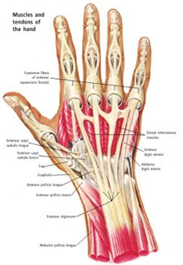
Recognition and Management of Injuries to the Wrist, Hand and Fingers
Wrist Sprains
Cause of Injury
Most common wrist injury
Arises from any abnormal, forced movement
Falling on hyperextended wrist, violent flexion or torsion
Signs of Injury
Pain, swelling and difficulty w/ movement

Slide 54
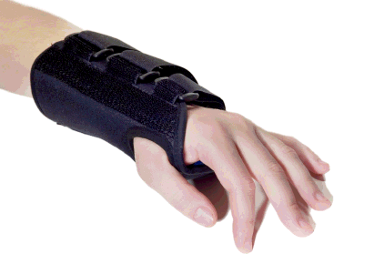
Care
Refer to physician for X-ray if severe
RICE, splint and analgesics
Have athlete begin strengthening soon after injury
Tape for support can benefit healing and prevent further injury

Slide 55
Wrist Tendinitis
Cause of Injury
Primary cause is overuse of the wrist
Repetitive wrist accelerations and decelerations
Signs of Injury
Pain on active use or passive stretching
Tenderness and swelling over involved tendon
Care
Acute pain and inflammation treated w/ ice massage 4x daily for first 48-72 hours, NSAID’s and rest
Use of wrist splint may protect injured tendon
PRE can be instituted once swelling and pain subsided (high rep, low resistance)

Slide 57
Carpal Tunnel Syndrome
Cause of Injury
Compression of median nerve due to inflammation of tendons and sheaths of carpal tunnel
Result of repeated wrist flexion or direct trauma to anterior aspect of wrist
Signs of Injury
Sensory and motor deficits (tingling, numbness and paresthesia); weakness in thumb

Slide 58
Care
Conservative treatment - rest, immobilization, NSAID’s
If symptoms persist, corticosteroid injection may be necessary or surgical decompression of transverse carpal ligament

Slide 59
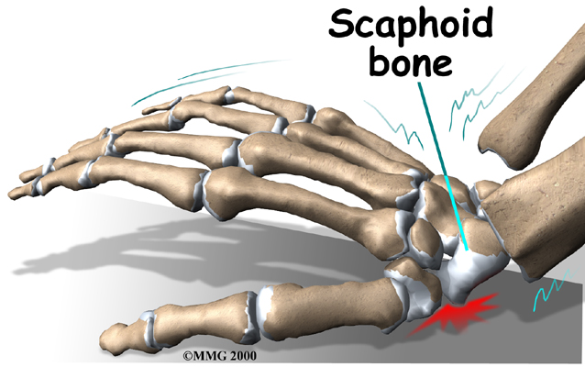
Scaphoid Fracture
Cause of Injury
Caused by force on outstretched hand, compressing scaphoid between radius and second row of carpal bones
Signs of Injury
Swelling, severe pain in anatomical snuff box

Slide 60
-Care
Must be splinted and referred for X-ray prior to casting
May be missed on initial X-ray
Immobilization lasts 6 weeks and is followed by strengthening and protective tape
Wrist requires protection against impact loading for 3 additional months
Often fails to heal due to poor blood supply

Slide 61
Hamate Fracture
Cause of Injury
Occurs as a result of a fall or more commonly from contact while athlete is holding an implement
Signs of Injury
Wrist pain and weakness (5th digit due to ulnar nerve compression), along w/ point tenderness
Care
Casting wrist and thumb is treatment of choice
Hook of hamate can be protected w/ doughnut pad to take pressure off area

Slide 62
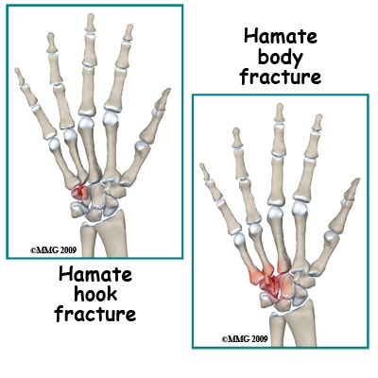

Slide 63
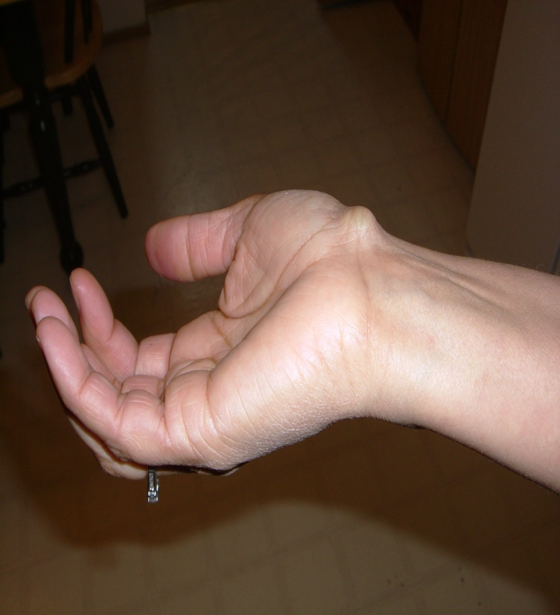
Wrist Ganglion
Cause of Injury
Synovial cyst (herniation of joint capsule or synovial sheath of tendon)
Generally appears following wrist strain or repeated forced hyperextension
Signs of Injury
Appear on back of wrist generally
Occasional pain w/ lump at site
Pain increases w/ use
May feel soft, rubbery or very hard

Slide 64
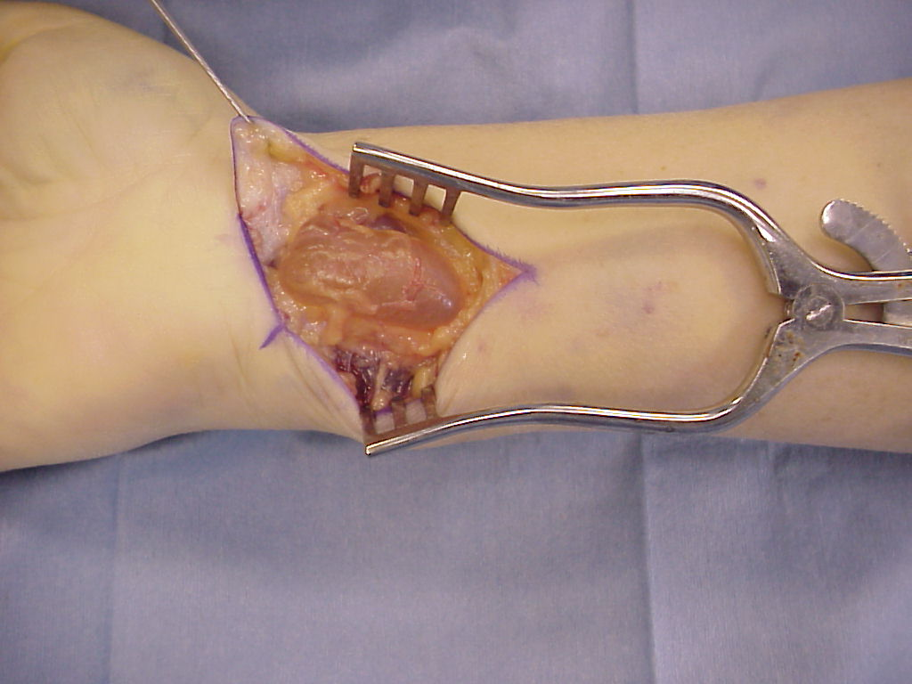
-Care
Old method was to first break down the swelling through distal pressure and then apply pressure pad to encourage healing
New approach includes aspiration, chemical cauterization w/ subsequent pressure from pad
Surgical removal is most effective way

Slide 65
Metacarpal Fracture
Cause of Injury
Direct axial force or compressive force
Fractures of the 5th metacarpal are associated w/ boxing or martial arts (boxer’s fracture)
Signs of Injury
Pain and swelling; possible angular or rotational deformity
Palpable defect is possible

Slide 66
-Care
RICE, refer to physician for reduction and immobilization
Deformity is reduced, followed by splinting - 4 weeks

Slide 67
Recognition and Management of Finger Injuries
Mallet Finger
Cause of Injury
Caused by a blow that contacts tip of finger avulsing extensor tendon from insertion
Signs of Injury
Pain at DIP; X-ray shows avulsed bone on dorsal proximal distal phalanx
Unable to extend distal end of finger (carrying at 30 degree angle)
Point tenderness at sight of injury

Slide 68
-Care
RICE and splinting (in extension) for 6-8 weeks

Slide 69
Boutonniere Deformity
Cause of Injury
Rupture of extensor tendon dorsal to the middle phalanx Forces DIP joint into extension and PIP into flexion
Signs of Injury
Severe pain, obvious deformity and inability to extend DIP joint
Swelling, point tenderness

Slide 70
Care
Cold application, followed by splinting of PIP
Splinting must be continued for 5-8 weeks
Athlete is encouraged to flex distal phalanx

Slide 71
Jersey Finger
Cause of Injury
Rupture of flexor digitorum profundus tendon from insertion on distal phalanx
Often occurs w/ ring finger when athlete tries to grab a jersey
Signs of Injury
DIP can not be flexed, finger remains extended
Pain and point tenderness over distal phalanx

Slide 72
Care
Must be surgically repaired
Rehab requires 12 weeks and there is often poor gliding of tendon, w/ possibility of re-rupture

Slide 73
Gamekeeper’s Thumb
Cause of Injury
Sprain of UCL of MCP joint of the thumb
Mechanism is forceful abduction of proximal phalanx occasionally combined w/ hyperextension
Signs of Injury
Pain over UCL in addition to weak and painful pinch
Tenderness and swelling over medial aspect of thumb

Slide 74
Care
Immediate follow-up must occur
If instability exists, athlete should be referred to orthopedist
If stable, X-ray should be performed to rule out fracture
Thumb splint should be applied for protection for 3 weeks or until pain free

Slide 75
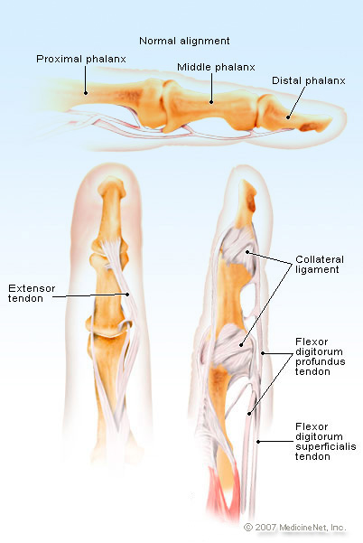
Collateral Ligament Sprains
Cause of Injury
Axial force to the tip of the finger – produces the “jammed” effect
Signs of Injury
Severe point tenderness at the joint
Collateral ligaments
Lateral or medial joint instability
Care
Ice for the acute stage
X-ray to rule out fracture and splint for support

Slide 76
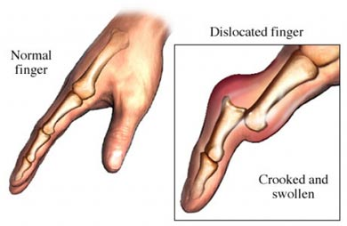
Dislocation of Phalanges
Cause of Injury
Blow to the tip of the finger (directed upward from palmar side
Forces 1st or 2nd joint dorsally
Results in tearing of supporting capsular tissue and hemorrhaging
Possible rupture of flexor or extensor tendon(s) and/or chip fractures may also occur

Slide 77
Care
Reduction should be performed by physician
X-ray to rule out fractures
Splint for 3 weeks in 30 degrees of flexion
Inadequate immobilization may lead to instability or excessive scar tissue accumulation
Buddy-tape for support upon return
Special consideration must be given for thumb dislocations and MCP dislocations
MCP joint of thumb dislocation occurs with thumb forced into hyperextension
Any MCP dislocation will require immediate care by a physician

Slide 78
Phalangeal Dislocations

Slide 79
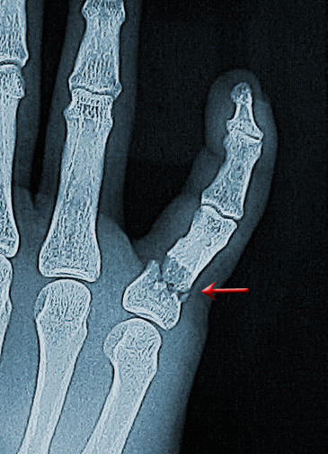
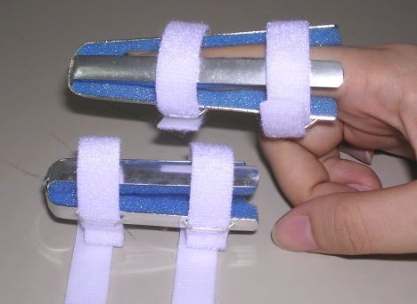
Phalanx Fracture
Cause of Injury
Crushed, hit by ball, twisted – multiple mechanisms of injury
Signs of Injury
Pain and swelling
Tenderness at point of fracture

Slide 80
Care
Splint in slight flexion around gauze roll or curved splint – avoid full extension
Relaxes flexor tendons
Fx of distal phalanx is generally less complicated than fx of middle or proximal phalanx
RICE, immobilize, splint, refer to physician

Slide 81
Subungual Hematoma
Cause of Injury
Contusion of distal finger causing blood accumulation in the nail bed
Signs of Injury
Produces extreme pain due to pressure – nail loss will ultimately occur
Discoloration – bluish-purple
Slight pressure on nail will exacerbate condition

Slide 82
Care
Ice pack for pain and swelling reduction
Drill nail within 12-24 hours to relieve pressure
Perform under sterile conditions
May be required to drill a second time due to additional blood accumulation

