Slide 1
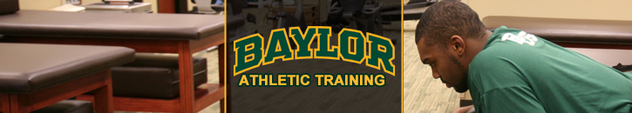
Building an AT Facility and Budget

Slide 2
Policies and Procedures for an Athletic Training Facility
Multipurpose area used for prevention, treatment, first aid, and rehabilitation of athletic injuries
  It is not a site for social gatherings
The tables, floors, counters, and equipment should be kept clean at all times
Food and drinks should be kept out of the AT facilities during treatment and rehabilitation

Slide 3
Common Policies
No cleated Shoes
All game and practice equipment should be kept outside
No shoes on the treatment tables
Athletes must shower before receiving treatment
Roughhousing and profanity are not allowed
Athletes must be supervised in the AT room at all times
WHY??

Slide 4
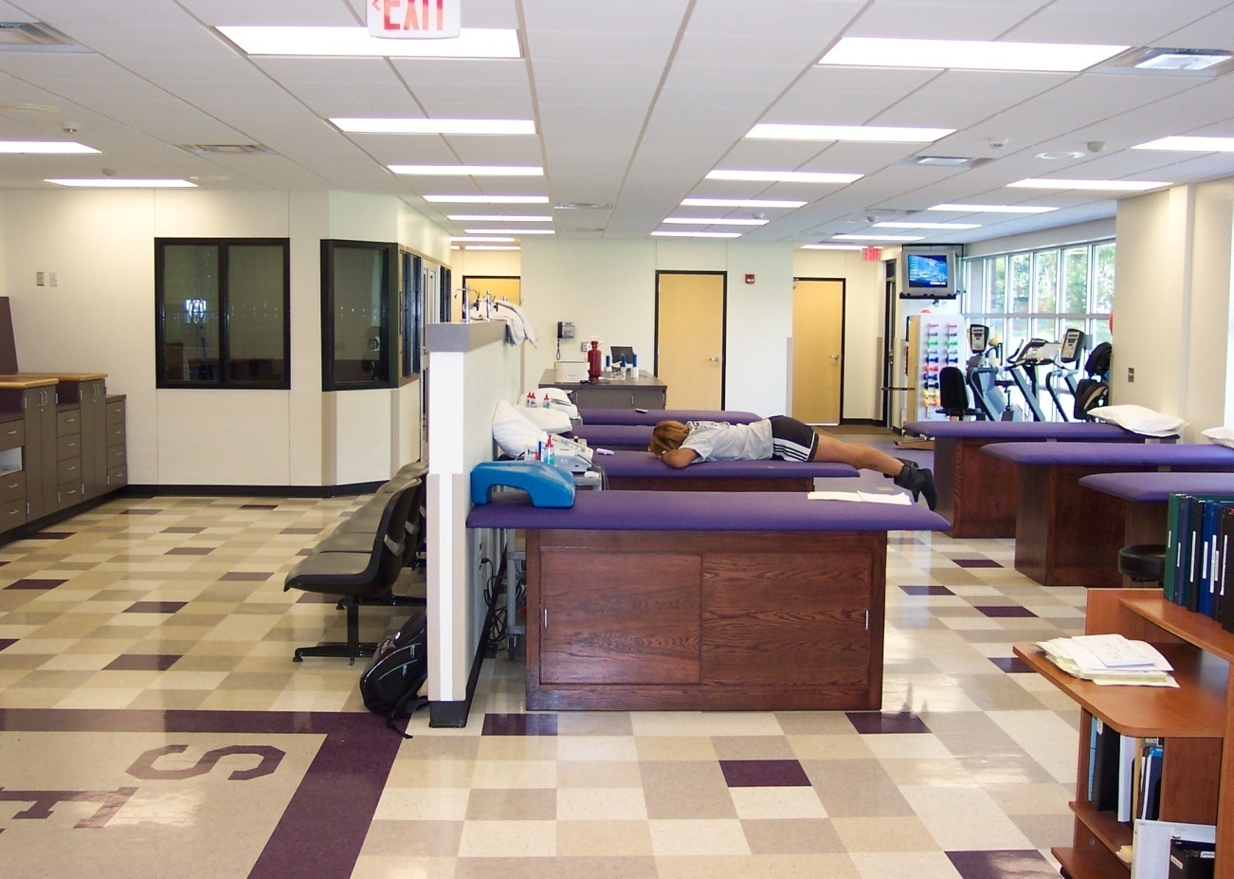
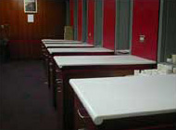
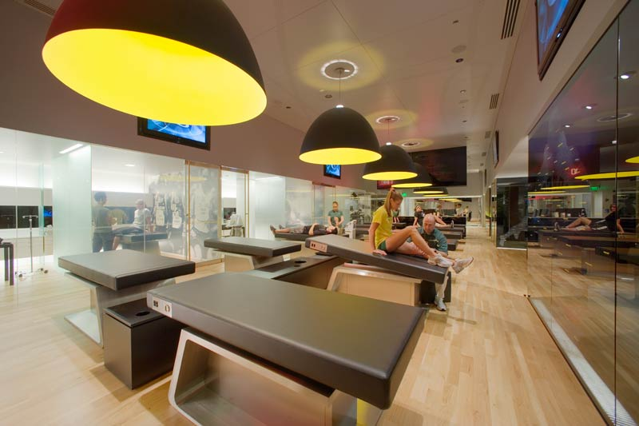
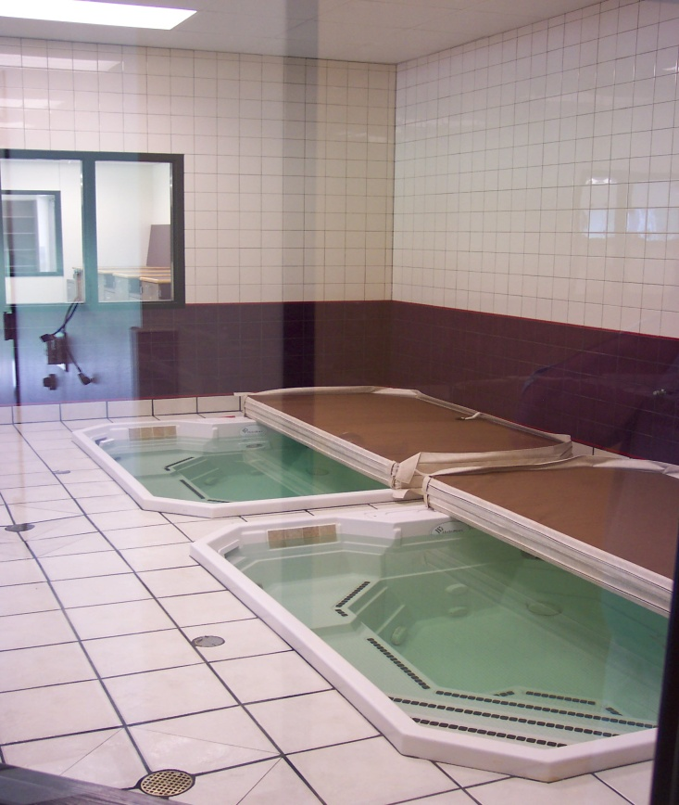

Slide 5

10 Phases to the Design Process:
Conduct a needs assessment
Seek approval for the project
Select a construction process model
Select an architect
Develop schematics
Secure the required funding
Bid the construction
Analyze bids and take action
Begin construction
Monitor construction

Slide 6
1.) Conduct a needs assessment
Assessment of future program needs
  In other words what will the program/facility provide?
    Rehab? Treatment? Taping? Wet room area?
  How will the program expand?
    Meaning, how many athletic teams will be treated?
      Football, volleyball, golf, tennis, wrestling, swimming, baseball, softball, basketball, cross country, track and field, , soccer, etc…
      Varsity, JV, Freshman??

Slide 7
2. Seek Approval for the Project
People with the financial investments (providing the money) need to be convinced that the project is necessary
  Is it a necessity to have an Athletic Training Room at Boswell, Chisholm Trail or Saginaw High Schools?
  Is it necessary to have a storage room?
Approval from school administrators, city council, etc…
  It may take months or years for approval

Slide 8
3. Select a Construction Process
Lump-Sum – Most traditional method; Usually used for governmental units like Schools and Universities.
General Contractor- The company responsible for coordinating the construction of the building; provides bids for the right to build
    Important to gain more than one bid
    He/she will give advice on materials, cost , sub-contractors, etc…

Slide 9

3. Select a Construction Process
Subcontractor- Company hired by the general contractor to complete a particular portion of the building project
  Examples – Plumbers, electrical work, or landscaping

Slide 10

4.) Select an Architect
Architect- person trained in the planning, design and oversight of the construction of buildings, and is licensed to practice architecture.
Variety of ways to find one…
  Ask friends and/or colleagues (referrals)
  Screen many different firms – large, small, close, distant, etc…
  Design competition – large scale project
  Have several design firms compete against each other
Recommended to visit previous projects

Slide 11
5.) Develop Schematics
Schematic drawing – graphic representation derived from the program statement, that illustrates the relationships among the principle functions of a building.

Slide 12
5.) Develop Schematics
Determine space needs –
  number and type of clients
  amount and kinds of equipment
      Bike? Weights? Tables? Storage? Whirlpools? Computer?
  staff personnel
      Offices? Locker room?
  and growth
Traffic patterns – the anticipated flow of people from one area of the building to the another

Slide 13

6. Secure the Required Funding
Bank Loans are most common
Private clinics have a difficult time securing funding vs. a University or HS facility

Slide 14

7. Bid the Construction
Gather all technical drawings, schematics, relationship charts and determine the estimated cost of construction
  Request cost quotes from various construction firms

Slide 15
8. Analyze the Bids and Take Action
Decide which firm is best for the construction of the facility
Is the information on the bids consistent with the bidding documents?
  Meaning--

Slide 16
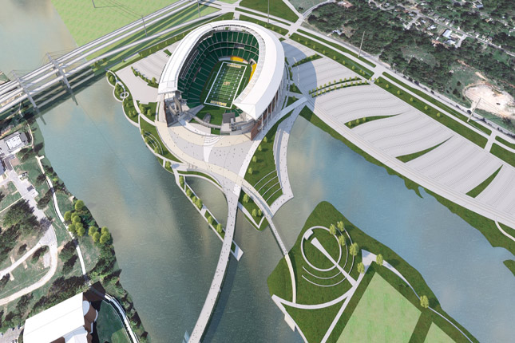
9. Begin Construction
The Fun Part!
The contractor is making the blueprints, construction documents, and schematics a reality

Slide 17
10.) Monitor Construction
Monitor to ensure the design features are being implemented
Observe General contractors and subcontractors to make sure they are following the design
The details should be formulated as designed
  Outlets, lights, doors, storage, drains, showers, etc…

Slide 18
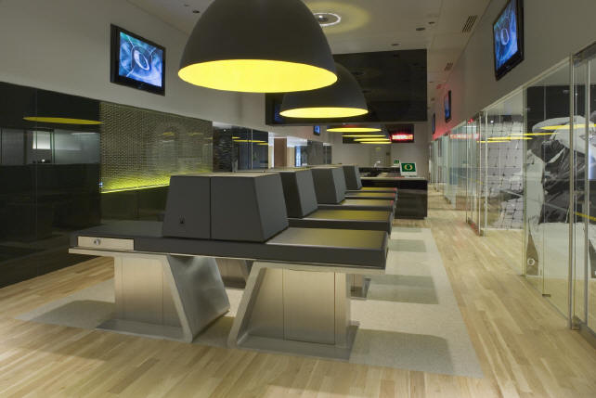
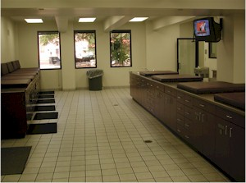
Areas of an AT Facility
Office
  Desk, chairs, medical files, storage, etc
Taping and bandaging area
  Sturdy tables, shelving, cabinets, and taping stations

Slide 19
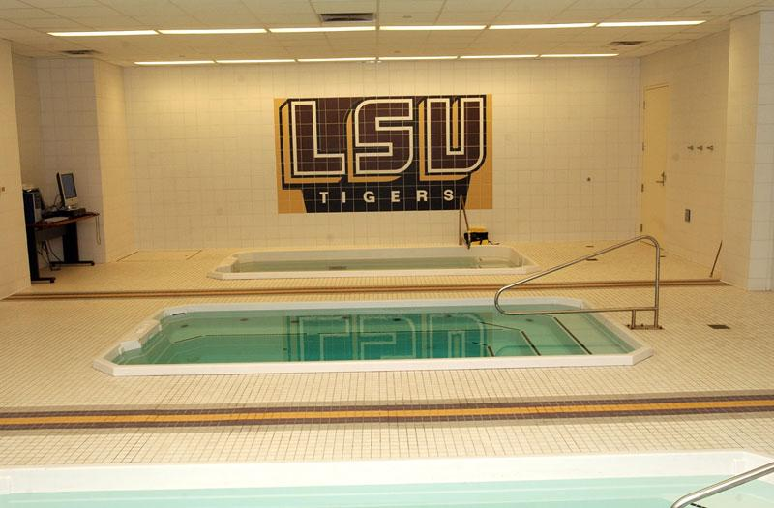
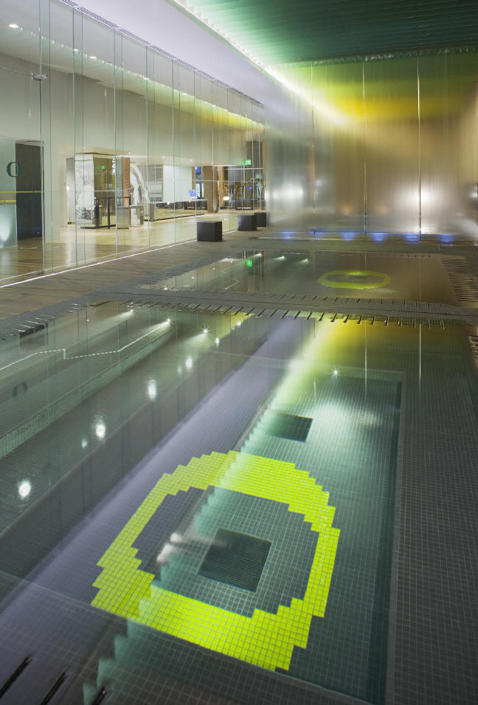
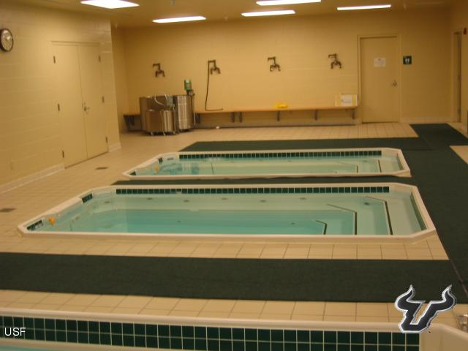
Areas of an AT Facility
Hydrotherapy
  Whirlpools, ice machines, and freezers/fridge
  GFI outlets

Slide 20
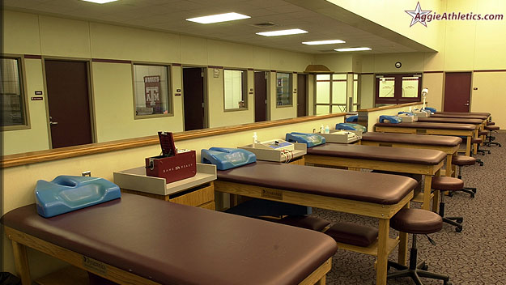
Areas of an AT Facility
Treatment
  Treatment tables, electrical stimulation machines, Ultrasound Machine, other various modalities.

Slide 21
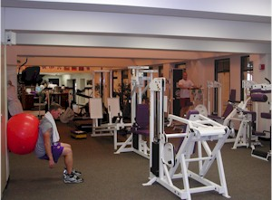
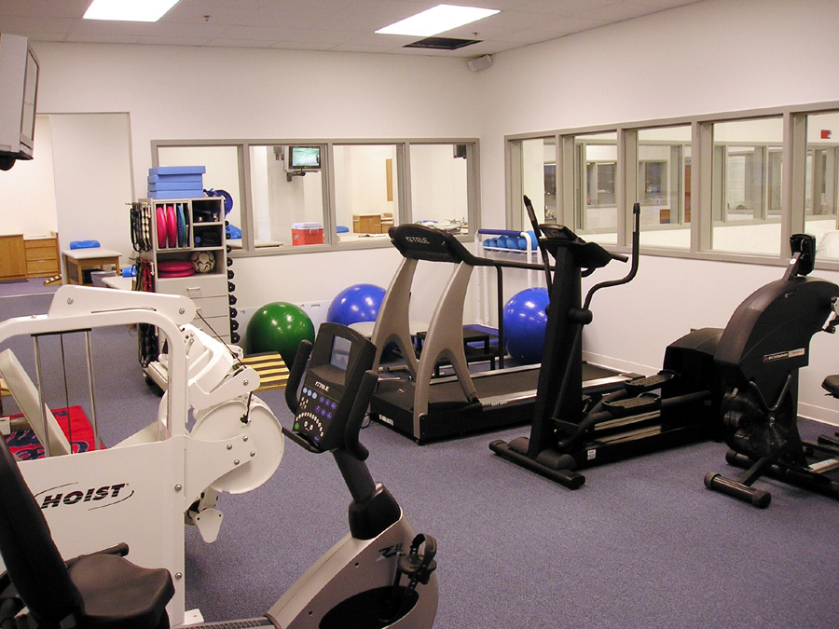
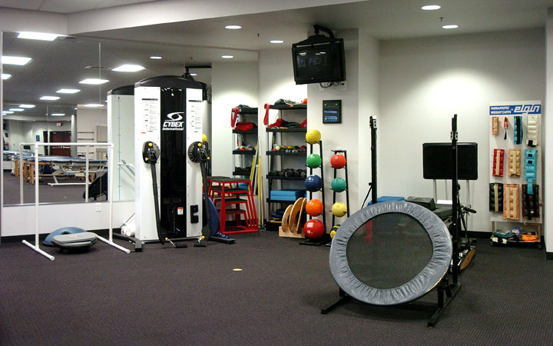
Areas of an AT Facility
Rehabilitation
  Weights, Swiss Balls, Tables, Bikes, Treadmills, etc…

Slide 22
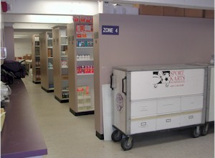
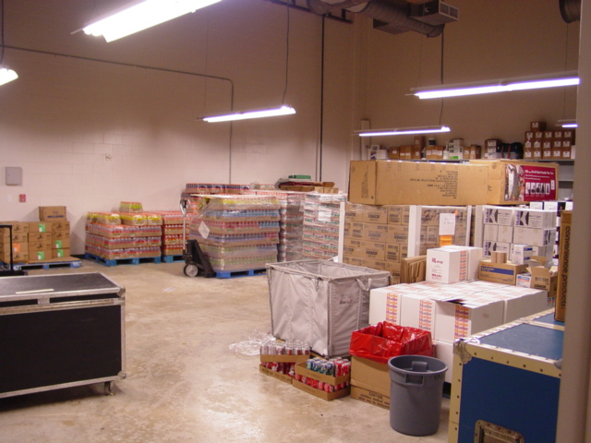
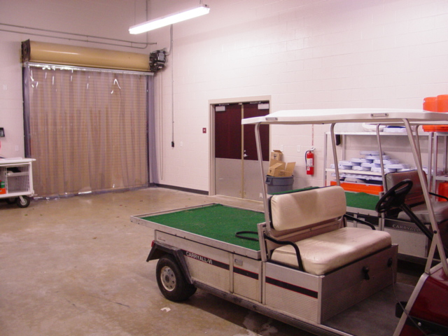
Areas of an AT Facility
Storage
  Shelves, cabinets, ventilation, must be cool and dry

Slide 23
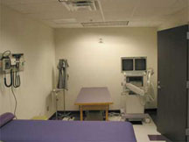
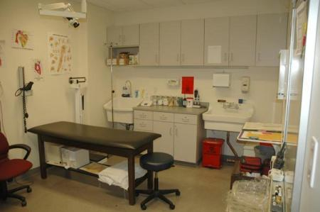
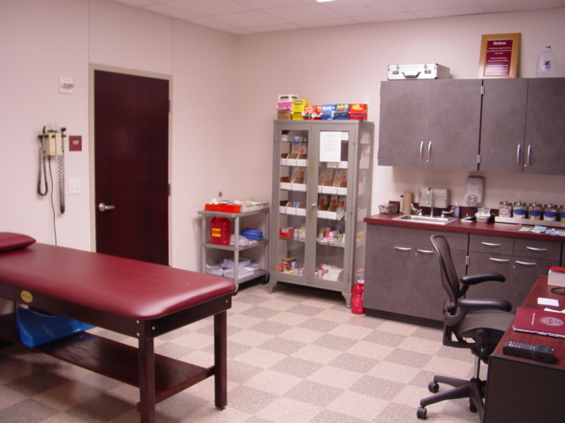
Areas of an AT Facility
Restroom/locker room
Private Exam Office/Dr. Office
  Exam table, Light, Supplies, Shelves, etc

Slide 24

Required Areas
Office with door (that locks)
Taping (cabinets, possible sink, counters)
Treatment (Taping and Treatment Area can be same)
Wet Area with drain (pay special attention to the outlets)
Storage Room with door
Area dedicated to rehab (bikes, treadmill, rehab equipment)

Slide 25
Budget:
Ordering Supplies and Equipment

Slide 26
Budget Concerns
Budget- A plan for the coordination of resources and expenditures.
Supplies : Identify what and how much you need of everything
  Tape, band-aids, towels, powerflex, biofreeze, pre-wrap, telfa pads, tongue depressors, etc…
Bidding – Process where vendors provide cost quotations for goods and services they wish to sell

Slide 27

Budget Concerns
Purchasing – The process of acquiring goods and services.
Three Phases
  Phase One – Exploration
    Identify the need
    Collect information for each item
    Decide where and how to collect the product information
  Phase Two – Gather Information
    Collect as much information about needs
    Prioritize needs
    Justify each need

Slide 28

Budget Concerns
  Phase Three – Decision Making
    Develop alternative solutions for each need
    Determine budgetary implications for each solution
    Prioritize solutions
    Integrate solutions into the program budget

Slide 29
Budget Concerns
Six Steps for Purchasing
  1- Request For Quotation (RFQ)-
    A document that provides vendors with the specifications for bidding on the sale of goods and services.
  2- Negotiation
    Bargain with vendors
  3- Requisition-
    Formal or informal communication, usually written, for requesting authorization to purchase goods or services.

Slide 30
Budget Concerns
  4- Purchase order (PO) -
    Document that formalizes the terms of a purchase and transmits the intentions of the buyer to purchase goods and services from the vendor
  5- Receiving -
    Process of receiving goods from a vendor.
  6- Accounts Payable
    Cost of supplies, paid after receiving the goods

Slide 31
General vs. Capital Items
General- budget items that are considered a one-time usage or consumable .
Ex: band-aids, Neosporin, gauze pads, tape, cleaning supplies
Capital Items- budget items that are considered re-usable and should be around for awhile to be utilized. Ex: ice machine, modality units, coolers, athletic training kits

