Slide 1
Chapter 22: The Head, Face, Eyes, Ears, Nose and Throat

Slide 2
Prevention of Injuries to the Head, Face, Eyes, Ears, Nose and Throat
Head and face injuries are prevalent in sport, particularly in collision and contact sports
Education and protective equipment are critical in preventing injuries to the head and face
Head trauma results in more fatalities than other sports injury
Morbidity and mortality associated w/ brain injury have been labeled the silent epidemic

Slide 5
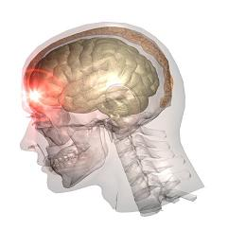
Assessment of Head Injuries
Brain injuries occur as a result of a direct blow, or sudden snapping of the head forward, backward, or rotating to the side
May or may not result in loss of consciousness, disorientation or amnesia; motor coordination or balance deficits and cognitive deficits
May present as life-threatening injury or cervical injury (if unconscious)

Slide 6
History
Determine loss of consciousness and amnesia
Additional questions (response will depend on level of consciousness)
Do you know where you are and what happened?
Can you remember who we played last week? (retrograde amnesia)
Can you remember walking off the field (antegrade amnesia)
Does your head hurt?
Do you have pain in your neck?
Can you move your hands and feet?

Slide 7
Observation
Is the athlete disoriented and unable to tell where he/she is, what time it is, what date it is and who the opponent is?
Is there a blank or vacant stare? Can the athlete keep their eyes open?
Is there slurred speech or incoherent speech?
Are there delayed verbal and motor responses?
Gross disturbances to coordination?

Slide 8
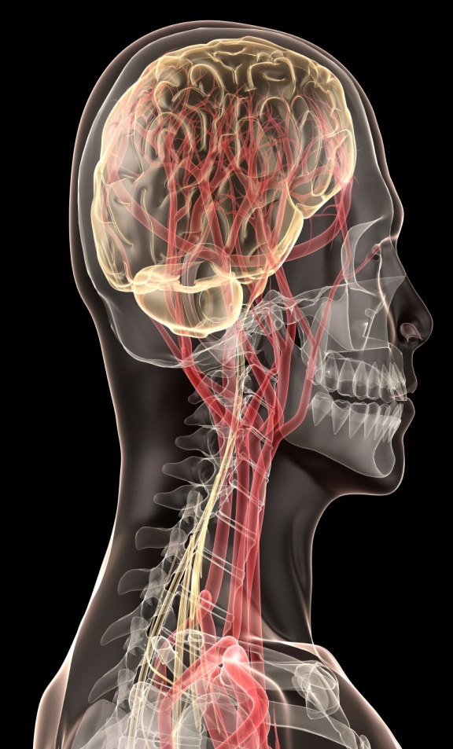
Inability to focus attention and is the athlete easily distracted?
Memory deficit?
Does the athlete have normal cognitive function?
Normal emotional response?
How long was the athlete’s affect abnormal?
Is there any swelling or bleeding from the scalp?
Is there cerebrospinal fluid in the ear canal?

Slide 9
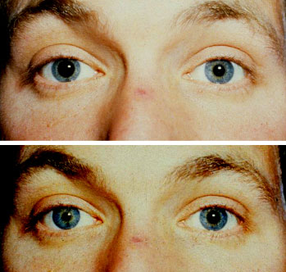
Palpation
Neck and skull for point tenderness and deformity
Special Tests
Neurologic exam
Assess cerebral testing, cranial nerve testing, cerebellar testing, sensory and reflex testing
Eye function
Pupils equal round and reactive to light (PEARL)
Dilated or irregular pupils
Ability of pupils to accommodate to light variance
Eye tracking - smooth or unstable (nystagmus, which may indicate cerebral involvement)
Blurred vision

Slide 10
Balance Tests
Romberg Test
Assess static balance - determine individual’s ability to stand and remain motionless
Tandem stance is ideal
Coordination tests
Finger to nose, heel-to-toe walking
Inability to perform tests may indicate injury to the cerebellum

Slide 11
Cognitive Tests
Used to establish impact of head trauma on cognitive function and to obtain objective measures to assess patient status and improvement
On or off-field assessment
Serial 7’s, months in reverse order, counting backwards
Tests of recent memory (score of contest, breakfast game, 3 word recall)
Neuropsychological Assessments
Standardized Assessment of Concussion (SAC) provides immediate objective data concerning presence and severity of neurocognitive impairment

Slide 12
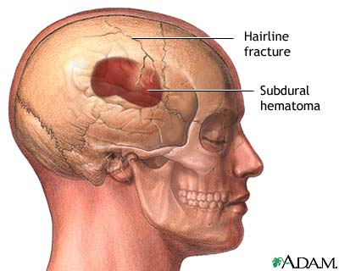
Recognition and Management of Specific Head Injuries
Skull Fracture
Cause of Injury
Most common cause is blunt trauma
Signs of Injury
Severe headache and nausea
Palpation may reveal defect in skull
May be blood in the middle ear, ear canal, nose, ecchymosis around the eyes (raccoon eyes) or behind the ear (Battle’s sign)
Cerebrospinal fluid may also appear in ear and nose
Care
Immediate hospitalization and referral to neurosurgeon

Slide 13
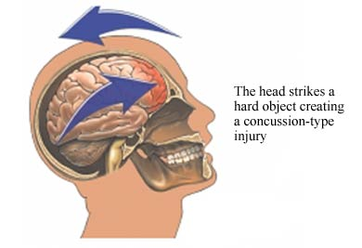
Cerebral Concussion
Characterized by immediate and transient post-traumatic impairment of neural function
Cause of Injury
Result of direct blow, acceleration/deceleration forces producing shaking of the brain
Signs of Injury
Primary symptoms – altered level of consciousness and amnesia (anterograde and retrograde)
Brief periods of diminished consciousness or unconsciousness that lasts seconds or minutes
Headache, tinnitus, nausea, irritability, confusion, disorientation, dizziness, posttraumatic amnesia, retrograde amnesia, concentration difficulty, blurred vision, photophobia, sleep disturbances

Slide 14
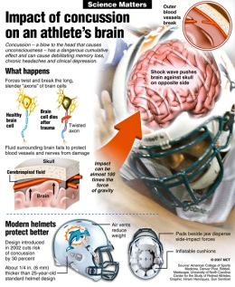

Slide 15
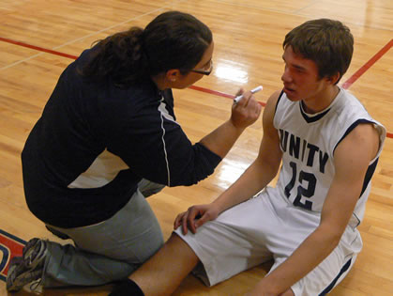
Care
The decision to return an athlete to competition following a brain injury is a difficult one that takes a great deal of consideration
If any loss of consciousness occurs the ATC must remove the athlete from competition
With any loss of consciousness (LOC) a cervical spine injury should be assumed
Objective measures (BESS and SAC) should be used to determine readiness to play
A number of guidelines have been
established to in an effort to aid clinicians
in their decisions

Slide 16
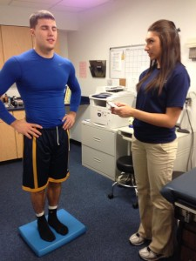
Care (continued)
All post-concussive symptoms should be resolved prior to returning to play -- any return to play should be gradual
Athlete must be cleared by the team physician
Recurrent concussions can produce cumulative traumatic injury to the brain
Following an initial concussion the chances of a second episode are 3-6 times greater

Slide 17
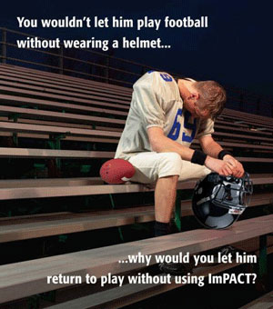
Post-concussion Syndrome
Cause of Injury
Condition which occurs following a concussion
May be associated w/ those MHI’s that don’t
involve a LOC or in cases of severe concussions
Signs of Injury
Athlete complains of a range of post-concussion problems
Persistent headaches, impaired memory, lack of concentration, anxiety and irritability, giddiness, fatigue, depression, visual disturbances
May begin immediately following injury and may last for weeks to months
Care
ATC should treat symptoms to greatest extent possible
Return athlete to play when all signs and symptoms have fully resolved

Slide 18
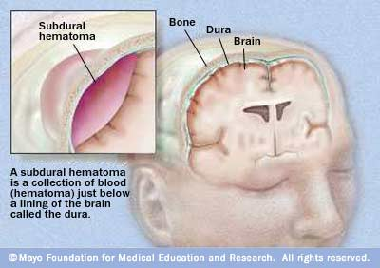
Second Impact Syndrome
Cause of Injury
Result of rapid swelling and herniation of brain after a second head injury before symptoms of the initial injury have resolved
Second impact may be relatively minimal and not involve contact w/ the cranium
Impact disrupts the brain’s blood autoregulatory system leading to swelling, increasing intracranial pressure
Signs of Injury
Often athlete does not LOC and may looked stunned
W/in 15 seconds to several minutes of injury athlete’s condition degrades rapidly
Dilated pupils, loss of eye movement, LOC leading to coma, and respiratory failure

Slide 19
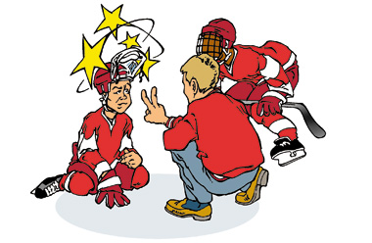
Second Impact Syndrome (continued)
Care
Life-threatening injury that must be addressed w/in 5 minutes w/ life saving measures performed at an emergency facility
Best management is prevention from the ATC’s perspective

Slide 20
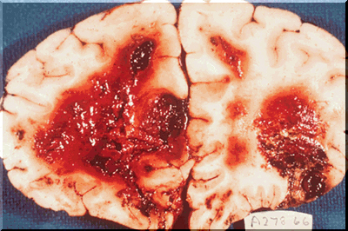
Cerebral Contusion
Cause of Injury
Focal injury to the brain that involves small hemorrhages or intracranial bleeding w/in the cortex, stem or cerebellum
Generally occurs when head strikes a stationary object
Signs of Injury
Severity will vary greatly based on the extent of the injury
Will likely experience a LOC followed by a very talkative state
Normal neurological exam; presenting w/ headache, dizziness and nausea
Care
Hospitalization w/ CT and MRI
Treatment will vary according to status of the athlete
Return to play occurs when athlete is asymptomatic and CT is normal

Slide 21
Epidural Hematoma
Cause of Injury
Blow to head or skull fracture which tear meningeal arteries
Blood pressure, blood accumulation and creation of hematoma occur rapidly (minutes to hours)

Slide 22
Signs of Injury
LOC followed by period of lucidity, showing few signs and symptoms of serious head injury
Gradual progression of S&S
Head pains, dizziness, nausea, dilation of one pupil (same side as injury), deterioration of consciousness, neck rigidity, depression of pulse and respiration, and convulsion
Care
Requires urgent neurosurgical care; CT is necessary for diagnosis
Must relieve pressure to avoid disability or death

Slide 23
Subdural Hematoma
Cause of Injury
Result of acceleration/deceleration forces that tear vessels that bridge dura mater and brain
Venous bleeding (simple hematoma may result in little to no damage to cerebellum while more complicated bleed can damage cortex)

Slide 24
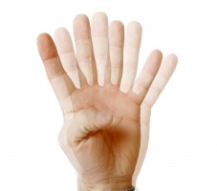
Signs of Injury
Athlete may experience LOC, dilation of one pupil
Signs of headache, dizziness, nausea or sleepiness
Care
Immediate medical attention
CT or MRI is necessary to determine extent of injury

Slide 25
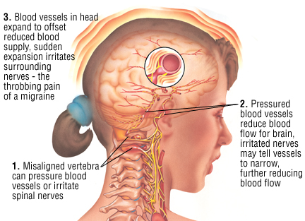
Migraine Headaches
Cause of Injury
Disordered characterized by recurrent attacks of severe headache
Seen in those that have had repeated head trauma
Exact cause unknown (believed to be vascular)
Signs of Injury
Sudden onset w/ possible visual or gastrointestinal problems
Flashes of light, blindness (half field vision), paresthesia
Care
Prevention is key
Prescription medications have a high success rate

Slide 26
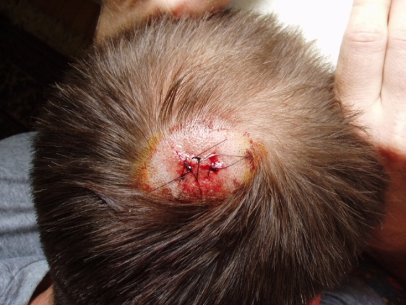
Scalp Injuries
Cause of Injury
Blunt trauma or penetrating trauma tends to be the cause
Can occur in conjunction with serious head trauma
Signs of Injury
Athlete complains of blow to the head
Bleeding is often extensive (difficult to pinpoint exact site)
Care
Clean w/ antiseptic soap and water (remove debris)
Cut away hair if necessary to expose area
Apply firm pressure or astringent to reduce bleeding
Wounds larger than 1/2 inch in length should be referred
Smaller wounds can be covered w/ protective covering and gauze (use extra adherent)

Slide 27
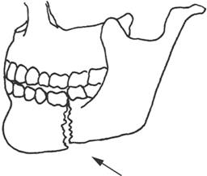
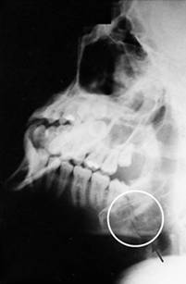
Recognition and Management of Specific Facial Injuries
Mandible Fractures
Cause of Injury
Direct blow (generally fractures at frontal angle)
Signs of Injury
Deformity, loss of occlusion, pain with biting, bleeding around teeth, lower lip anesthesia
Care
Temporary immobilization w/ elastic wrap followed by reduction and fixation

Slide 28
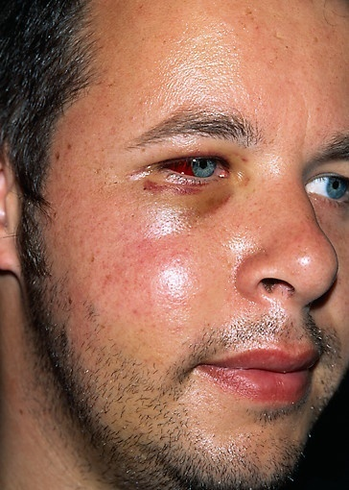
Zygomatic complex (cheekbone) fracture
Cause of Injury
MOI = direct blow
Signs of Injury
Deformity, or bony discrepancy, nosebleed, diplopia, and numbness in cheek
Care
Cold application to control edema and immediate referral to a physician
Healing will take 6-8 weeks and proper gear will be required upon return to play

Slide 29
Facial Lacerations
Cause of Injury
Result of a direct impact, and indirect compressive force or contact w/ a sharp object
Signs of Injury
Pain, substantial bleeding,
Care
Apply pressure to control bleeding
Referral to a physician will be necessary for stitches

Slide 30
Dental Anatomy

Slide 31
Prevention of Dental Injuries
When engaged in contact/collision sports mouth guards should be routinely worn
Greatly reduces the incidence of oral injuries
Practice good dental hygiene
Dental screenings should occur yearly
Cavity prevention
Prevention of abscess development, gingivitis, and periodontitis

Slide 32
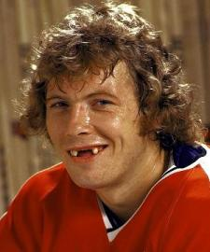
Recognition and Management of Specific Dental Injuries

Slide 33
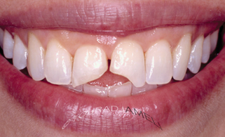
Tooth Fractures
Cause of Injury
Impact to the jaw, direct trauma
Signs of Injury
Uncomplicated fractures produce fragments w/out bleeding
Complicated fractures produce bleeding, w/ the tooth chamber being exposed w/ a great deal of pain
Root fractures are difficult to determine and require follow-up w/ X-ray

Slide 34
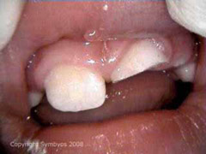
Tooth Fractures (continued)
Care
Uncomplicated and complicated crown fractures do not require immediate attention
Fractured pieces can be placed in a bag and and if not sensitive to air or cold, follow-up can wait for 24-48 hours
Bleeding can be controlled via gauze
Cosmetic reconstruction of tooth
In instances of root fractures, the athlete can continue to play but must follow-up immediately following competition
Tooth repositioning may be required, along with bracing and the use of mouthpieces in the future

Slide 35
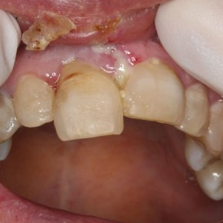
Tooth Subluxation, Luxation and Avulsion
Cause of Injury
Direct blow
Signs of Injury
Tooth may be slightly loosened, dislodged
When subluxed tooth may be loose w/in socket w/ little or no pain
With luxations, no fracture has occurred, however, there is displacement
W/ an avulsion, the tooth is completely knocked from the oral cavity
Care
For a subluxed tooth, referral should occur w/in the first 48 hours
With a luxated tooth, repositioning should be attempted along w/ immediate follow-up
Avulsed teeth should not be re-implanted except by a dentist (use a Save a Tooth Kit, milk or saline)

Slide 36
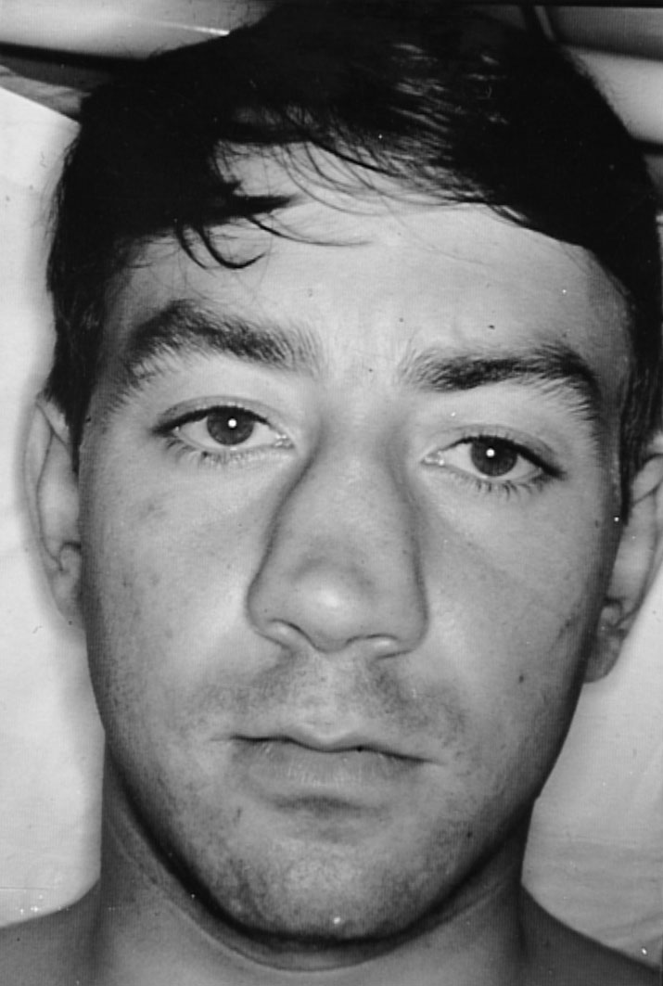
Nasal Injuries
Nasal Fractures and Chondral Separation
Cause of Injury
Direct blow
Signs of Injury
Separation of frontal processes of maxilla, separation of lateral cartilage or combination
Profuse bleeding and hemorrhaging, immediate swelling and deformity

Slide 37
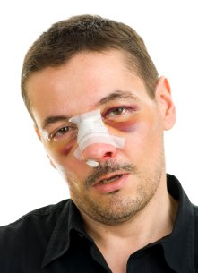
Care
Control bleeding and refer to a physician for X-ray,examination and reduction
Uncomplicated and simple fractures will pose little problem for the athlete’s quick return
Splinting may be necessary

Slide 38
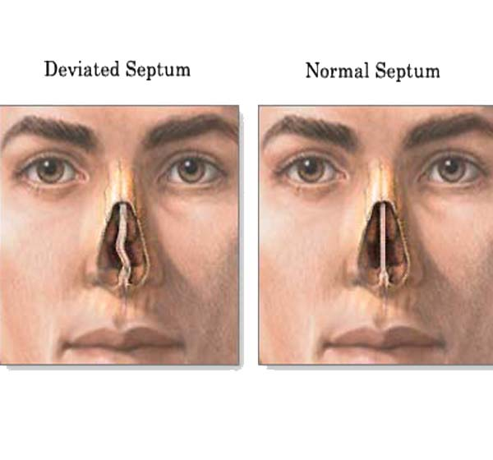
Deviated Septum
Cause of Injury
Compression or lateral trauma
Signs of Injury
Bleeding and in some instances a septal hematoma
Athlete will complain of nasal pain
Care
At the site of the hematoma, compression will be required (and if present, drained immediately)
Following drainage, a wick is inserted to allow for further drainage
Packing will be necessary to prevent a return of the hematoma
A neglected hematoma will result in formation of an abscess along with bone and cartilage loss and deformity

Slide 39
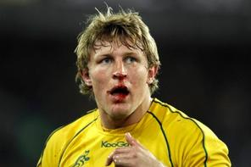
Nosebleed (epistaxis)
Cause of Injury
Result of a direct blow, a sinus infection, high humidity, allergies, a foreign body or some other serious facial injury
Signs of Injury
Generally bleeding from the anterior aspect of the septum
Generally presents with minimal bleeding and resolves spontaneously
More severe bleeding may require more medical attention

Slide 40
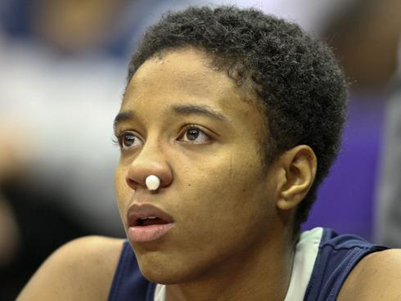
Care
W/ acute bleeding, sit upright w/ a cold compress over the nose, pressure on the affected nostril and the ipsilateral carotid artery
Also gauze between the upper lip and gum - limits blood supply
If bleeding does not cease in 5 minutes, a gauze/cotton nose plug to encourage clotting should be utilized
After bleeding has ceased, the athlete can return to play but should be reminded not to blow the nose under any circumstances for at least 2 hours after the initial insult

Slide 41
Anatomy of the Ear

Slide 42
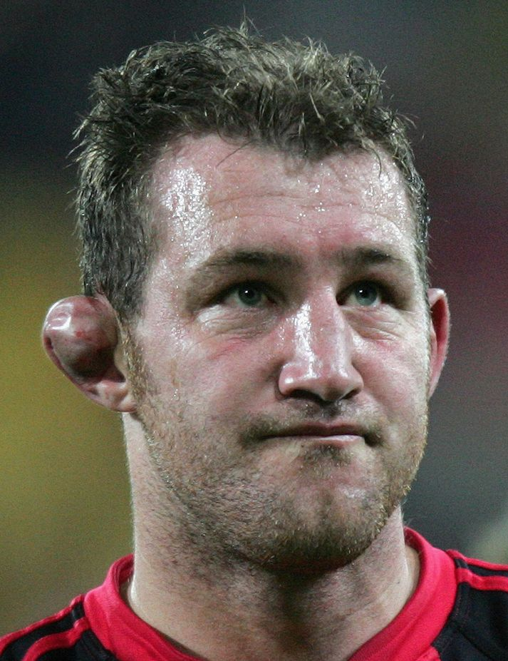
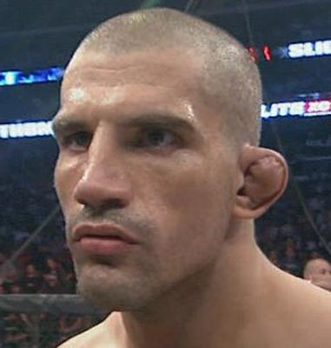
Recognition and Management of Specific Ear Injuries
Auricular Hematoma (Cauliflower Ear)
Cause of Injury
Occurs either from compression or shear injury to the ear (single or repeated)
Causes subcutaneous bleeding

Slide 43
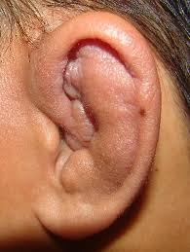
Auricular Hematoma (Cauliflower Ear)
Signs of Injury
Tearing of overlying tissue away from cartilage
Hemorrhaging and fluid accumulation
If unattended - coagulation, organization and fibrosis occurs
Appears as elevated, white, rounded nodular formation, that is firm and resembles cauliflower
Care
To prevent, wear proper ear protection
Cold application will minimize hemorrhaging
If swelling occurs, measures must be taken to prevent fluid solidification
Physician aspiration, packing, pressure, keloid removal if necessary

Slide 44
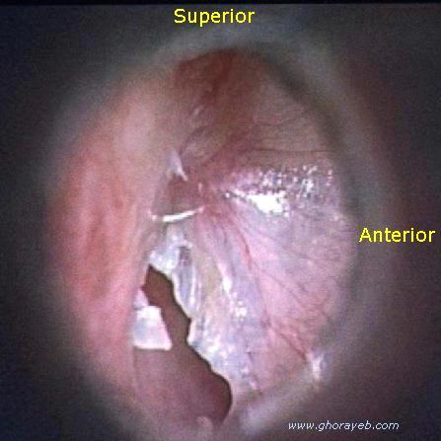
Rupture of the Tympanic Membrane
Cause of Injury
Fall or slap to the unprotected ear or sudden underwater variation can result in a rupture
Signs of Injury
Complaint of loud pop, followed by pain in ear, nausea, vomiting, and dizziness
Hearing loss, visible rupture (seen through otoscope)
Care
Small to moderate perforations usually heal spontaneously in 1-2 weeks
Infection can occur and must be continually monitored
Should not fly until condition is resolved

Slide 45
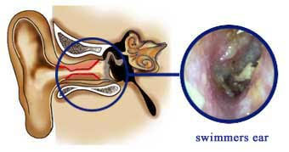
Swimmer’s Ear (Otitis Externa)
Cause of Injury
Infection of the ear canal caused be a gram-negative bacillus
Water becomes trapped by a cyst, bone growths, earwax plugs or swelling caused by allergies
Signs of Injury
Pain and dizziness, itching, discharge and even partial hearing loss
Care
Prevent by drying ear with a soft towel, use ear drops with boric acid and alcohol before and after swimming
Avoid things that might cause infection, overexposure to cold wind or sticking foreign objects into the ear
Physician referral will be necessary for antibiotics, acidification of the environment to kill bacteria and to rule out tympanic membrane rupture

Slide 46
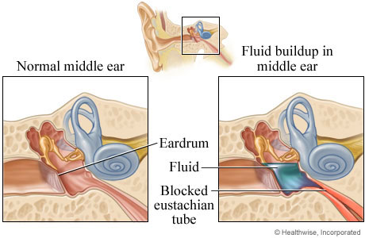
Middle Ear Infection (Otitis Media)
Cause of Injury
Accumulation of fluid in the middle ear caused by local and systemic infection and inflammation
Signs of Injury
Intense pain in the ear, fluid drainage from the ear canal, transient hearing loss
Systemic infection may also cause a fever, headaches, irritability, loss of appetite, and nausea
Care
Fluid withdrawal may be necessary to determine the appropriate antibiotics
Analgesics for pain
Generally resolves in 24 hours while pain may last for 72 hours

Slide 47
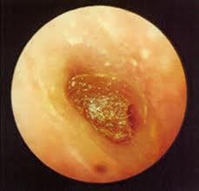
Impacted Cerumen
Cause of Condition
Excessive wax may accumulate, clogging the ear canal
Signs of Condition
Degree of muffled hearing or hearing loss
Generally little or no pain because no infection is involved
Care
Initial attempts should be made to irrigate the canal with warm water
Do not try to remove with cotton swab, as it may increase the degree of impaction
May require physician removal with a curette

Slide 48
Anatomy of Eye

Slide 49
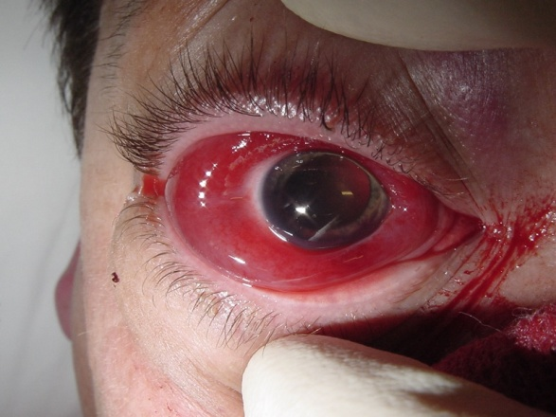
Recognition and Management of Specific Eye Injuries
Orbital Hematoma (Black Eye)
Cause of Injury
Blow to the area surrounding the eye which results in capillary bleeding
Signs of Injury
Signs of a more serious condition may be displayed as a subconjunctival hemorrhage
Swelling and discoloration
Care
Cold application for at least 30 minutes, 24 hours of rest if athlete has distorted vision
Do not blow nose after acute eye injury – may increase hemorrhaging

Slide 50
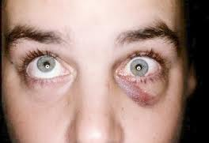
Orbital Fracture
Cause of Injury
Blow to the eyeball forcing it posteriorly, compressing the orbital fat until a blowout rupture occurs to the floor of the orbit (muscle and fat can herniate)
Signs of Injury
Diplopia, restricted eye movement, downward displacement of the eye, soft-tissue swelling and hemorrhaging
Numbness associated with infraorbital nerve on the floor of the orbit
Care
X-ray will be necessary to confirm fracture
Antibiotics to decrease risk of infection (due to proximity of maxillary sinus and bacteria)
Treat surgically or allow to resolve spontaneously

Slide 51
Foreign Body in the Eye
Signs of Injury
Foreign object produces considerable pain, and disability
No attempt should be made to remove by rubbing or via fingers
Care
Close eye and determine location (upper or lower lid)
Pull upper lid over lower lid to cause tearing
Utilize sterile swab to retrieve object
Wash eye with saline; use petroleum jelly to relieve soreness
If object is embedded, close and patch eye and refer to a physician

Slide 53
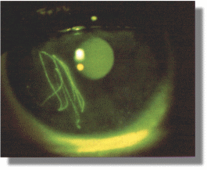
Corneal Abrasions
Cause of Injury
Athlete attempts to remove foreign object from eye by rubbing - cornea becomes abraded
Signs of Injury
Severe pain, watering of the eye, photophobia, and spasm of the orbicular muscle of the eyelid
Care
Patch eye and refer to a physician
Antibiotic ointment is applied with a semi-pressure patch over the closed eyelid (prescribed by physician)

Slide 54
Corneal Abrasion

Slide 55
Hyphema
Cause of Injury
Blunt blow to the eye
Major eye injury that can lead to serious problems with the lens, choroid or retina
Signs of Injury
Causes collection of blood to collect in anterior chamber of the eye
Visible reddish tinge in anterior chamber (blood may turn pea green)
Vision is partially of completely blocked

Slide 56
Care
Refer to physician
Bed rest and elevation (30-40 degrees); both eyes patched; sedation; and medication to reduce anterior chamber pressure
Occasionally additional bleeding will occur
Insert 22-17

Slide 57
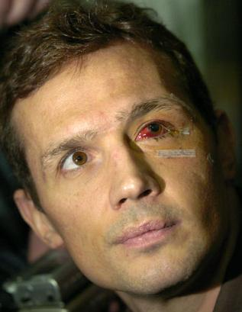
http://www.youtube.com/watch?v=JuKce4hLB7U

Slide 58
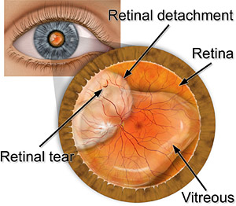
Retinal Detachment
Cause of Injury
Blow to the eye can partially or completely separate the retina from the underlying retinal pigment epithelium
Signs of Injury
Painless, however, early signs include specks floating before the eye, flashes of light, or blurred vision
As it progresses, “curtain falling” over the field of vision occurs
Care
Immediate referral to an ophthalmologist
Bed rest, patches for both eyes

Slide 59
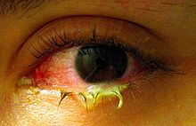
Acute Conjunctivitis (pink eye)
Cause of Injury
Caused by bacteria or allergens
Conjunctival irritation caused by wind, dust, smoke, or air pollution
Associated with common cold or upper respiratory conditions
Signs of Injury
Eyelid swelling w/ purulent discharge; itching associated with an allergy; burning or itching
Care
Highly infectious
Refer to physician for treatment

Slide 60
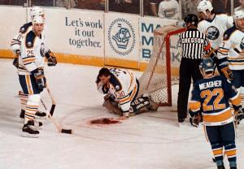
Throat Injuries
Contusions
Cause of Injury
Direct blow (clothes-lining)
Could result in trauma to the carotid artery (clotting), impacting blood flow to the brain (serious injury could result)
Signs of Injury
Severe pain w/ spasmodic coughing, speaking w/ a hoarse voice, and complaining of difficulty with swallowing
Fractured cartilage may be indicative of an inability to breathe and expectoration of frothy blood; cyanosis may be present

Slide 61
Contusions (continued)
Care
Airway integrity - first
If breathing is compromised, referral to the the emergency room is necessary
Most situations will require intermittent cold application
Severe neck contusion may require stabilization w/ a well-padded collar

