Slide 1
Chapter 14: The Foot

Slide 3
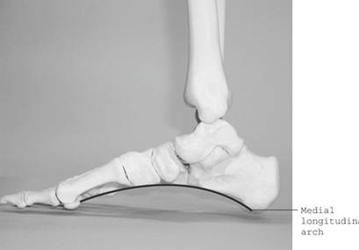
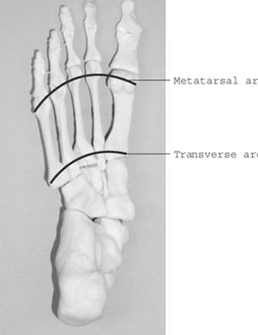
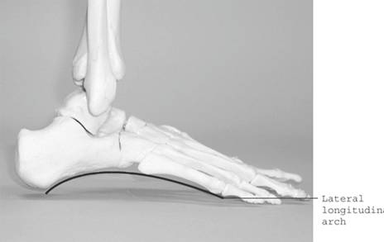
Arches of the Foot

Slide 4
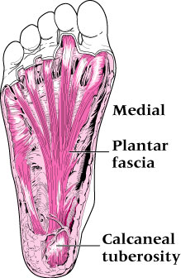
Plantar Fascia

Slide 5
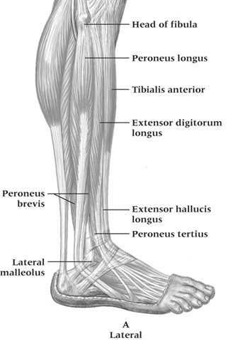
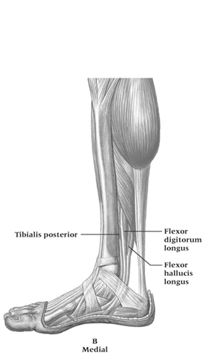
Muscles of the Foot and Lower Leg

Slide 6
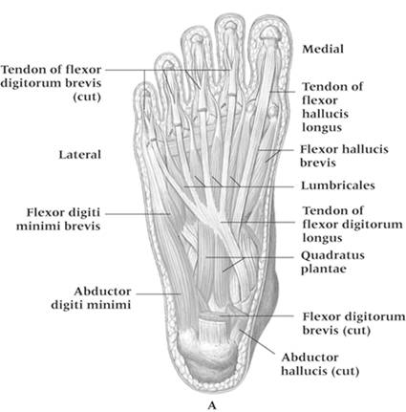

Slide 8
Prevention of Foot Injuries
Highly vulnerable area to variety of injuries
Injuries best prevented by selecting appropriate footwear, correcting biomechanical structural deficiencies through orthotics
Foot will adapt to training surfaces over time
Must be aware of potential difficulties associated with non-yielding and absorbent training surfaces

Slide 9
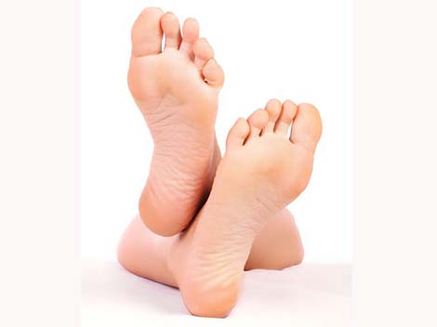
Foot Assessment
Athletes should be referred to qualified personnel for injury evaluation
History
Generic history questions
Questions specific to the foot
Location of pain - heel, foot, toes, arches?
Training surfaces or changes in footwear?
Changes in training, volume or type?
Does footwear increase discomfort?

Slide 10
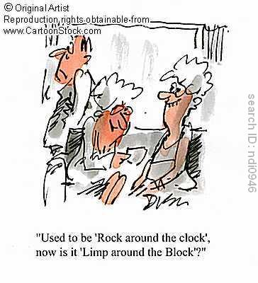
Observations
Does athlete favor a foot, limp, or is unable to bear weight?
Does foot color change w/ weight bearing?
Is there pes planus/cavus?
How is foot alignment?
Structural deformities?
What does wear pattern look like on the sole of the shoe?
Is the wear symmetrical?

Slide 11
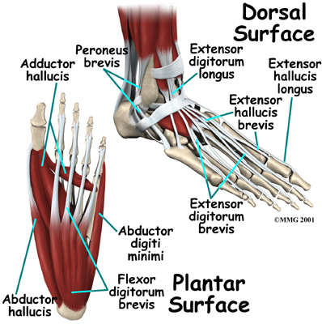
Palpation
Should assess the bony anatomy first
Checking for deformities and areas of tenderness
Assessment of soft tissue (muscles and tendons) will allow for detection of point tenderness, swelling, muscle spasm or muscle guarding
Circulation must also be monitored using the dorsal pedal pulse
Located on anterior surface of ankle and foot

Slide 12
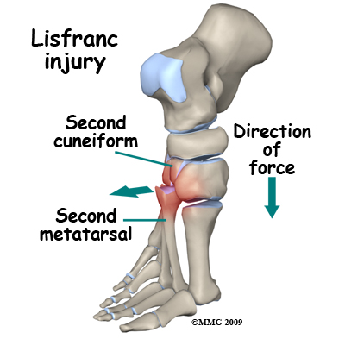
Recognition and Management of Specific Injuries
Foot problems are associated with improper footwear, poor hygiene, anatomical structural deviations or abnormal stresses
Sports place exceptional stress on feet
ATC’s must be aware of potential problems and be capable of identifying, ameliorating or preventing them

Slide 13
Retrocalcaneal Bursitis (Pump Bump)
Cause of Injury
Caused by inflammation of bursa beneath Achilles tendon
Result of pressure and rubbing of shoe heel counter of a shoe
Chronic condition that develops over time and may take extensive time to resolve, exostosis (pump bump) may develop
Must differentiate from Sever’s disease (Osgood Schlatters of the ankle)

Slide 14
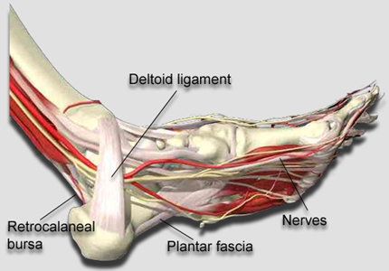
Sign and Symptoms
Signs of inflammation
Tender, palpable bump on calcaneous
Pain w/ palpation superior and anterior to Achilles insertion, swelling on both sides of the heel cord
Care
Routine stretching of Achilles, heel lifts to reduce stress, donut pad to reduce pressure
Select different footwear that results in increasing or decreasing height of heel counter.

Slide 15
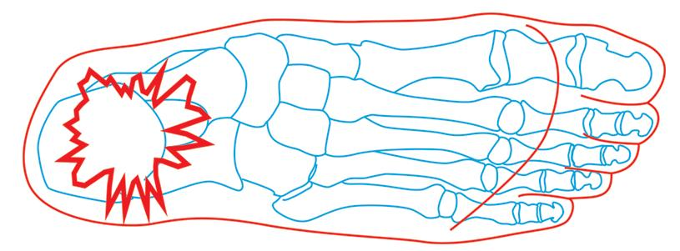
Heel Bruise
Cause of Injury
Caused by sudden starts, stops or changes of direction, irritation of fat pad
Signs of Injury
Severe pain in heel and is unable to withstand stress of weight bearing
May progress to chronic inflammation of bone covering
Care
Reduce weight bearing for 24 hours, RICE and NSAID’s
Resume activity with heel cup or doughnut pad after pain has subsided (be sure to wear shock absorbent shoes)
Applying tape can also be effective in generating a “heel cup”

Slide 16
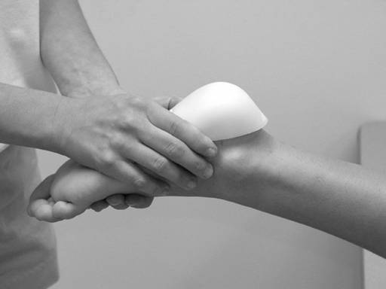

Slide 17
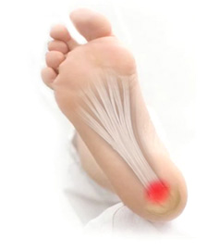
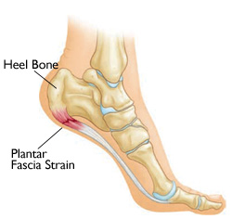
Plantar Fasciitis
Cause of Condition
Increased stress on fascia
Change from rigid supportive footwear to flexible footwear
Poor running technique
Leg length discrepancy, excessive pronation, inflexible longitudinal arch, tight gastroc-soleus complex
Running on soft surfaces, shoes with poor support
Sign and Symptoms
Pain in anterior medial heel, along medial longitudinal arch
Increased pain in morning, loosens after first few steps, pain with forefoot dorsiflexion

Slide 18
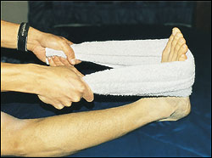
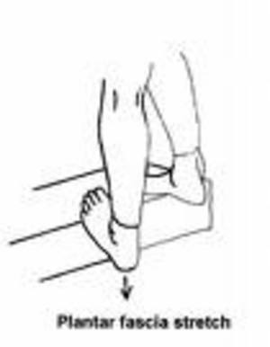
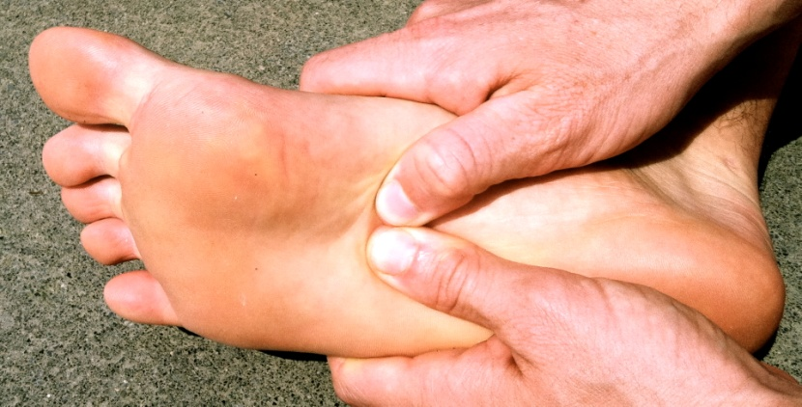
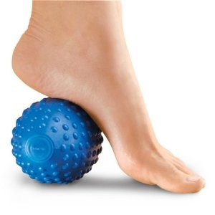
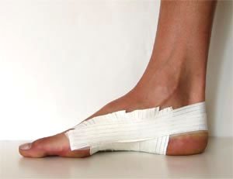
Care
Extended treatment (8-12 weeks) is required
Orthotic therapy is very useful (soft orthotic with deep heel cup)
Simple arch taping, use of a night splint to stretch
Vigorous heel cord stretching and exercises that increase great toe dorsiflexion
NSAID’s and occasionally steroidal injection

Slide 19
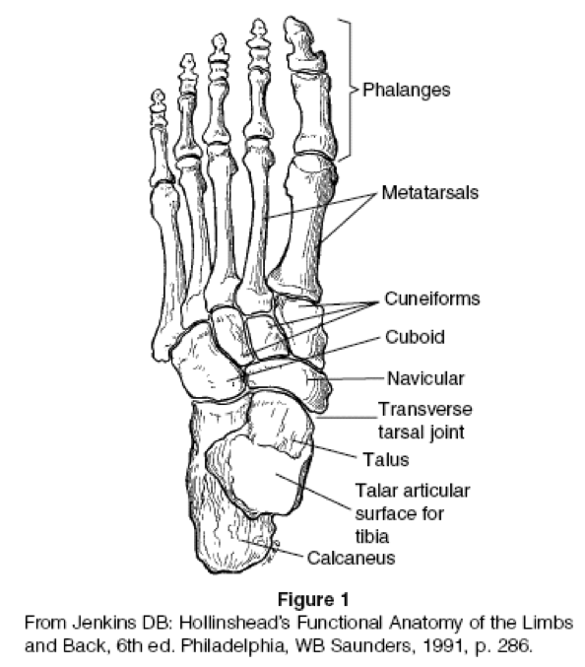
Metatarsal Fractures
Cause of Injury
Direct force or by placing torsional/twisting stresses on bone
Signs of Injury
Difficult to distinguish fracture from sprain in this case
Generally present with swelling, pain, point tenderness and possible deformity
X-ray will be necessary to distinguish fx from sprain
Care
Symptomatic
RICE for swelling
Short leg walking cast once swelling subsides (3-6 weeks)

Slide 20
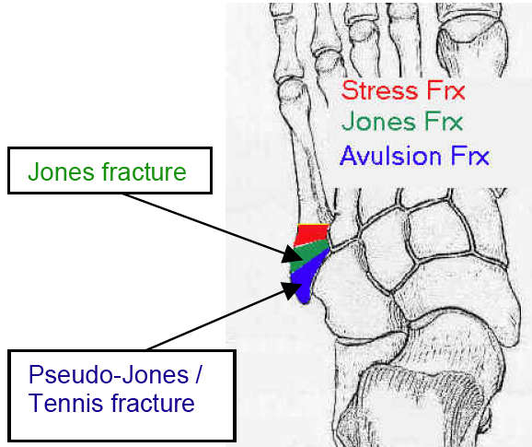
Jones Fracture
Cause of Injury
Fracture of metatarsal caused by inversion or high velocity rotational forces
Most common = base of 5th metatarsal
Sign of Injury
Immediate swelling, pain over 5th metatarsal
May feel a “pop”
High nonunion rate and course of healing is unpredictable
Care
Generally requires 6-8 weeks non-weight bearing with short leg cast if non-displaced
If nonunion occurs, internal fixation may be required

Slide 21
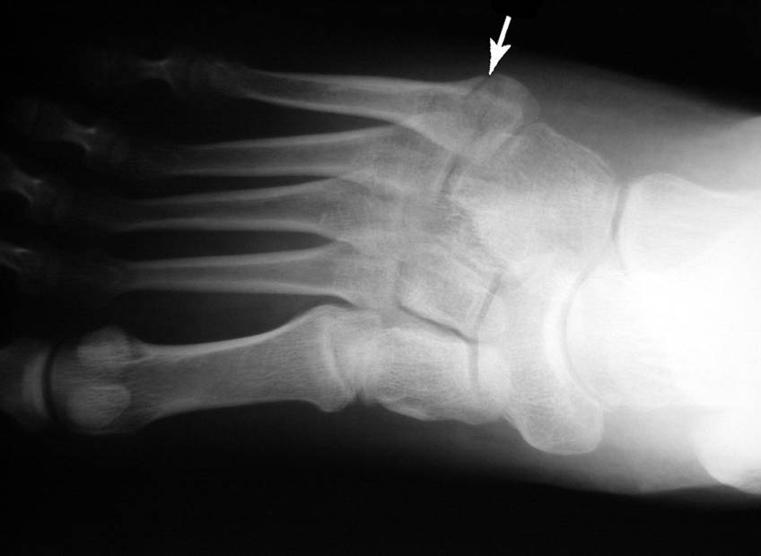

Slide 22
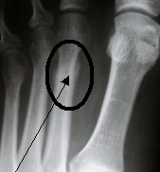
Metatarsal Stress Fractures
Cause of Injury
2nd metatarsal fracture (March fracture)
Why do you think it is called a March fracture?
Change in running pattern, mileage, hills, or hard surfaces
Often the result of structural deformities of the foot or training errors (terrain, footwear, surfaces)
Often associated with Morton’s toe
Signs of Injury
Pain and tenderness along second metatarsal
Pain with running and walking
Continued pain/aching when non-weight bearing

Slide 23
Care
Determine cause of injury
Generally good success with modified rest and training modifications (pool running, stationary bike) for 2-4 weeks
Return to running should be gradual over a 2-3 week period with appropriate shoes

Slide 24
Metatarsal Stress Fracture

Slide 25
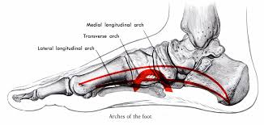
Metatarsal Arch Strain
Cause of Injury
Hypermobility of metatarsals caused by laxity in ligaments – results in excessive splay of foot
Will appear to have fallen arch
Signs of Injury
Pain or cramping in metatarsal region
Point tenderness (metatarsalgia), weakness
Heavy callus may form in area of pain
Care
Pad to elevate metatarsals just behind ball of foot
Strengthening of foot muscles and heel cord stretching

Slide 26
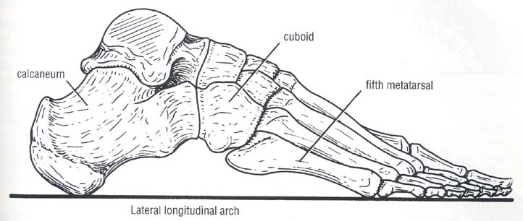
Longitudinal Arch Strain
Cause of Injury
Result of increased stress on arch of foot
Flattening of foot during midsupport phase causing strain on arch (appear suddenly or develop slowly
Sign of Injury
Pain with running and jumping, usually below posterior tibialis tendon, accompanied by pain and swelling
May also be associated with sprained calcaneonavicular ligament and flexor hallucis longus strain
Care
Immediate care, RICE, reduction of weight bearing.
Weight bearing must be pain free
Arch taping may be used to allow pain free walking

Slide 28
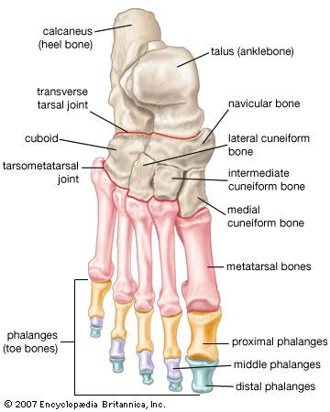
Fractures and Dislocations of the Phalanges
Cause of Injury
Kicking un-yielding object, stubbing toe, being stepped on
Signs of Injury
Immediate and intense pain
Swelling and discoloration
Obvious deformity with dislocation
Care
Dislocations should be reduced by a physician
Casting may occur with great toe or stiff soled shoe
Buddy taping is generally sufficient
Shoe with larger toe box may be necessary

Slide 30
Bunion (Hallux Valgus Deformity)
Cause of Injury
Exostosis of 1st metatarsal head; associated with forefoot varus; shoes that are too narrow, pointed or short
Bursa becomes inflamed and thickens, enlarging joint, and causing lateral malalignment of great toe
Sign of Injury
Tenderness, swelling, and enlargement of joint initially
As inflammation continues, angulation increases causing painful ambulation

Slide 31
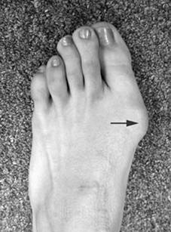
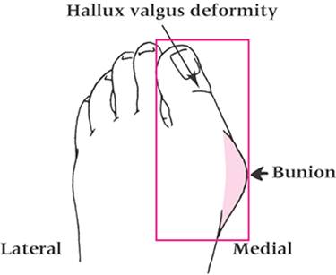
Care
Wear correct fitting shoes, appropriate orthotics, pad over 1st metatarsal head, tape splint between 1st and 2nd toe
Surgery may be required during later stages of condition
http://www.youtube.com/watch?v=b8uzqdmlqKw

Slide 32
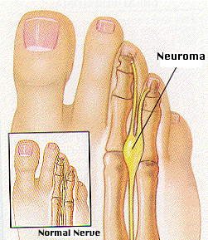
Morton’s Neuroma
Cause of Condition
Thickening of nerve sheath (common plantar nerve) at point where nerve divides into digital branches
Commonly occurs between 3rd and 4th met heads where medial and lateral plantar nerves come together
Signs of Condition
Burning paresthesia and severe intermittent pain in forefoot
Pain relieved with non-weight bearing
Toe hyperextension increases symptoms

Slide 34
Care
Teardrop pad can be placed between met heads to increase space, decreasing pressure on neuroma
Shoes with wider toe box would be appropriate

Slide 35
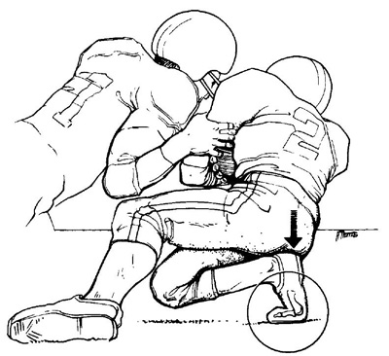
Turf Toe
Cause of Injury
Hyperextension injury resulting in sprain of 1st metatarsophalangeal joint
May be the result of single or repetitive trauma
Signs and Symptoms
Pain and swelling which increases during push off in walking, running, and jumping
Care
Increase rigidity of forefoot region in shoe
Taping the toe to prevent dorsiflexion
Rest and discourage activity until pain free
3-4 weeks may be required for pain to subside

Slide 37
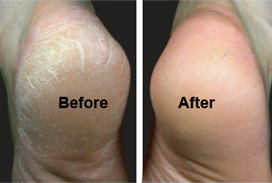
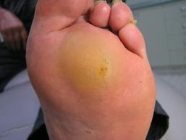
Calluses
Cause of Condition
Develop from friction – may be painful as fatty layer loses elasticity and cushioning effect
May be vulnerable to tears and cracks and possible blister development underneath
Care
Emery callus file may be necessary
Massaging with small amounts of lotion may be helpful
Sanding or pumicing – care must be exercised
Can be prevented
Shoes that fit appropriately are recommended
Wear at least one layer of socks
Apply petroleum jelly to reduce friction

Slide 38
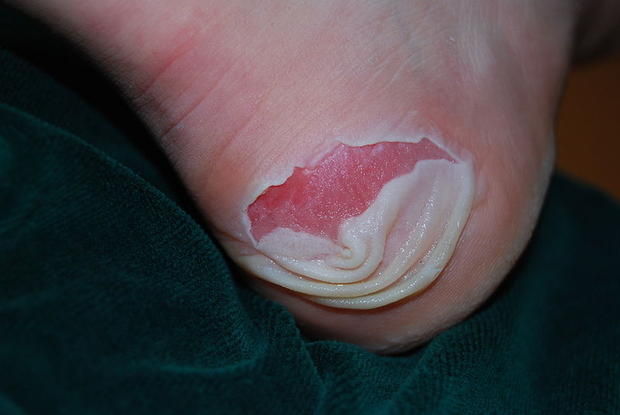
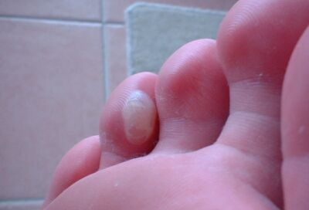
Blisters
Cause of Injury
Shearing forces on skin – results in development of fluid accumulation between layers of skin
Wearing appropriate footwear (socks and shoes) and applying lubricants may help to reduce friction
Care
Take action to reduce friction (apply lubricants, cover with tape/band aid/donut pad)
Avoid puncturing in order to prevent infection
Puncturing may be necessary if pressure build-up is to great and is causing excessive pain

Slide 39
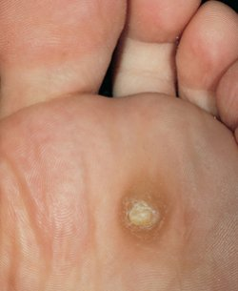
Corns
Cause of Condition
Result of pressure from improperly fitting shoes
Hard corns are often associated with hammer toes
Soft corns result from wearing narrow shoes and excessive foot perspiration
Signs of Condition
Form between 4th and 5th toes
Circular area of thickened, white macerated skin
Care
For soft corns – good fitting shoes are necessary in conjunction with good foot hygiene
Use of padding or cotton to separate toes is helpful
Soaking in warm soapy water will also aid in softening of corns

Slide 40
Ingrown Toenails
Cause of Condition
Leading edge of nail grows into nearby soft tissue
Care
Shoes should be appropriate width and length
Prevent with correct trimming of nails
Nail should be left sufficiently long and not cut so as to allow penetration into soft tissue
Should be cut short enough that it is not irritated by shoes or socks
Treatment may require soaking and packing toenail with cotton in order to lift nail away from soft tissue
Cutting a “V” notch toward the infected side will allow the nail to grow towards the middle

Slide 42
Subungual Hematoma
Cause of Injury
Direct pressure, dropping an object on toe, kicking another object
Repetitive shear forces on toenail
Signs of Injury
Accumulation of blood underneath toenail
Likely to produce extreme pain and ultimately loss of nail
Care
RICE immediately to reduce pain and swelling
Relieve pressure within 12-24 hours (lance or drill nail) – must be sterile to prevent infection

