Slide 1
The History of Health Care

Slide 2
Ancient Times
Prevention of injury from predators
Illness/disease caused by supernatural spirits

Slide 3

Ancient Times
Herbs and plants were used as medicine
examples:
  Digitalis from foxglove plants
    Then, leaves were chewed to strengthen & slow heart
    Now, administered by pills, IV, or injections

Slide 4

Ancient Times
Herbs and plants were used as medicine
examples:
  Quinine from bark of cinchona tree
    Controls fever and muscle spasms
    Used to treat malaria

Slide 5
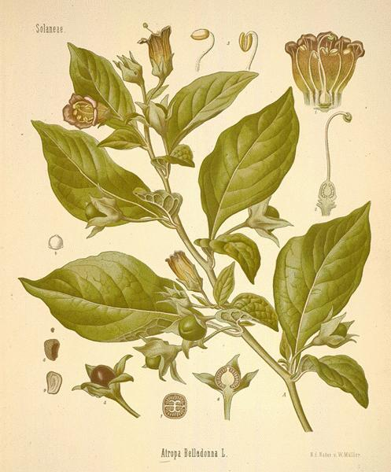
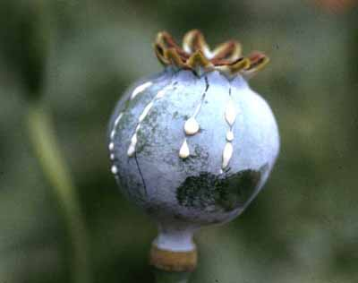
Ancient Times
Herbs and plants were used as medicine
examples:
  Belladonna and atropine from poisonous nightshade plant
    relieves muscle spasms especially GI
  Morphine from opium poppy
    relieves severe pain

Slide 6
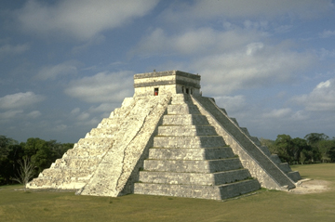
Egyptians
Earliest to keep accurate health records
Superstitious
Called upon gods
Identified certain
diseases
Pharaohs kept many
specialists

Slide 7
Egyptians
Priests were the doctors
  Temples were places of worship, medical schools, and hospitals
  Only the priests could read the medical knowledge from the god Thoth

Slide 8
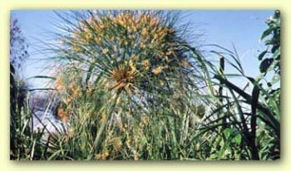
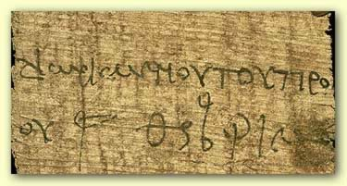
Egyptians
Magicians were also healers
Believed demons caused disease
Prescriptions were written on papyrus

Slide 9
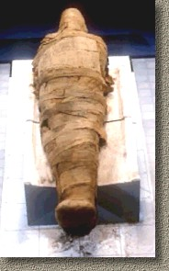
Egyptians
Embalming
  Done by special priests
    (NOT the doctor priests)
  Advanced the knowledge of anatomy
  Strong antiseptics used to prevent decay
  Gauze similar to today’s surgical gauze

Slide 10
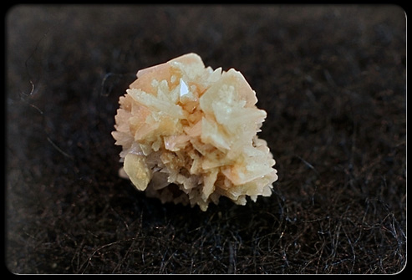
Egyptians
Research on mummies has revealed the existence of diseases
  Arthritis
  Kidney stones
  Arteriosclerosis

Slide 11
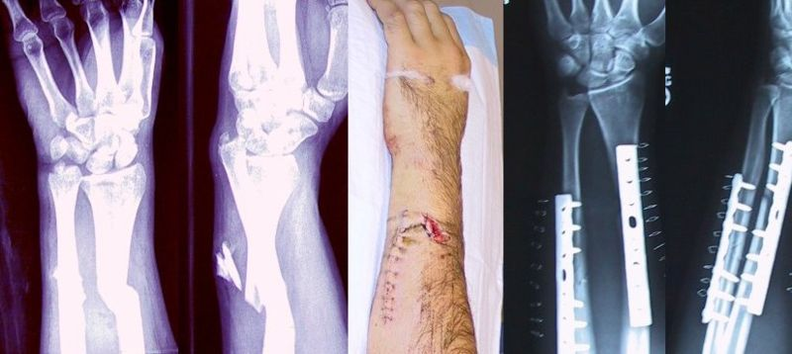
Egyptians
Some medical practices still used today
  Enemas
  Circumcision (4000 BC) preceded marriage
  Closing wounds
  Setting fractures

Slide 12
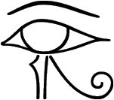
Egyptians
Eye of Horus
  5000 years ago
  Magic eye
  amulet to guard against disease, suffering, and evil
  History: Horus lost vision in attack by Seth; mother (Isis) called on Thoth for help; eye restored
  Evolved into modern day R_{x} sign

Slide 13
Jewish Medicine
Avoided medical practice
Concentrated on health rules concerning food, cleanliness, and quarantine
Moses: pre-Hippocratic medical practice
  banned quackery (God was the only physician)
  enforced Day of Rest

Slide 14
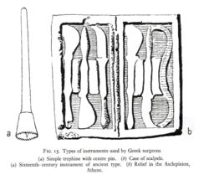
Greek Medicine
First to study causes of diseases
Research helped eliminate superstitions
Sanitary practices were associated with the spread of disease

Slide 15
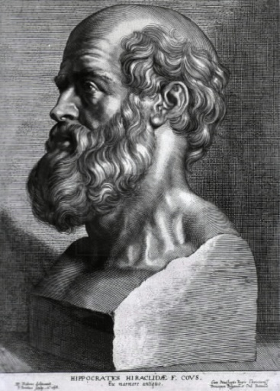
Greek Medicine
Hippocrates
  no dissection, only observations
  took careful notes of signs/symptoms of diseases
  disease was not caused by supernatural forces
Father of Medicine
  wrote standards of ethics which is the basis for today’s medical ethics
  (Invented toothpaste)

Slide 16
Greek Medicine
Aesculapius
  staff and serpent symbol of medicine
  temples built in his honor because the first true clinics and hospitals

Slide 17
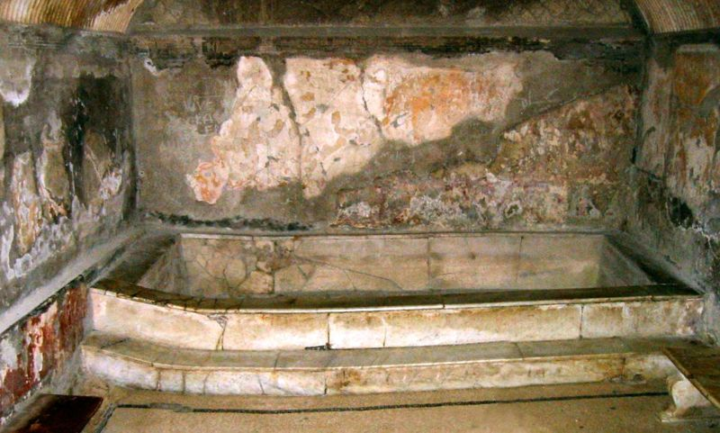
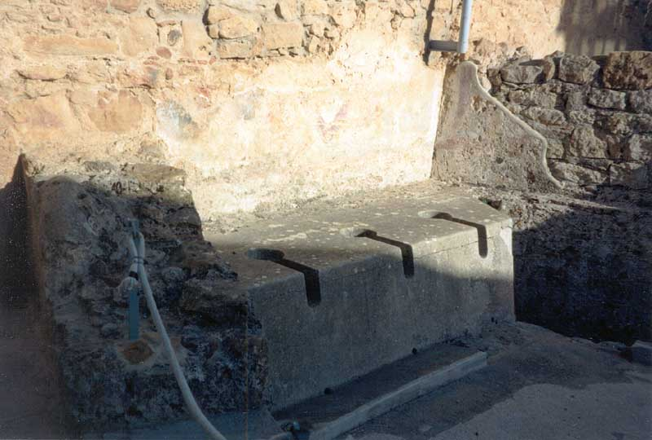
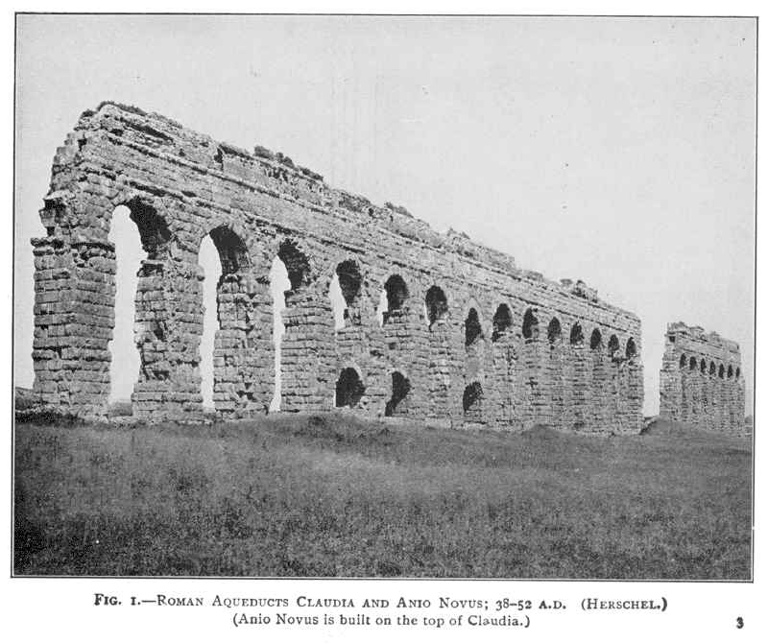
Roman Medicine
Learned from the Greeks and developed a sanitation system
  Aqueducts and
    sewers
  Public baths
Beginning of public health

Slide 18
Roman Medicine
First to organize medical care
Army medicine
Room in doctors’ house became first hospital
Public hygiene
  flood control
  solid construction of homes

Slide 19
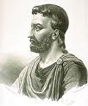
Roman Medicine
Aulus Cornelius Celsus is considered one of the most important contributors to medicine and scientific thought during the Roman Empire, and the most important source of present-day knowledge of Alexandrian medicine. Although apparently not a physician himself, Celsus gathered extensive writings from the Greek Empire, translated them into Roman, and compiled their vast knowledge intoan encyclopedia entitled De artibus (A.D. 25-35).
Considered the 1st dental surgeon “Keeper of the Teeth”

Slide 20

Dark Ages (400-800 A.D.) and
Middle Ages (800-1400 A.D.)
Medicine practiced only in convents and monasteries
custodial care
life and death in God’s hands

Slide 21
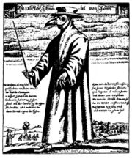
Dark Ages (400-800 A.D.) and
Middle Ages (800-1400 A.D.)
Terrible epidemics
  Bubonic plague (Black Death)
  Small pox
  Diphtheria
  Syphilis
  Measles
  Typhonid fever
  Tuberculosis

Slide 22

Dark Ages (400 –800 A.D.) and Middle Ages (800-1400 A. D.)
Crusaders spread disease
Cities became common
Special officers to deal with sanitary problems
Realization that diseases are contagious
Quarantine laws passed

Slide 23
Renaissance Medicine
(1350-1650 A.D.)
Universities and medical schools for research
Dissection
Book publishing

Slide 24
16th & 17th Century
Leonardo da Vinci
  anatomy of the body
Anton van Leeuwekhoek (1676)
  invented microscope
  observed microorganisms

Slide 25
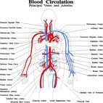
16th & 17th Century
William Harvey
  circulation of blood
Gabriele Fallopian
  discovered fallopian tube
Bartholomew Eustachus
  discovered the eustachian tube
Some quackery still going on

Slide 26
18th Century
Edward Jenner 1796
  smallpox vaccination
Joseph Priestly
  discovered oxygen

Slide 27
18th Century
Benjamin Franklin
  invented bifocals
  found that colds could be passed from person to person
Laennec
  invented the stethoscope

Slide 28

19th & 20th Century
Inez Semmelweiss
  identified the cause of puerperal fever which led to the importance of hand washing
Louis Pasteur (1860 –1895)
  discovered that microorganisms cause disease (germ theory of communicable disease)

Slide 29
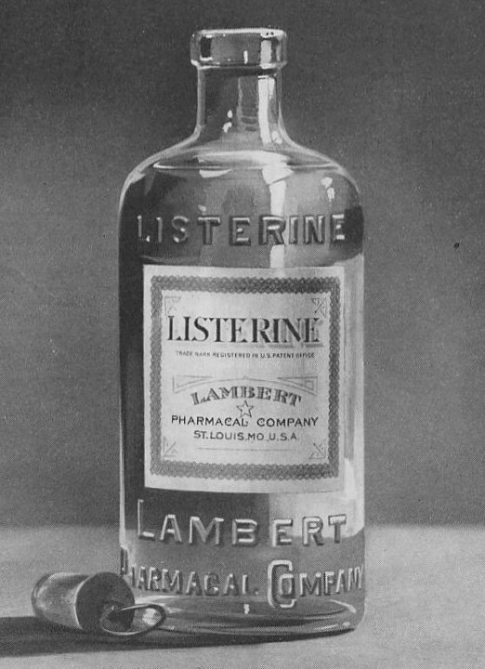
19th & 20th Century
Joseph Lister
  first doctor to use antiseptic during surgery
Ernest von Bergman
  developed asepsis (sterile)
Robert Koch
  Father of Microbiology
  identified germ causing TB (tuberculosis)

Slide 30
19th & 20th Century
Wilhelm Roentgen
  discovered X-rays
Paul Ehrlick
  discovered effect of medicine on disease causing microorganisms
Anesthesia discovered
  nitrous oxide, ether, chloroform

Slide 31
19th & 20th Century
Alexander Fleming
  discovered penicillin
Jonas Salk
  discovered that a killed polio virus would cause immunity to polio
Alfred Sabin
  discovered that a live virus provided more effective immunity

Slide 32
1900 to 1945
Acute infectious diseases (diphtheria, TB, rheumatic fever)
No antibiotics, DDT for mosquitoes, rest for TB, water sanitation to help stop spread of typhoid fever, diphtheria vaccination
Hospitals were places to die
Most doctors were general practitioners

Slide 33
1945 to 1975
Immunization common
antibiotic cures
safer surgery
Transplants
increased lifespan
chronic degenerative diseases

Slide 34
1945 to 1975
new health hazards
  obesity
  neuroses
  lung cancer
  hypertension
disintegrating families
greatly increasing medical costs

Slide 35
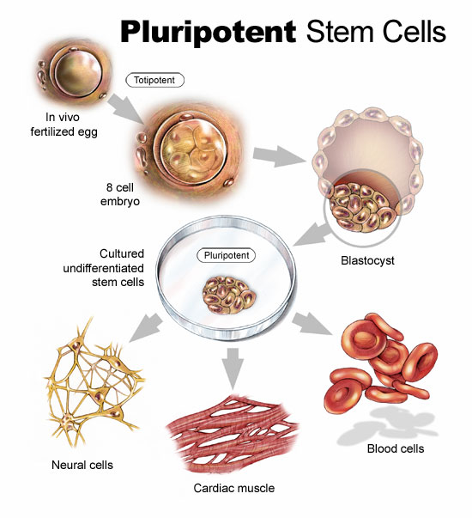
The 21st Century
Human genome project
Embryonic stem cell research
Threat of bioterrorism with the use biologic agents as weapons
Viruses that can cause pandemic (world-wide) epidemics
(continues)

Slide 36

The 21st Century
(continued)
World Health Organization (WHO) is dedicated to monitoring health problems
to prevent world wide epidemics
Countries are working together to promote global health awareness

Slide 37

Summary
Health care has seen many changes over
the centuries
The future may hold more dramatic ones

