Slide 1
Mental Illness
Refers to a group of psychiatric disorders characterized by severe disturbances in thought, mood, and behavior
Psychiatry is the medical specialty that diagnoses and prescribes medical treatment for mental illness.

Slide 2
Mental Illness (cont.)
Psychology is the discipline that studies normal and abnormal behavior and applies counseling methods to treat mental illness.

Slide 3
Mental Illness (cont.)
Mental illness affects one of every four Americans and is associated with social stigma, disability, and death. Many people suffering from mental illness may not look as though they are ill, while others may appear detached and withdrawn from society.

Slide 4
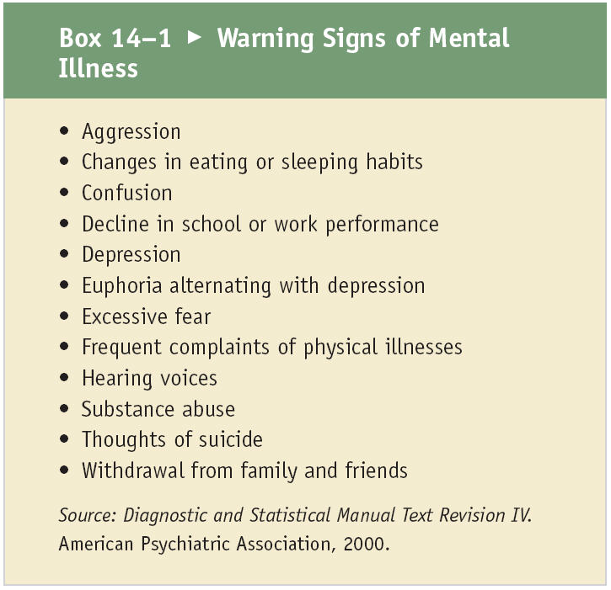
Box 14-1: Warning Signs of Mental Illness

Slide 5
Diagnostic and Statistical Manual of Mental Disorders (DSM)
Over 200 psychiatric diagnoses for adults and children are categorized
The DSM-IV is the most recent edition; it is used internationally to classify, assess, and guide treatment for mental illness.
Because it is difficult to provide a single definition that accounts for all mental illness, disorders are categorized in the DSM-IV according to groups of symptoms or diagnostic criteria.

Slide 6
Diagnostic and Statistical Manual of Mental Disorders (DSM) (cont.)
Psychiatric diagnoses are assigned 5 axes that address developmental, medical, psychosocial, and overall adaptive issues that contribute to the primary psychiatric diagnosis.
All DSM-IV diagnoses require evidence that the symptoms impair academic achievement, occupational performance, and social relationships.

Slide 7
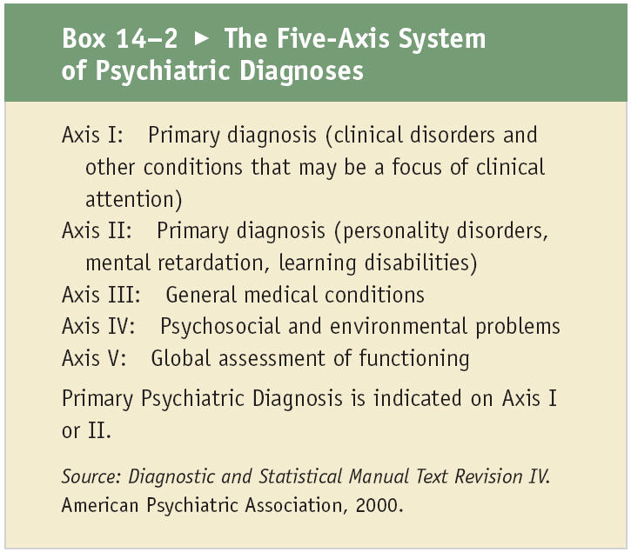
Box 14-2: The Five-Axis System of Psychiatric Diagnoses

Slide 8
Biological Basis for Mental Illness
Neurotransmitters that are implicated in mental illness
Anatomical differences, such as brain size and altered neural connections, develop from physical insults to the brain, degenerative processes, and genes.
Genes within the DNA are inherited from both parents, and contain all the necessary information to build the structures that mediate the specialized function of neurotransmitters.

Slide 9
Neurotransmitters
Produced, stored, and released from neurons or nerves cells within the central and peripheral nervous system
Voluntary and involuntary physical and psychological processes, such as heart rate and blood pressure, behavior, emotions, mood, sleep, and sex drive, are regulated by intricate neurotransmitter activity.

Slide 10
Neurotransmitters (cont.)
Inadequate regulation of neurotransmitters as well as excess neurotransmitter activity in distinct areas of the brain, is associated with mental illness.

Slide 11
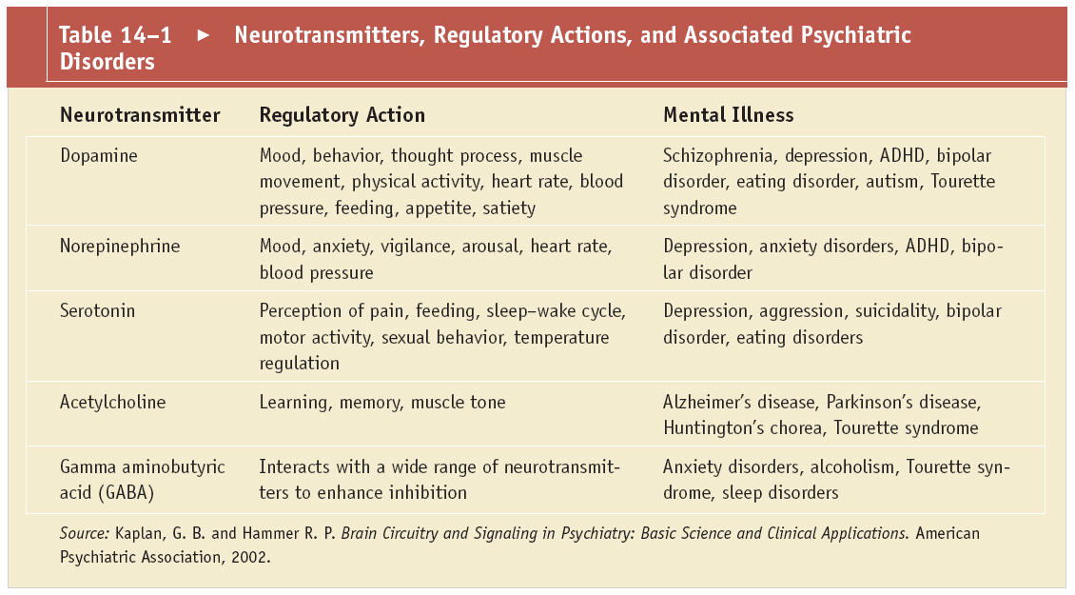
Table 14-1: Neurotransmitters, Regulatory Actions, and Associated Psychiatric
Disorders

Slide 12
Environment and Mental Illness
Family interactions, age, gender, race, culture, and socioeconomic status alter biological and psychological vulnerability for mental illness, and define learned behaviors, attitudes, and perception of health and illness.

Slide 13
Environment and Mental Illness (cont.)
Persons of different age groups and gender are at risk for differing mental health problems and illnesses.
  Mood disorders such as depression, anxiety disorders, and eating disorders occur more frequently in women, whereas disorders with externalizing behaviors such as antisocial personality disorder, and associated substance abuse are more common in males.

Slide 14
Environment and Mental Illness (cont.)
Persons of different age groups and gender are at risk for differing mental health problems and illnesses.
  Attention deficit hyperactivity disorder is a development behavioral disorder that appears more commonly in males prior to the age of seven years of age.
  Disorders involving memory and irritability, such as Alzheimer’s disease, and Huntington’s chorea are more evident with an aging population.

Slide 15
Environment and Mental Illness (cont.)
Access to medical care and acceptance of psychiatric illness is influenced by race, cultural beliefs, and socioeconomic status.
Mental illness affects all cultures, races, and socioeconomic classes. The highest rates of mental illness are found among the lowest social classes where adverse living circumstances increase social stress, and contribute to poor mental hygiene.

Slide 16
Mental Illness in Childhood
Can have far reaching academic, social, developmental, and physical consequences
Common complications of childhood onset mental illness include learning delays with school failure, low self esteem, impaired relationships with family and friends, social rejection, and withdrawal.

Slide 17
Mental Illness in Childhood (cont.)
Though many psychiatric disorders begin in childhood, many are not diagnosed until adulthood.
In the United States, about one in ten children and adolescents have a mental disorder. However, only about 20% of these children receive needed treatment.

Slide 18
Mental Illness in Childhood (cont.)
The outcome of childhood mental illness depends on the ability of the family to cope and seek treatment, the severity of the illness, and the ability of the child to compensate and adapt with mental health deficits.

Slide 19
Disruptive Behavior Disorders
Conduct disorder, and oppositional defiant disorder are characterized by willful disobedience.
  Conduct disorders affect males more often than females, and commonly overlap with other psychiatric disorders.
  Many of these children come from broken homes and are exposed to domestic violence, poverty, and shifting parental figures.

Slide 20
Disruptive Behavior Disorders (cont.)
Conduct disorder, and oppositional defiant disorder are characterized by willful disobedience. (cont.)
  Harsh parental discipline with physical punishment appears to lead to aggressive behavior, however genetic heritability of antisocial and aggressive behaviors have been identified.

Slide 21
Disruptive Behavior Disorders
(cont.)
Defiance of authority, fighting, school failure, and destruction of property are common indicators of conduct disorder.
During adolescence, fire setting, theft, sexual promiscuity, and criminal behaviors may develop.

Slide 22
Disruptive Behavior Disorders
(cont.)
The risk for disruptive behavior disorders increases with inconsistent parenting and punitive disciplinary techniques, parental alcohol and drug abuse, and parental antisocial personality disorder.

Slide 23
Attention Deficit Hyperactivity Disorder (ADHD)
A neurobiological condition characterized by prominent symptoms of inattention, and or hyperactivity and impulsivity.

Slide 24
Attention Deficit Hyperactivity Disorder (ADHD) (cont.)
ADHD affects males more often than females and persists into adolescence and adulthood. Family and twin studies provide evidence of genetic susceptibility, and molecular DNA studies implicate the role of genes in ADHD. Imaging techniques show anatomic and metabolic differences in ADHD subjects compared to non-ADHD subjects.

Slide 25
The DSM-IV Criteria for ADHD
Three subtypes of ADHD
  Predominantly inattentive subtype
    Children with the inattentive subtype tend to be described as “spacey,” socially withdrawn, and have fewer conduct and behavioral problems than the hyperactive-impulsive subtype
  Predominantly hyperactive-impulsive subtype
    Hyperactive ADHD children tend to run around excessively, fidget, and have difficulty playing or engaging in quiet activities.

Slide 26
The DSM-IV Criteria for ADHD (cont.)
Three subtypes of ADHD(cont.)
  Combined inattentive, hyperactive and impulsive subtype.
  Impulsivity in ADHD is characterized by the inability to wait turns, blurting out answers, and interrupting others.

Slide 27
ADHD Co-Morbidity and Treatment
Contrary to common belief, ADHD is not limited to childhood.
ADHD has a chronic lifelong course and, if untreated, results in school and work failure, substance use disorders, legal difficulties, car accidents and fatalities, and sexual indiscretions.

Slide 28
ADHD Co-Morbidity and Treatment (cont.)
ADHD commonly occurs with depressive disorders, anxiety disorders, conduct disorder, oppositional defiant disorder, and learning disorders.
The majority of children with ADHD are effectively treated with stimulant medications.

Slide 29
ADHD Co-Morbidity and Treatment (cont.)
Stimulant medications are the oldest and most established pharmacological agents in children with ADHD.
Behavior therapy can improve academic achievement, and reduce targeted conduct problems especially in children with a co-occurring conduct disorder.

Slide 30
Mental Retardation
Low intelligence, accompanied by deficits in social language skills, and adaptive functioning
Mental retardation is the result of psychosocial factors, biological factors, or a combination of the two.
Often the exact cause cannot be identified.
Parental intelligence, psychosocial involvement, material resources, and availability of social support services influence the course of mental retardation.

Slide 31
Autistic Disorder
Autistic disorders include deficits in reciprocal language and social interactions, with associated behavioral peculiarities such as repetitive stereotyped behaviors.
Autism may be apparent in infancy, however, in some patients the full disorder does not appear until after 3 years of age.

Slide 32
Autistic Disorder (cont.)
Causes of autism include illnesses that result in central nervous system dysfunction such as rubella, seizures, encephalitis, and toxins.
The concordance rate or occurrence of autism among identical twins is about 90%, and the rate of autism is higher in families with a history of language-related disorders.

Slide 33
Symptoms
Deficits in reciprocal social interactions
  Eye contact with caregivers and peers is minimal, language development is delayed, and disinterest in social interactions with peers is usually observed during the toddler years.
  When speech does develop, it usually is illogical, and echolike as words that are heard are repeated. Repetitive and stereotypic behaviors include odd posturing, hand flapping, self-injurious behavior, abnormal patterns of eating and drinking, and unpredictable mood changes.

Slide 34
Treatment of Autism
Multimodal treatment including medication, behavioral modification, occupational therapy, and speech therapy show significant improvement.
Parental guidance and assurance is critical for obtaining appropriate medical and psychosocial support.
Informed parents contribute to the child’s learning of self-care and adaptive skills, and long-term outcomes.

Slide 35
Tic Disorder
A tic is a sudden, rapid, involuntary stereotyped movement or vocalization that may be temporarily suppressed by conscious efforts.
All forms of tics are exacerbated by stress, anxiety, boredom, or fatigue, and typically decrease in severity while concentrating on an enjoyable task. Tics occur more commonly in boys than girls, and are presumed to result from a neurotransmitter imbalance.

Slide 36
Complications and Treatment of Tic Disorders
Include shame and impaired self-esteem that results from being teased and rejected by peers and adults
Severe symptoms may interfere with forming intimate friendships. The reported unemployment rate in adults with tics has been as high as 50%.

Slide 37
Complications and Treatment of Tic Disorders (cont.)
Transient tics usually do not require treatment. Complicated tic disorders require carefully titrated medication therapy.
Medication therapy is usually complicated by high rates of side effects, and difficultly in finding effective combinations of medications due to the disorder’s natural waxing and waning course.

Slide 38
Dementia
Degenerative syndrome characterized by deficits in memory, language, and mood
The most common form of dementia is Alzheimer’s disease which develops gradually and occurs most commonly after the age of 60 years.

Slide 39
Dementia (cont.)
Vascular dementia has a more abrupt onset and is caused by physical insults from high blood pressure, diabetes, and strokes. Poor nutrition, head injuries, with chronic alcohol intake may result in alcohol-related dementia.
Parkinson’s disease is a degenerative neurological movement disorder, characterized by dementia in late stages of the disease.

Slide 40
Alzheimer’s Disease
The earliest manifestation is loss of short-term memory.
Psychosis, aggression, and profound personality changes are associated with advanced disease.
With severe disease, judgment is lost, personal care is neglected, and physical illnesses ultimately may lead to death.

Slide 41
Alzheimer’s Disease (cont.)
Physical findings in Alzheimer’s disease include degeneration of neurons, and plaque formation on and around neurons.
Plaques or deposits of proteins build up around neurons and interrupt communication between neurons by neurotransmitters.
Abnormal collections of proteins form neurofibrilatory tangles that are detected by brain scans.

Slide 42
Alzheimer’s Disease (cont.)
Acetylcholine is the neurotransmitter that is most aggressively affected by Alzheimer’s disease.
Decreases in acetylcholine are correlated with memory loss.
Alterations in norepinephrine, GABA, and serotonin have been documented, and may play a role in mood, behavior, and aggression.

Slide 43
Risks for Alzheimer’s Disease
The two most significant risk factors for Alzheimer’s disease are advanced age and family history.
The prevalence of Alzheimer’s disease is 25–30% in the 85–90 year old population.
Mutations in chromosomes and inheritance of two copies of high-risk genes are associated with a greater risk for developing Alzheimer’s disease.

Slide 44
Treatment of Alzheimer’s Disease
Medications are used to slow the progression of Alzheimer’s disease and to treat symptoms of depression, aggression, and anxiety.
Medications that replace acetylcholine improve memory.

Slide 45
Treatment of Alzheimer’s Disease (cont.)
Antidepressants and antianxiety medications are prescribed to manage depression and anxiety.
Social support is needed to improve the quality of life, and maximize personal care.
Vitamin E may prevent the progression of Alzheimer’s disease by decreasing oxygen free radicals that accelerate cell death.

Slide 46
Substance Use Disorders
Drug and alcohol abuse and addiction
Drug abuse is a social problem with extensive emotional and economic consequences.
Individuals who abuse drugs and alcohol often make bad choices, harm their health and personal relationships, and place themselves or other people in danger.
Notes:
includes..
.

Slide 47
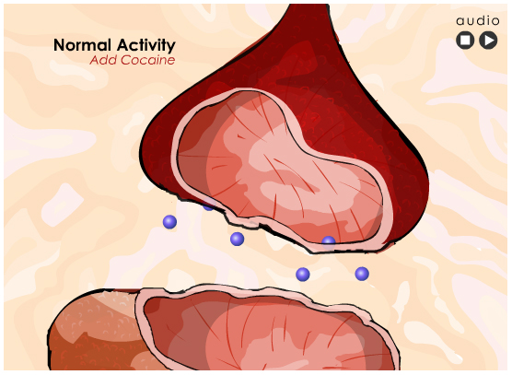
Click here to view an animation showing cocaine.
Return to Directory

Slide 48
Addiction
Informative and punitive measures such as “Drug Abuse Resistance Education” (D.A.R.E.) in schools and legal charges for driving under the influence are useful in reducing drug abuse.
Notes:
.

Slide 49
Addiction (cont.)
Despite interventions, the pleasurable effects of drugs and alcohol produce changes in the brain that ultimately lead to addiction, which is a chronic, compulsive, relapsing illness.
Notes:
.

Slide 50
Addiction (cont.)
Addicts cannot quit by themselves, and treatment is necessary to break the craving, social manipulation, and risky tactics the addict uses to obtain drugs or alcohol.
Notes:
.

Slide 51
Symptoms and Warning Signs
Initial pleasurable effects of the abused substance are replaced by strong physical and psychological cravings where greater amounts are needed to reproduce the same effect.

Slide 52
Symptoms and Warning Signs (cont.)
Core symptoms of drug and alcohol dependence include compulsive use, physical and psychological cravings, tolerance, and withdrawal.
The addict is unable to function without the use of drugs and/or alcohol and daily life is preoccupied with activities centered on obtaining the substance.

Slide 53
Symptoms and Warning Signs (cont.)
Warning signs of substance use disorders include use that is physically damaging, and persistent use regardless of medical, social, economic, and legal consequences.
The addict will continue to drink alcohol or abuse drugs regardless of health problems and medical recommendations.

Slide 54
Symptoms and Warning Signs (cont.)
Family and friends may feel manipulated or deceived as the addict denies the severity of their addiction and makes excuses to continue to use drugs or alcohol.
A legal charge for driving under the influence often imposes professional evaluation and treatment for substance abuse.

Slide 55
Triggers of Addiction
Stressful events, medical uses of an addictive substance, untreated or undertreated mental disorders, neurochemical changes, and genetics influence the development of substance use disorders.

Slide 56
Triggers of Addiction (cont.)
Addicts frequently come from broken homes or disturbed families with inconsistent parenting, abuse, and hostility. In adolescents and adults, drugs and alcohol relieve feelings of isolation, loneliness, anger, and depression.

Slide 57
Triggers of Addiction (cont.)
Untreated or undertreated attention deficit hyperactivity disorder or bipolar disorder are associated with significant risk for substance use disorders.

Slide 58
Triggers of Addiction (cont.)
Alterations in dopamine in reward centers of the brain and the subsequent use of alcohol or drug simulates pleasure and reward in susceptible individuals. Family and twin studies have lead to identification of genes that are implicated in addiction.

Slide 59
Health Consequences of Addiction
As tolerance and financial troubles develop, the addict will go to great lengths to obtain drugs.
Young men and women may sell sex in exchange for drugs or money for alcohol at the risk of contracting HIV and other diseases.
Sharing needles is a source of hepatitis and HIV infection.

Slide 60
Health Consequences of Addiction (cont.)
Damage to the lungs, liver, brain, heart, and kidney from nutritional deficiencies, and physical injury from drugs or alcohol are common causes of death.
Addiction with its health consequences may be viewed as a death wish, although non-chemical means, such as gunshots, are more commonly used methods to commit suicide.

Slide 61
Treatment of Substance Abuse
Medical, psychological, and social interventions are needed to restore health, and provide alternatives for drug and alcohol use.
Understanding that addiction is a common relapsing illness is necessary for a commitment for lifelong treatment.
Twelve-step programs provide a safe place for the addict to gain support and socialization away from situations that lead them to drug and alcohol abuse.

Slide 62
Schizophrenia
Complex illnesses characterized by psychosis or a loss of contact with reality, accompanied by severe disturbances in social functioning, bizarre thoughts, changes in affect or emotional state, withdrawal from social relations, and unpredictable behavior

Slide 63
Schizophrenia (cont.)
The onset of schizophrenia is mostly noted in late teenage years or early adulthood when family and friends observe that the patient has no regard for daily life activities such as work, education, socialization, and self-care.

Slide 64
Characteristic Presentation of Schizophrenia
A gradual withdrawal from people, activities, and social contacts, with increasing concern for abstract and sometimes eccentric ideas
Some patients experience only a single episode and remain symptom free for most of their lives.

Slide 65
Characteristic Presentation of Schizophrenia (cont.)
The course of the illness can fluctuate over many years, and can get worse if episodes reoccur. Depression, anxiety, suspiciousness, difficulty in concentrating, and restlessness are among the early symptoms of schizophrenia, and intensify or diminish as the illness progresses.

Slide 66
Schizophrenia Disturbances
Disturbances in perception or hallucinations
False beliefs or delusions are reflected in behavior and thoughts that are vague and detached from reality.
Delusions are commonly persecutory (belief that they are being watched, followed, or plotted against), grandiose (belief that they have special powers, influence, or wealth), or somatic (physical belief that something is rotting inside their bodies).

Slide 67
Schizophrenia Disturbances (cont.)
Affect, or "feeling tone," refers to the outward expression of emotion. The schizophrenic affect may be extremely unstable with rapid shifts from sadness to happiness for no obvious reason, or may be flattened, showing no signs of emotion in tone of voice or facial expression.

Slide 68
Schizophrenia Disturbances (cont.)
Motor disturbances in schizophrenia may be catatonic or rigid, or disorganized or agitated. Catatonic features may range from a total reduction in movement or “zombie like state,” to a wild aggressive and agitated state.
Disorganized conduct is usually blunted or dull, bearing no relationship to social signals.

Slide 69
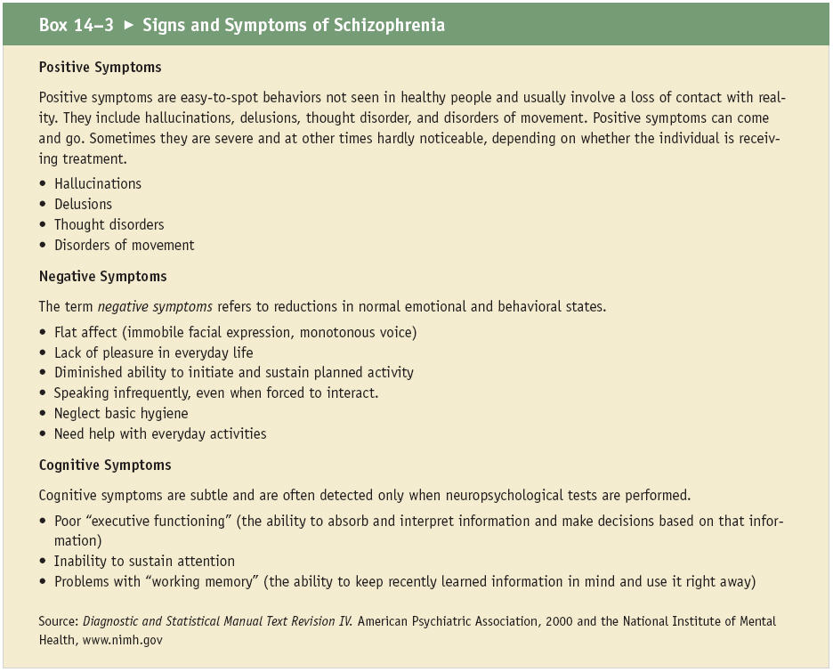
Box 14-3: Signs and Symptoms of Schizophrenia

Slide 70
Development of Schizophrenia
Genetics, neurobiology, family influences, social and environmental attributes, provide details about the development of schizophrenia
There may be a common event in a predisposed individual that is reported to have either triggered the development of, or worsening of, schizophrenia.

Slide 71
Development of Schizophrenia (cont.)
In other patients, a precipitating event is not reported, as psychological stresses may be difficult to describe as the individual retreats from a painful reality.

Slide 72
Brain Abnormalities of Schizophrenia
Abnormalities in the brains of individuals with schizophrenia, including faulty brain development, atypical brain anatomy, and alterations in chemical regulation of the neurotransmitter, dopamine, support the physiological basis of schizophrenia.

Slide 73
Brain Abnormalities of Schizophrenia (cont.)
Imaging studies point to anatomical differences in the prefrontal cortex, cingulate cortex, temporal cortex, and the lateral ventricles in the brain.
A decrease in dopamine neurotransmission identified in the nigrostriatal, mesolimbic, and mesocortical tracts of the brain strongly correlate to symptoms of schizophrenia.

Slide 74
Treatment of Schizophrenia
Schizophrenia has remained the most serious psychiatric illness known for the past 200 years.
Suicide rate among schizophrenics is 10%, and the average life expectancy is lower than the general population.
Comprehensive medical and psychosocial treatment has improved the quality of life of patients and their families.

Slide 75
Treatment of Schizophrenia
(cont.)
Medications that replace dopamine effectively normalize overt behavior and thought processes, and allow the patient to communicate coherently.
Psychosocial therapy, in combination with medication, helps patients establish a life that is free from symptoms, enriched by personal, social, and occupational achievements.

Slide 76
Mood Disorders
Mood disorders are characterized by marked periods of sadness and euphoria.
While it is normal for people to experience ups and downs during their lives, those who have major depression or bipolar illness experience debilitating symptoms that result in vocational failure, social withdrawal, and dysfunctional relationships.

Slide 77
Major Depression
Complaints of sadness, hopelessness, and despair vary widely in depressed individuals. Major depression occurs at any age and if untreated may result in suicide.

Slide 78
Major Depression (cont.)
Women are diagnosed with major depression about twice as often as men. Depression in the elderly is often masked by concurrent physical illness and is attributed to normal aging processes. School failures, irritability, loss of appetite, social withdrawal, and pretending to be sick are signs of depression in children.

Slide 79
Major Depression (cont.)
A major depressive disorder consists of at least one episode of serious mood depression, accompanied by a number of changes in behavior.
Complaints frequently include a loss of interest and pleasure and withdrawal from activities. Feelings of guilt, worthlessness, anxiety, and shame are reported as individuals with major depression view their illness as a moral deficiency.

Slide 80
Major Depression (cont.)
Physical symptoms that suggest emotional distress include unexplained weight loss or weight gain, disturbed sleep, decreased energy, poor eye contact, monosyllabic speech, and indifference to pleasure or joy.

Slide 81
Subcategories of Depression
Seasonal affective disorder
  Due to decreased sunlight exposure during the winter months
Postpartum depression
  occurs two weeks to six months following the birth of a child

Slide 82
Subcategories of Depression (cont.)
Dysthymia
  Symptoms of depression that persist for more than two years
Premenstrual dysmorphic disorder
  Cyclic depressive symptoms prior to menstruation may occur regularly for some women

Slide 83
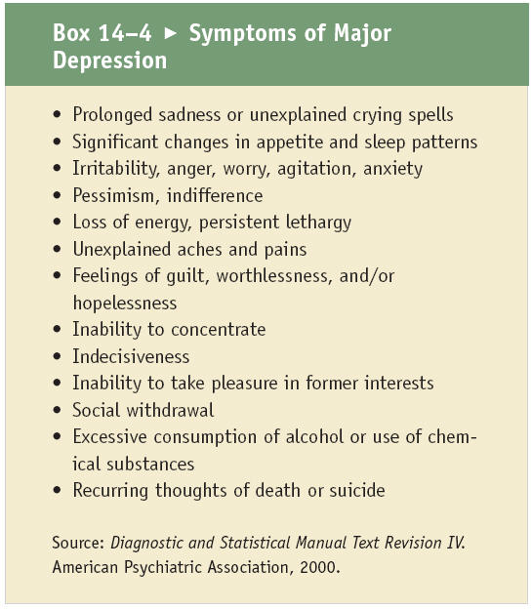
Box 14-4: Symptoms of Major Depression

Slide 84
Etiology of Depression
Heredity
  The risk for major depression is higher in families with a history of mood disorders. Depression in a parent contributes to depression in genetically vulnerable children, via modeling, emotional unavailability, and decreased capacity for care giving activities.
Stressful life events trigger sadness, despair, and grief, stressful factors alone do not cause major depression

Slide 85
Etiology of Depression (cont.)
Regulatory disturbances in neurotransmitters
  Serotonin, norepinephrine, and dopamine are widely distributed in the central nervous system and are implicated in regulation of mood, arousal, movement, and sleep. Medications that increase serotonin, norepinephrine, and dopamine, effectively reduce symptoms of depression.

Slide 86
Mood Disorders and Co-Morbidity
Physical disorders such as thyroid disease or Cushing’s disease induce depression by altering hormone levels.
Chronic heart disease or cancer produce depressive symptoms from associated disability, fatigue, and physical pain.

Slide 87
Mood Disorders and Co-Morbidity (cont.)
Direct physical causes of depression include infections with the human immunodeficiency virus, or seizure disorders that damage the brain and central nervous system.
Psychological disorders such as anxiety disorders, eating disorders, and developmental disorders are often referred to as co-morbid disorders as they commonly occur with major depression.

Slide 88
Mood Disorders and Medications
Various prescription medications and substance abuse induce depression by altering brain function and regulation of hormones and neurotransmitters.
Heart medications, for example, alter neuronal responses to norepinephrine leading to fatigue and depressive symptoms.

Slide 89
Mood Disorders and Medications (cont.)
Corticosteroid medications induce behavioral changes, psychosis, and major depression especially in susceptible individuals.
Alcoholic beverages as well as many commonly abused substances depress the central nervous system.

Slide 90
Treatment of Depression
A trial of antidepressant medication that restores regulation of norepinephrine, dopamine, and or serotonin is indicated for most cases of major depression.
Optimal reduction of symptoms is usually noticed 14 to 21 days after starting medication. Psychosocial treatment is often required to improve social functioning, to change depressive thought processes.

Slide 91
Bipolar Disorder
Bipolar disorder, or manic-depressive illness, is a mood disorder that causes unusual shifts from depression, to mania, an overly elevated, energetic, irritable mood.
Periods of highs and lows are called episodes of mania and depression.
Bipolar disorder affects more than 2 million American adults. Bipolar disorder typically develops in late adolescence or early adulthood.

Slide 92
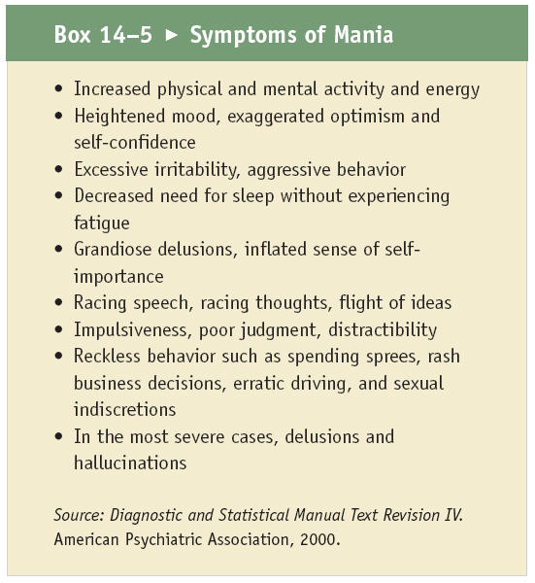
Box 14-5: Symptoms of Mania

Slide 93
Categories of Bipolar Disorder
Bipolar I disorder is associated with periods of intense mania and depression that lasts for several weeks.
Bipolar II illness is associated with less severe episodes of mania, however depression may continue for several weeks.

Slide 94
Categories of Bipolar Disorder (cont.)
A chronic fluctuating mood, with mild symptoms of both depression and mania, or cyclothymic disorder, often is undiagnosed and may eventually result in a more severe form of bipolar disorder.

Slide 95
Etiology of Bipolar Disorder
Genetic, biochemical, and environmental causes have been identified.
Several genes acting together may ultimately identify patients that develop bipolar illness.
Bipolar illness runs in families and stressful experiences may trigger some symptoms.

Slide 96
Etiology of Bipolar Disorder (cont.)
Changes in neurotransmitter regulation that lead to bipolar illness may be affected by the presence of another illness, stress, substance abuse, changes in diet and exercise, and hormonal changes.

Slide 97
Treatment of Bipolar Illness
Prolonged treatment with medications called mood stabilizers, antidepressants, sedative medications or “sleep aids,” and major tranquilizers or antipsychotic medications
Family and individual patient counseling improves social functioning by providing psychological support and treatment that stabilize extreme characteristics of mania or depression

Slide 98
Anxiety Disorders
Includes a number of disorders where the primary feature is abnormal or inappropriate anxiety that interferes with daily school, work, recreational, and family activities.

Slide 99
Anxiety Disorders (cont.)
Anxiety is a normal phenomenon where our mind and body reacts to flee from danger; also known as “fight or flight.”
  Heart rate, respiratory rate, blood pressure, and muscle tension increases at the onset of a stressful event. Symptoms of anxiety become a problem when they occur without any recognizable cause or when the cause does not require an intense response.

Slide 100
Types of Anxiety Disorders
Panic disorder
Generalized anxiety disorder
Phobic disorders
Social phobia
Notes:
Types of Anxiety Disorders

Slide 101
Types of Anxiety Disorders
(cont.)
Physical symptoms and behaviors vary slightly with each subtype of anxiety disorder. Panic disorder, generalized anxiety disorder, phobic disorders, social phobia, obsessive compulsive disorder, and post-traumatic stress disorder share the common theme of excessive, irrational fear.
Notes:
Types of Anxiety Disorders

Slide 102
Etiology of Anxiety Disorders
Affect adults and children and may persist for many years without proper treatment
Like many other mental illnesses, family and friends often label those that suffer anxiety disorders as weak and unable to “snap out of their condition.”
Some people’s lives become so restricted that they avoid normal, everyday activities such as grocery shopping or driving.
In some cases they become housebound.

Slide 103
Pathophysiology and Etiology of Anxiety Disorders
The amygdala is an almond shaped structure located deep within the brain, and may play a role in fear and phobias.
The hippocampus is a structure of the brain that processes and stores information to memory. The size of the hippocampus appears smaller in persons with post-traumatic stress disorder, which may explain the memory deficits and flashbacks in individuals with PTSD.

Slide 104
Pathophysiology and Etiology of Anxiety Disorders (cont.)
Anxiety disorders are common among relatives of affected individuals.
The risk for phobias is greater in relatives of individuals with both depression and panic disorder.

Slide 105
Pathophysiology and Etiology of Anxiety Disorders (cont.)
Head injuries, overactive thyroid gland, cardiovascular disease, respiratory disease, altered regulation of neurotransmitters, and certain medications may cause anxiety disorders.

Slide 106
Generalized Anxiety Disorder
Severe persistent worries that are out of proportion to the circumstances
Common worries related to work, money, health, and safety are difficult to control.
Additional complaints of restlessness, fatigue, muscle tension, impaired concentration, and disturbed sleep may often be misdiagnosed as depression.

Slide 107
Treatment of Anxiety Disorders
Treatment of Anxiety Disorders
Anxiety, as a learned response to a stimulus, and corresponding biochemical changes in brain chemistry, responds to treatment with medications and psychotherapy.
Medications that increase serotonin are effective in the treatment of obsessive-compulsive disorder, though psychotherapy is often required to gain understanding of underlying emotional conflict.

Slide 108
Treatment of Anxiety Disorders (cont.)
Antianxiety medications that increase the effect of the neurotransmitter gamma-aminobutyric acid (GABA) have a calming effect and work quickly. The use of antianxiety medications is limited however by their potential for addiction.

Slide 109
Panic Disorder
Sudden onset of fear and terror accompanied by physical symptoms in vital organs such as the heart and lungs
  Shortness of breath, chest pains, palpitations, peak within ten minutes and usually resolve within 30 to 60 minutes

Slide 110
Panic Disorder (cont.)
Because of the unpredictability of a panic attack, people who have them develop anticipatory anxiety or a persistent pattern of worry regarding when and where the attack will take place.
Physical complaints often lead patients to seek emergency medical care.

Slide 111
Phobic Disorders
An irrational fear of something that poses little or no danger
Examples: fear of the dark, strangers, or large animals
They begin in childhood and disappear with age.

Slide 112
Phobic Disorders (cont.)
Hyperventilation or rapid breathing may accompany a fear of heights, flying, closed spaces, insects, and rodents.
Although adults with phobias realize that these fears are irrational, they often find facing the feared object or situation brings on a panic or severe anxiety attack.

Slide 113
Social Phobia
Excessive worry and self-consciousness in everyday social situations.
Intense fears of being humiliated in social situations interfere with ordinary activities.
Physical symptoms that accompany social anxiety include blushing, profuse sweating, nausea, and difficulty talking.

Slide 114
Obsessive Compulsive Disorder
Anxious irrational thoughts and images also known as obsessions, lead to the need to perform rituals to prevent or get rid of the obsessive stimulus.
Rituals are patterns of irrational behaviors or compulsions that provide temporary relief from the anxiety.

Slide 115
Obsessive Compulsive Disorder (cont.)
Obsessions centered on cleanliness and fear of germs, for example, may lead to compulsive hand washing.
Patients with obsessive-compulsive disorder (OCD) are aware that their compulsion and corresponding ritual is irrational, but cannot stop it.
OCD affects both men and women, and symptoms may ease over time with appropriate treatment.

Slide 116
Post-traumatic Stress Disorder
Exposure to a traumatic incident, rape, violence, child abuse, or war, may lead to symptoms and diagnosis of post-traumatic stress disorder or PTSD.
Persistent frightening thoughts and memories months or years after the event

Slide 117
Post-traumatic Stress Disorder (cont.)
The traumatic event is repeatedly experienced as nightmares and flashbacks or numbing recollections of the event throughout the day.
May be a loss of interest in things they used to enjoy, avoid affection, and become more irritable or aggressive. People with PTSD often feel guilty about surviving the event or behaving destructively as in the case of veterans of war.

Slide 118
Sensitivity and Neurotransmission
Individuals with anxiety disorders are more sensitive to medications that increase heart rate, blood pressure, and fear behaviors.
Abnormal neurotransmission of the neurotransmitter serotonin as a cause of obsessive-compulsive disorder is recognized by a reduction of symptoms with medications that increase serotonin.

Slide 119
Eating Disorders
Eating disorders involve serious disturbances in eating behavior.
  Fashion trends, ad campaigns, social attitudes, and athletics promote a preoccupation with body shape and weight.
  Extreme attitudes surrounding weight and food, combined with psychological and medical complications, define the disabilities that meet the criteria for eating disorders.

Slide 120
Anorexia Nervosa
Anorexia means lack of appetite.
Anorexia nervosa is a preoccupation with dieting and limiting food intake to the point of starvation. There is an intense fear of gaining weight or becoming fat even though anorexic patients become dangerously thin.
The process of eating becomes an obsession with rituals centered on meal plans, calorie counts, compulsive exercise, and self-induced vomiting despite little food intake.

Slide 121
Signs and Symptoms of
Anorexia Nervosa
Typically, an adolescent female who has lost 15% of her body weight, fears obesity, stops menstruating
Low blood pressure, decreased heart rate, and edema or swelling of tissues
Metabolic changes including dehydration, and depletion of electrolytes (sodium, potassium, and chloride) can result in abnormal heart rhythm, heart failure, sudden cardiac arrest and death

Slide 122
Signs and Symptoms of
Anorexia Nervosa (cont.)
Often high academic and athletic achievers
Denial
Depression

Slide 123
Bulimia Nervosa
Preoccupation with body weight and physical shape
Binge by eating an excessive amount of food within a restricted period of time, followed by compensatory purging behavior such as self-induced vomiting or misuse of laxatives or diuretics. Rigorous dieting and exercise may also follow binges to prevent weight gain.

Slide 124
Bulimia Nervosa (cont.)
Loss of control during the binging episode followed by intense distress and guilt
Body weight may be normal which makes it easy for bulimics to hide their illness.

Slide 125
Medical Consequences of Bulimia Nervosa
Stomach acid and digestive enzymes from vomiting erode tooth enamel, and cause injury and inflammation to the esophagus and salivary glands.
Severe dental cavities and gum disease eventually requires removal of teeth.
Vomiting and laxative and diuretic abuse lower blood potassium levels causing muscle cramping, and abnormal heart rhythms.

Slide 126
Medical Consequences of Bulimia Nervosa (cont.)
Cardiac arrest may result from severe potassium loss.
Prolonged and excessive laxative abuse may severely damage the bowel. If the bowel ceases its function, surgery is required to form a colostomy.
Feelings of intense shame and guilt
Bulimics are generally outgoing, impulsive, and prone to depression, and alcohol or drug abuse.

Slide 127
Psychological and Interpersonal Issues—Etiology
Low self esteem and persistent feelings of inadequacy shape attitudes of perfection for the anorexic patient and severe self-criticism for the bulimic patient.
Troubled family relationships, difficulty expressing feelings and emotions, and a history of physical or sexual abuse are reported more often in bulimics than anorexics.

Slide 128
Psychological and Interpersonal Issues—Etiology (cont.)
Social attributes that value thinness, and limit beauty to specific body weight and shape, influences body image and contributes to extreme dieting and exercise for both anorexics and bulimics.

Slide 129
Biological Basis of Eating Behavior
Involves complex network of brain structures and neurotransmitters
The hypothalamus regulates hunger, monitors fullness of the stomach, and determines how much food to eat.
The limbic system influences emotions and selection of foods to appease the appetite.

Slide 130
Biological Basis of Eating Behavior (cont.)
The prefrontal region of the brain controls decisions about when, where, and how to eat.
Future studies on the biology of appetite control and behavior have the potential to lead to development of new medications to treat eating disorders.

Slide 131
Treatment of Eating Disorders
Acceptance - starvation, binging, and purging are destructive
Medical treatment - restoring nutrition and replacing fluids and electrolytes (sodium, potassium, chloride) is crucial to prevent death from organ failure

Slide 132
Treatment of Eating Disorders (cont.)
Medication to relieve depression and anxiety may improve mood and thought processes.
Group, family, individual, and nutritional counseling, provide support to break down delusions that shape eating behavior and distortions in body image.

Slide 133
Personality Disorders
Persistent, inflexible patterns of behavior that affect interpersonal relationships describe personality disorders.
Personality disorders appear in adolescence or early adulthood and remain stable throughout an individual’s lifetime. The DSM-IV describes three major categories of personality disorders based on “clusters” of symptoms.
Personality disorders occur along with medical and psychiatric illnesses.

Slide 134
Personality Disorders (cont.)
Relations with family, friends, and caregivers are often strained by inflexible and maladaptive personality characteristics.
People with severe personality disorders are more vulnerable to psychiatric breakdowns and are at risk for alcoholism, substance abuse, reckless sexual behavior, eating disorders, and violence.

Slide 135
Cluster A – Paranoid and Schizoid
Paranoid personality type
  Indifferent, suspicious, and hostile
  Relationships are shallow
  Tendency to interpret positive acts of kindness with distrust

Slide 136
Cluster A – Paranoid and Schizoid (cont.)
Schizoid personality type
  Appear cold and isolated
  Often called introverted, appear self-absorbed and withdrawn.
  Tendency to deal with fears through superstitions, magical thinking, and unusual beliefs.

Slide 137
Cluster B – Antisocial, Borderline, Histrionic, and Narcissistic
Antisocial personality
  Callous disregard for others
  Manipulation of people for personal gratification
  Antisocial personality may start as a conduct problem in childhood, where there is disrespect for authority, and personal and public property
  Adolescents and adults with antisocial personalities are at risk for alcoholism, drug abuse, sexual improprieties, and violence

Slide 138
Borderline Personality
Borderline personality disorders often occur in women that have been deprived of adequate care during childhood.
Unstable mood characterized by crisis and anger, alternating with depression.
Threats of real or imagined abandonment elicit impulsive behaviors such as promiscuity and substance abuse.

Slide 139
Borderline Personality (cont.)
The individual with a borderline personality disorder is vulnerable to brief psychotic episodes, substance abuse, and eating disorders.

Slide 140
Histrionic Personality
Theatrical and exaggerated emotions
Friendships are initially formed as others are attracted to their energetic and entertaining behavior.
Hysteria and flamboyant behaviors often result in negative responses and feelings of rejection.

Slide 141
Narcissistic Personality
Exaggerated self-image and a tendency to think little of others
Narcissists expect others to admire their grandiosity, and feel they are entitled to have their needs attended to.
When rejected by others through criticism or defeat, the narcissist becomes enraged or severely depressed.

Slide 142
Cluster C—Avoidant, Dependent, and Obsessive-Compulsive
Avoidant personality
  Appear shy and timid as if they have a social phobia
  They fear relationships although they have a strong desire to feel accepted.
  They are hypersensitive to criticism and rejection, are susceptible to depression, anxiety, and anger for failing to develop social relationships.

Slide 143
Dependent Personality
Dependent personality types have an extremely poor self-image.
They appoint others to make significant decisions out of fear of expressing themselves or offending others.
Extended illness may bring out a dependent personality in adults.

Slide 144
Obsessive-Compulsive Personality
The obsessive-compulsive personality is one who is dependable, meticulous, orderly, and intolerant of mistakes.
They are often high achievers attending to details while failing to complete the task at hand.
Individuals with an obsessive-compulsive personality avoid new situations and relationships, as they cannot be methodically controlled.

Slide 145
Treatment of Personality Disorders
Often secondary medical and psychiatric illnesses force persons with personality disorders to seek treatment.
Rigid thoughts and behavior often complicate compliance with treatment and is frustrating for the healthcare providers.
Individual, family, and group therapy
Medication is often helpful to relieve anxiety, depression, and psychosis.

Slide 146
Suicide
Irrational and impulsive self-directed acts of aggression.
Risks for suicide include substance abuse, previous suicide attempts, a family history of suicide, a history of sexual abuse, and impulsive or aggressive character.

Slide 147
Suicide (cont.)
More than four times as many men as women die by suicide; however, women attempt suicide more often during their lives than men.
Suicidal behavior occurs most often when people experience major losses, and stressful events such as divorce, loss of a job, incarceration, and chronic illness.

Slide 148
Warning Signs of Suicide
Unlike physical illnesses, mental illness has no visible wounds and as such is associated with social stigma, isolation, and personal faults.
May talk about their distress at the risk of being judged, ignored and isolated.
Warning signs of suicide include withdrawal, talk of death, giving away cherished possessions, and a sudden shift in mood.

Slide 149
Diagnostic Tests for Mental Illness
Medical history and physical exam, psychosocial history, mental health exam, and family history are essential for diagnosis of mental illness.
Multiple informants and obtaining a patient history from family and friends with major timelines of life events can help organize complex and detailed information.

Slide 150
Diagnostic Tests for Mental Illness (cont.)
Observation of the patient alone, or within a family milieu
Standardized written questionnaires and rating scales supplement the clinical evaluation by providing a systematic review and standard score of level of behaviors and emotions.

