Slide 1
Adaptations Jaguars
By: Joseph Torres

Slide 2
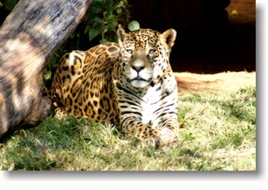
Diet
A jaguars diet is deer ,peccary , crocodiles , snakes , monkey , sloths , tapirs , turtles , eggs , frogs , fish and anything It catches.

Slide 3
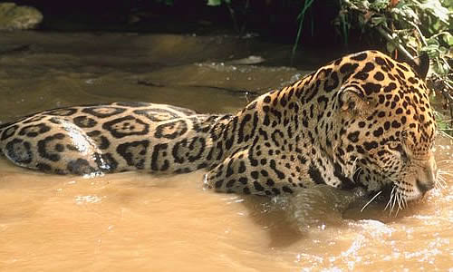
Jaguar Characteristics
The jaguar is a compact and a well-muscled animal . Rainforest jaguars are generally darker and considerably smaller than those found in open areas , due to the fewer large herbivorous prey in the area.

Slide 4
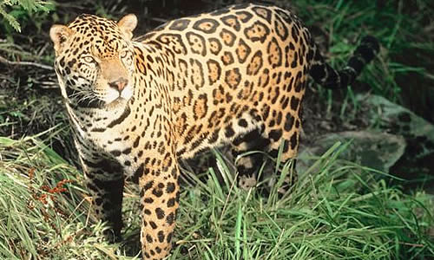
Range & Habitats
Jaguars lived from Argentina South America to the Grand Canyon in Arizona . Its habitat is deciduous forest ,rainforest , swamps , pampas ,grasslands and mountain scrub areas.

Slide 5
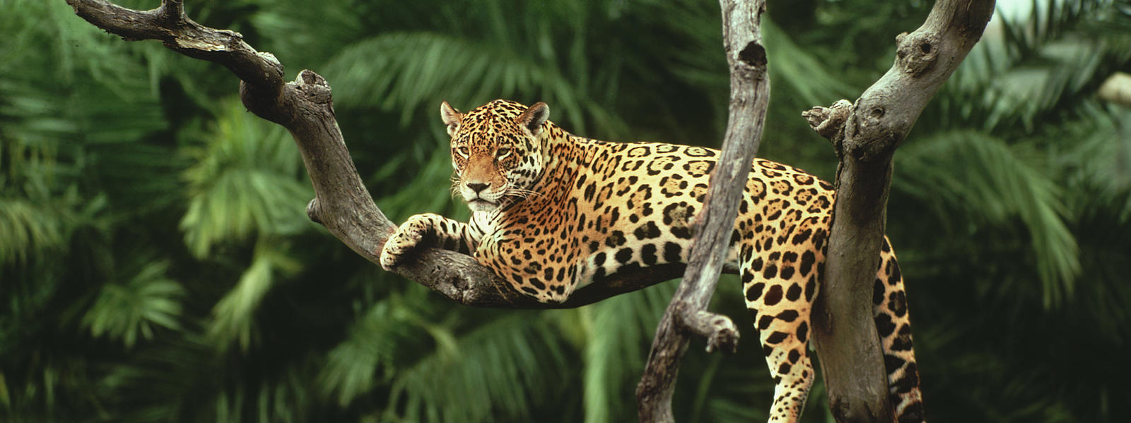
Species
There are a lot of species of jaguars . Jaguars can be spotted all over there body.

Slide 6
Thank You For Watching

