Slide 1
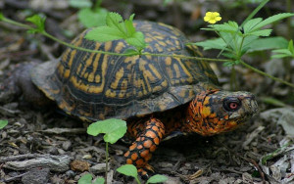
Box Turtle adaptations!
By: Brailey Shipp

Slide 2
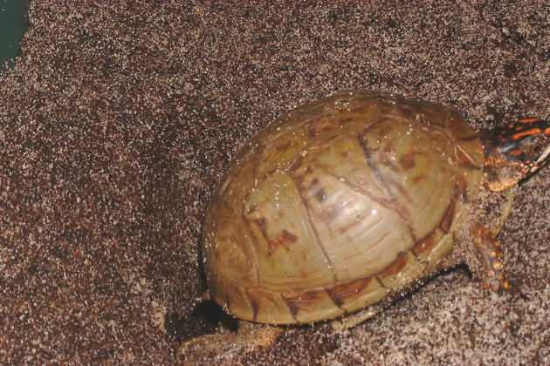
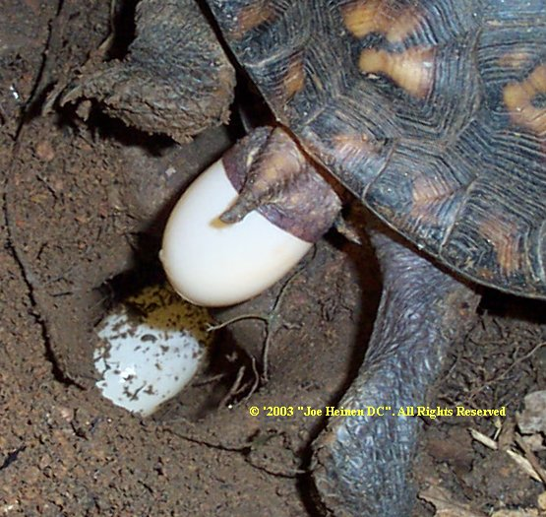
Turtle Shell
The Box Turtle is Just as Normal as any other Turtle The only thing different from some turtles is its shell.

Slide 3
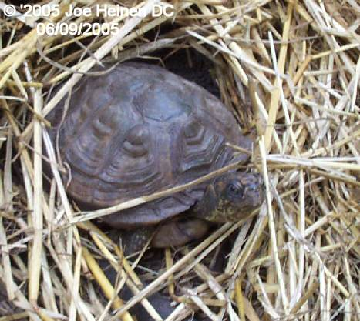
Habitat
They occupy around Maine to the east coast of Florida and since they are popular as household pets they can be found way out of where they were born.

Slide 4
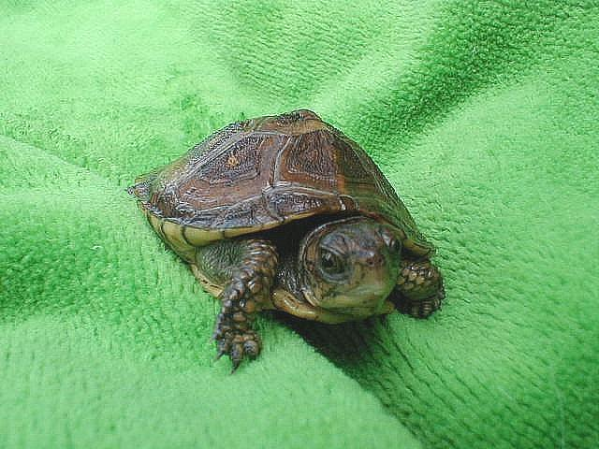
Hunting for prey
Turtles usually live on the beach if they do then they get their food off the beach and some times they hide the sand from predators and they watch for prey as they are hiding then they catch their prey and they start eating on it and since some turtles are small then the small turtles can catch prey and it can last them up to 3 days maybe even a week if there babies but some turtles can be huge and can eat up to 15 times a day but that’s very rare.

Slide 5
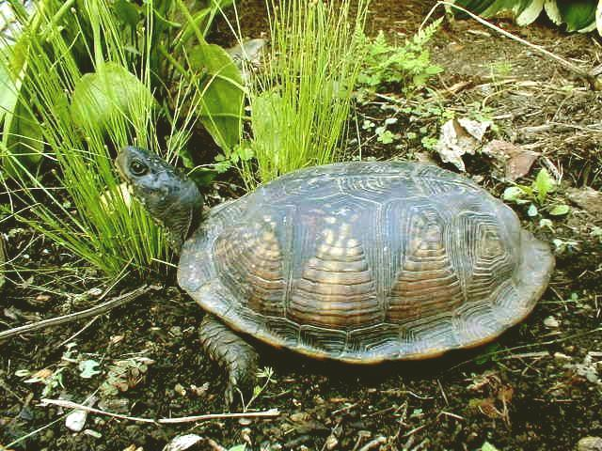
predators
When a box turtle gets ate its called getting hunted by its predator and sometimes turtles can make it but most of the time they get ate by their predators.

Slide 6
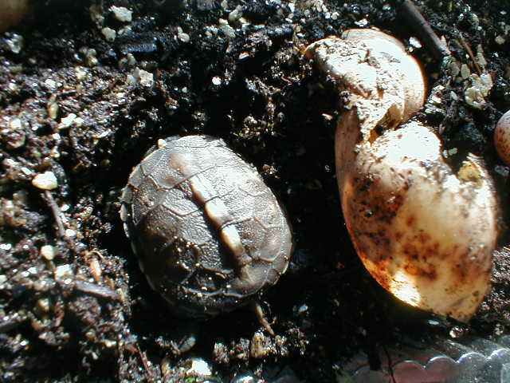
Box turtle
The box turtle has a shell shaped as a box that’s where it gets its name but most of the time its rare to find a box turtle just laying out somewhere or just in a swamp.

