Slide 1
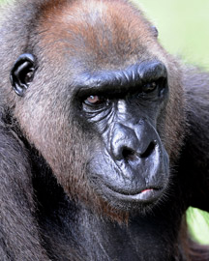
Adaptations of a Western Lowland Gorilla
By Billy Adams

Slide 2
Teeth!
Gorillas have very strong teeth to eat the plants that are hard and crunchy.
Western Lowland Gorilla has 32 teeth just like a modern day human!
Adult male gorillas grow strong canines!

Slide 3
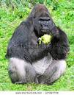

Diet?
A lot of animals like to eat meat so they are carnivores but Western Lowland Gorillas only eat vegetables like celery and carrots and apples

Slide 4
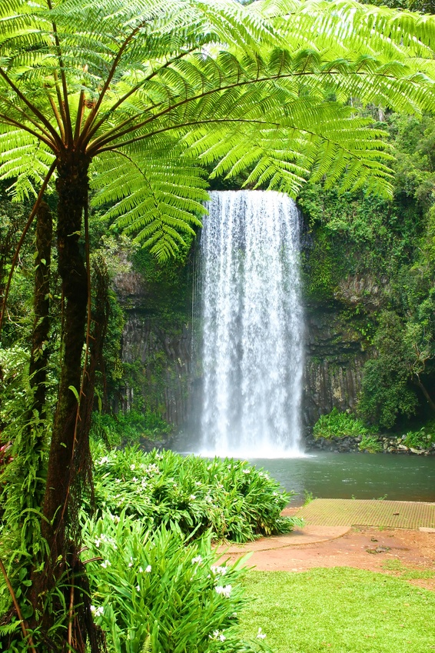

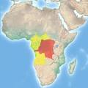
Habitat
The Western Lowland Gorilla lives in the African Tropics Secondary Forests. They enjoy it there because of the low and shady floor they live and sleep on.

Slide 5
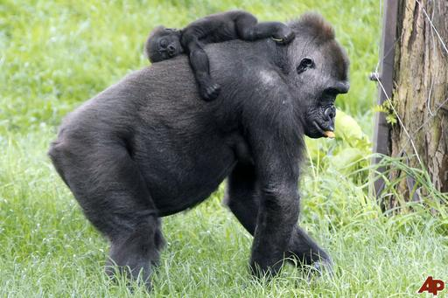
Lifespan
Normal wild Western Lowland Gorillas live to 35-40 years. But most gorillas that are held in captivity live to 35-50 because of the help they get or can get from zoo keepers.
ZzZzZzZ… Baby gorilla
→
Humph I'm a elder mother gorilla
←

Slide 6

Human Like Adaptations
Gorillas will use hand langue at least the ones that are taught will So they can communicate with there owners.
Like I said earlier they have the same amount of teeth as humans.

Slide 7
Fast Facts
Gorillas are almost extinct so we need to take better care of them and stop killing them.
Gorillas are usually huge! Like 6 feet tall.

Slide 8
FIN

