Slide 1
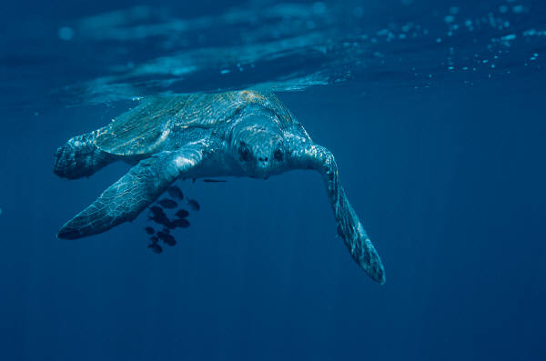
Life Cycle of Sea Turtle
By : Lilyana Hernandez

Slide 2
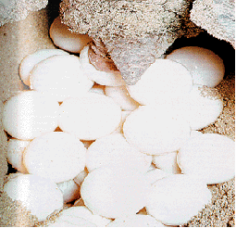
Eggs

Slide 3
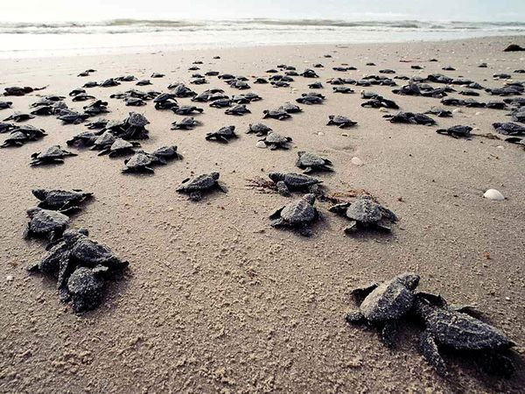
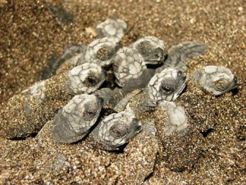
Hatchlings
Hatchlings are turtles that are just born.

Slide 4
Immature and turtle adult

Slide 5
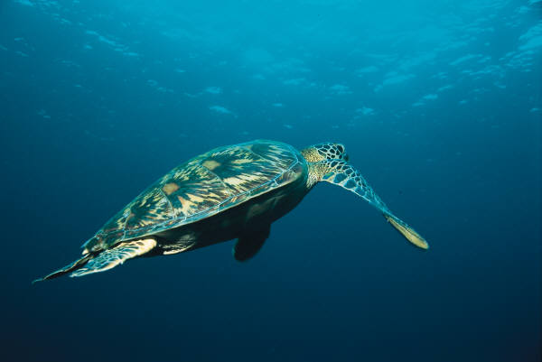
Migrate to breading areas

Slide 6
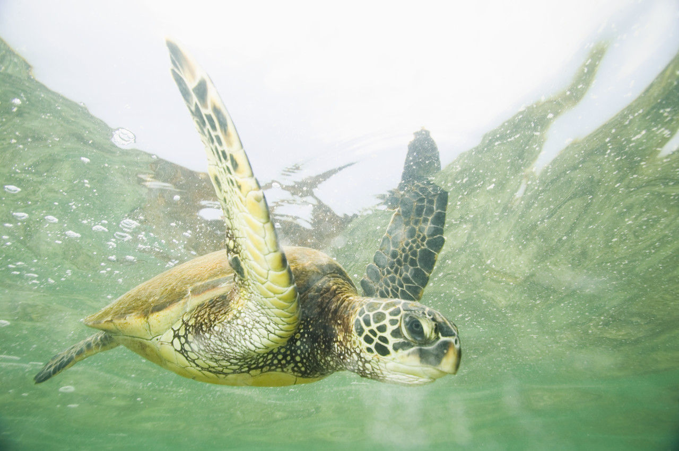
Full adult

