Slide 1
Abiotic Cycles
There are 6 major Abiotic cycles
Hydrologic (Water) Cycle
Carbon Cycle
Nitrogen Cycle
Phosphorus Cycle
Sulfur Cycle
Rock Cycle

Slide 2
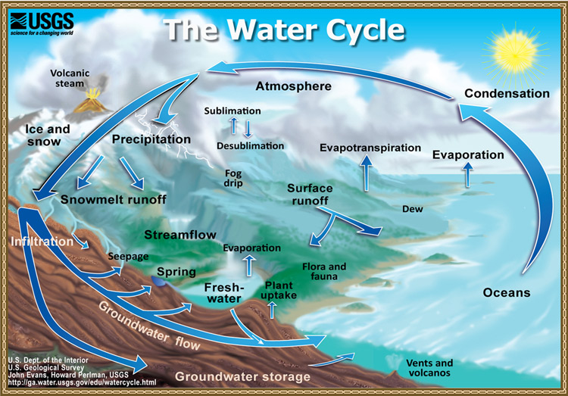
Hydrologic Cycle

Slide 3
Hydrologic Cycle
Condensation – gaseous water molecules turning into liquid water molecules
Precipitation – water in the form of rain, sleet, hail, and snow that falls from the atmosphere onto land and bodies of water
Infiltration/Percolation – downward movement of water through soil/passage of a liquid through the spaces of a porous material such as soil.
Transpiration – process in which water is absorbed by the root systems of plants, moves up through the plants, passes through pores (stomata) in their leaves or other parts, and evaporates into the atmosphere as water vapor
Evaporation – Conversion of a liquid into a gas

Slide 4
Hydrologic Cycle
5 things humans do to interfere with the hydrologic cycle.
Global Warming
Aquifer depletion from over pumping
Point source pollution
Increased flooding from wetland destruction
Reduced recharge of aquifers and flooding from covering land with crops and buildings

Slide 5
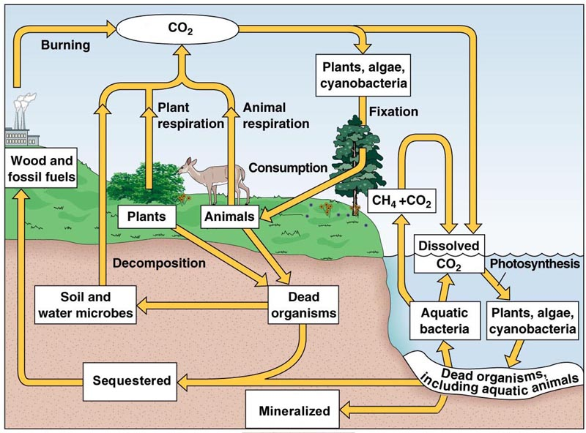
Carbon Cycle

Slide 6
Carbon Cycle
The Carbon Cycle depends on photosynthesis and aerobic respiration by the earth’s living organisms.
Carbon Dioxide (CO₂) in the atmosphere is the major carbon contributing compound for the carbon cycle
Management of the Carbon Cycle is the focus of Global Warming.

Slide 7
Carbon Cycle
CO₂ enters ecosystems via photosynthesis.
Respiration, deforestation, burning of fossil fuels, and forest fires are processes that put CO₂ up in the atmosphere.
Diffusion of CO₂ into aquatic systems from the atmosphere, allow carbon to get into the aquatic food webs. Here decomposition puts carbon into sediments.
Compaction over time turns carbon in sediments into fossil fuels such as coal.

Slide 8
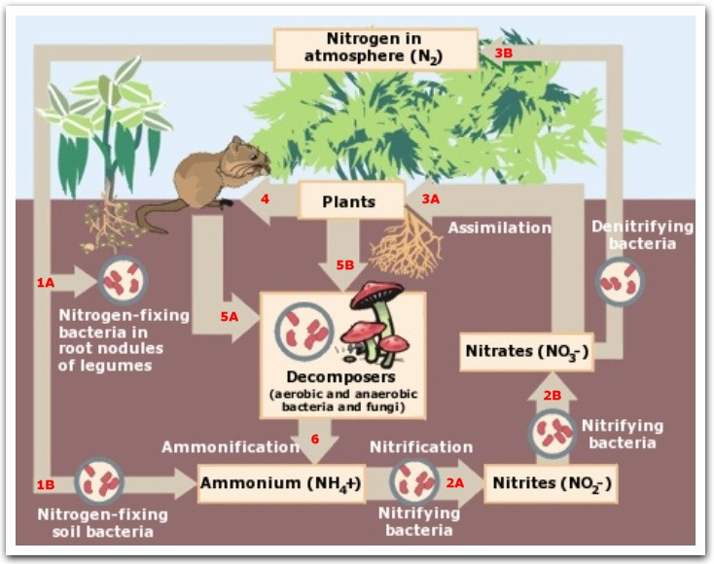
Nitrogen Cycle

Slide 9
Nitrogen Cycle
The major reservoir for nitrogen is the atmosphere. The chemically unreactive nitrogen gas (N₂) makes up 78% of the volume of the atmosphere.
Lightning and certain special bacteria in the roots of plants can fix nitrogen from the atmosphere.
Ammonia (NH₃), Ammonium (NH₄⁺), Nitrite (NO₂⁻), Nitrate (NO₃⁺) are the major sources of nitrogen in the soil and aquatic systems.
Burning fossil fuels, the use of fertilizers, the action of anaerobic bacteria on livestock wastes, and the destruction of forest, wetlands, and grasslands are ways humans interfere with the Nitrogen Cycle.
Natural processes like volcanic activity can also put Nitrogen Oxides in the atmosphere.

Slide 10
Nitrogen Cycle
Nitrogen Fixation – combining N₂ gas with H to make NH₃ which some is converted into NH₄⁺
Ammonification – conversion of detritus into simpler N containing inorganic compounds NH₃ and NH₄⁺
Nitrification – a two step process where special bacteria convert NH₃ and NH₄⁺ into NO₂⁻ and NO₃⁻ for use by plants.
Denitrification – conversion of NH₄⁺ and NH₃ back into NO₂⁻ and NO₃⁻ and then into N₂ and N₂O which releases to the atmosphere

Slide 11
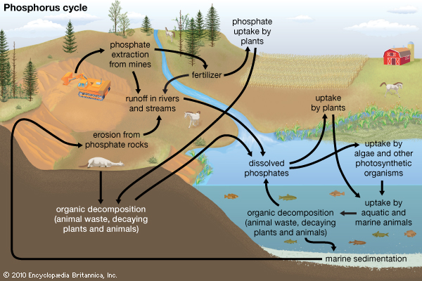
Phosphorus Cycle

Slide 12
Phosphorus Cycle
The major reservoir for phosphorus is phosphate salts containing phosphate ions (PO₄³⁻), in terrestrial rock formations and ocean bottom sediments.
Phosphorus Cycle is slow compared to the water, carbon, and nitrogen cycles.
Phosphorus is transferred by food webs. It is a component of nucleic acids, ADP, ATP, bones and teeth.
Phosphorus is often the limiting factor for plant growth, unless it is applied as fertilizer. It is also the limiting growth factor for producer populations in freshwater streams and lakes because it is only slightly soluble in water.

Slide 13
Phosphorus Cycle
Humans interfere with Phosphorus Cycle by extensive mining of phosphate salts, heavy use of fertilizer, and poor management of sewage.
Erosion and Runoff are the major transportation means of phosphates into aquatic systems.

Slide 14
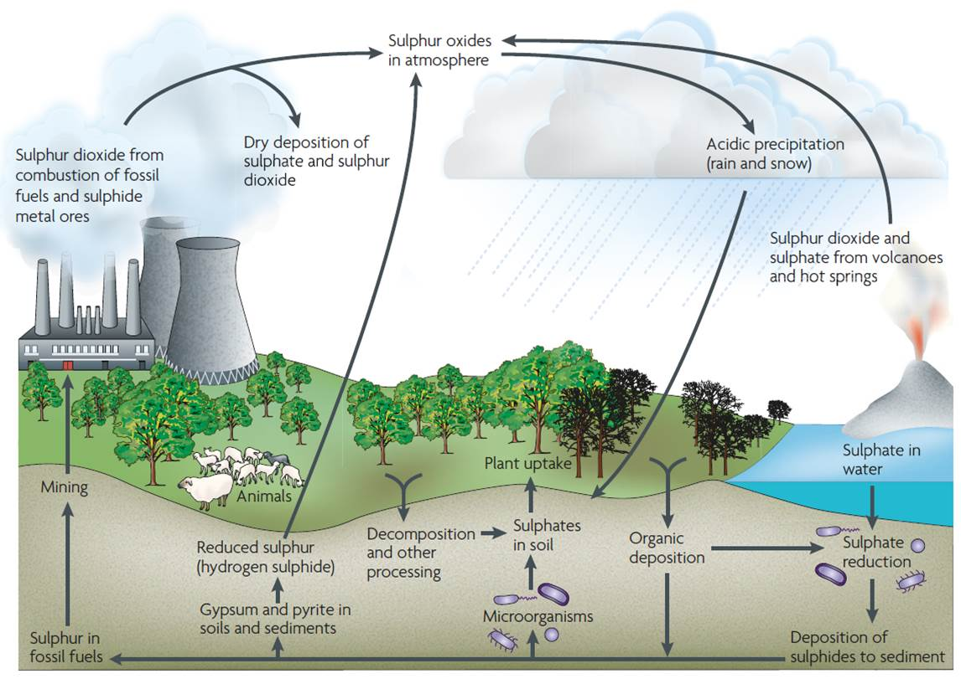
Sulfur Cycle

Slide 15
Sulfur Cycle
Most of the sulfur on earth is stored in rocks and minerals including sulfate salts (SO₄²⁻) buried deep under ocean sediments.
Sulfur also enters the atmosphere by anaerobic decomposers producing hydrogen sulfide (H₂S), and volcanic activities releasing sulfur dioxide (SO₂)
Sulfur particles such as ammonium sulfate enter the atmosphere from sea spray, dust storms, and forest fires
Sulfate ions are an essential component of many proteins
Humans interfere with the sulfur cycle by burning and refining fossil fuels, burning coal, and smelting metals which release Sulfur Dioxide into the atmosphere.

Slide 16
Sulfur Cycle
(DMS) Dimethyl sulfide (CH₃SCH₃) – tiny particles of this compound serve as condensation nuclei for water droplets to form clouds.
DMS is also converted into sulfur dioxide in which some turns into sulfur trioxide, in which tiny droplets of sulfuric acid can form.
DMS can react with atmospheric chemicals such as ammonia to produce tiny particles of sulfate salts.
These droplets and particles then fall to the earth as acid rain, or acid deposition.
In oxygen-deficient environments specialized bacteria convert sulfate ions (SO₄²⁻) sulfide ions (S²⁻). These sulfide ions react with metal ions to form insoluble metallic sulfides which become deposited as rock allowing the cycle to continue.

Slide 17
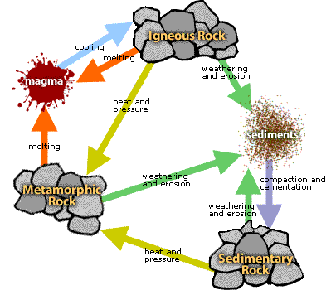
Rock Cycle

Slide 18
Rock Cycle
The slowest of earth’s cyclic processes
The earth’s crust consists of mostly minerals and rocks.
Most of the more than 2000 identified minerals occur as inorganic compounds formed by various combinations of elements.
Mineral – an element or inorganic compound that occurs naturally in the earth’s crust as a solid with a regular internal crystalline structure.
Rock – a solid combination of one or more minerals found in the earth’s crust.

Slide 19
Rock Cycle
Three major types of Rock
Sedimentary Rock – made of sediments, dead plant and animal remains and existing rock that are weathered or eroded into tiny particles.
(EX. Sandstone, Shale, Dolomite, Limestone, Lignite, Bituminous Coal)
Igneous Rock – made of liquid magma that wells up from the upper mantle or deep crust, then cools and hardens. Form the bulk of the earth’s crust.
(EX. Granite and Lava Rock)
Metamorphic Rock – when preexisting rock is subjected to high pressure and temperatures, chemically active fluids, or a combination of all three. These forces change the physical properties, appearance, and reshape the crystalline structure.
(EX. Anthracite, Slate, Marble)

Slide 20
VIDEOS
Role of Abiotic Factors
Carbon Cycle
Nitrogen Cycle
Phosphorus Cycle
Sulfur Cycle

