Slide 1
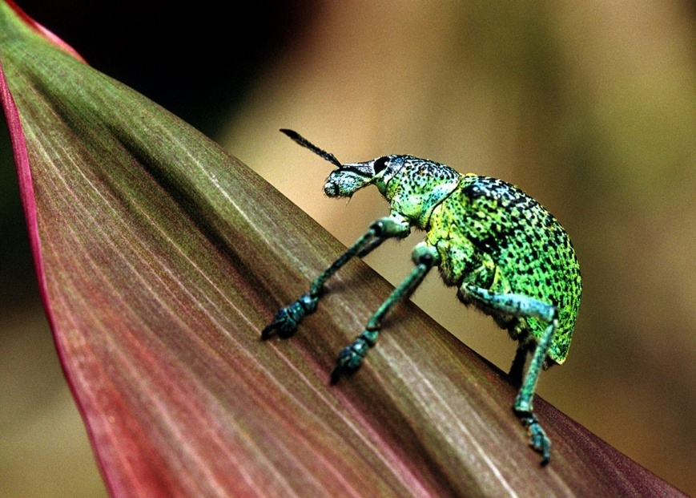
Symbiotic Relationships

Slide 2
What is symbiosis?
Literal definition:
the act of living together
What it means:
Two organisms that live together
Temporarily or for a longer time
At least one of the organisms
benefits from the relationship

Slide 3
What are the different kinds of symbiosis?
Mutualism
Commensalism
Parasitism
both organisms benefit
one organism benefits
one organism benefits
one organism is unaffected
one organism is harmed

Slide 4

Mutualism
Both species benefit from the relationship.
Ex. Flowers: Flowers provide the insects with food in the form of nectar, pollen, or other substances and the insects help the flowers reproduce by spreading the pollen.

Slide 5
Commensalism
One species benefits, the other is neither harmed or helped.
Barnacles attach themselves to a whale’s skin. They don’t harm the whale, but they benefit from the constant movement of water past the swimming whale, because the water carries food particles to them

Slide 6
Parasitism
One organism lives on or inside another and harms it. Parasites obtain all or part of is nutritional needs from the other organism, called the host.
Ex: Tapeworms live in the intestines of mammals
Ex: Fleas, ticks, lice live on bodies of mammals, feeding on the blood and skin of the host.

Slide 7
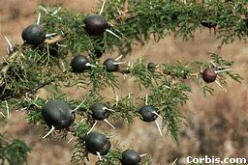
Acacia plant with ant galls
Ants lay eggs on acacia tree
Acacia covers the infected area with brown flesh (gall)
Parasitism: one benefits, one is harmed

Slide 8
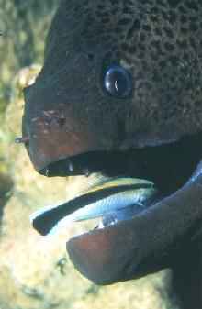
Mutualism: both benefit
Moray Eel with Cleaner Fish
Moray Eel gets a clean mouth Cleaner Fish gets a meal

Slide 9
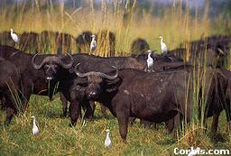
Cattle with cattle egrets
Cattle stir up insects as they eat grass
Egrets hang around and eat insects
Commensalism: one benefits, one is unaffected

Slide 10

Clown fish with anemone
Clown fish gets protection Anemone is unaffected
Commensalism: one benefits, one is unaffected

Slide 11
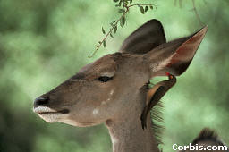
Mutualism: both benefit
Antelope with Oxbird
Antelope gets rid of parasites Oxbird gets a meal

Slide 12
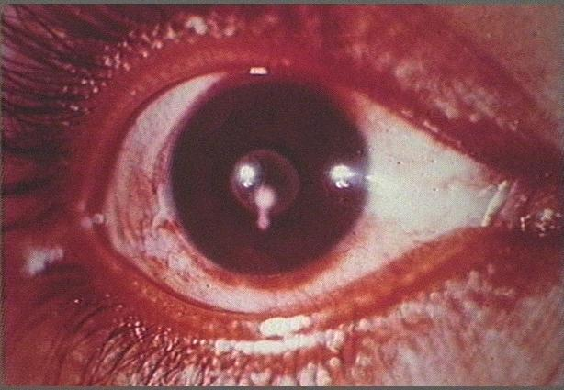
Taenia worm in human eye
Worm infects human blood stream
Human may go blind
Parasitism: one benefits, one is harmed

